Slide 1
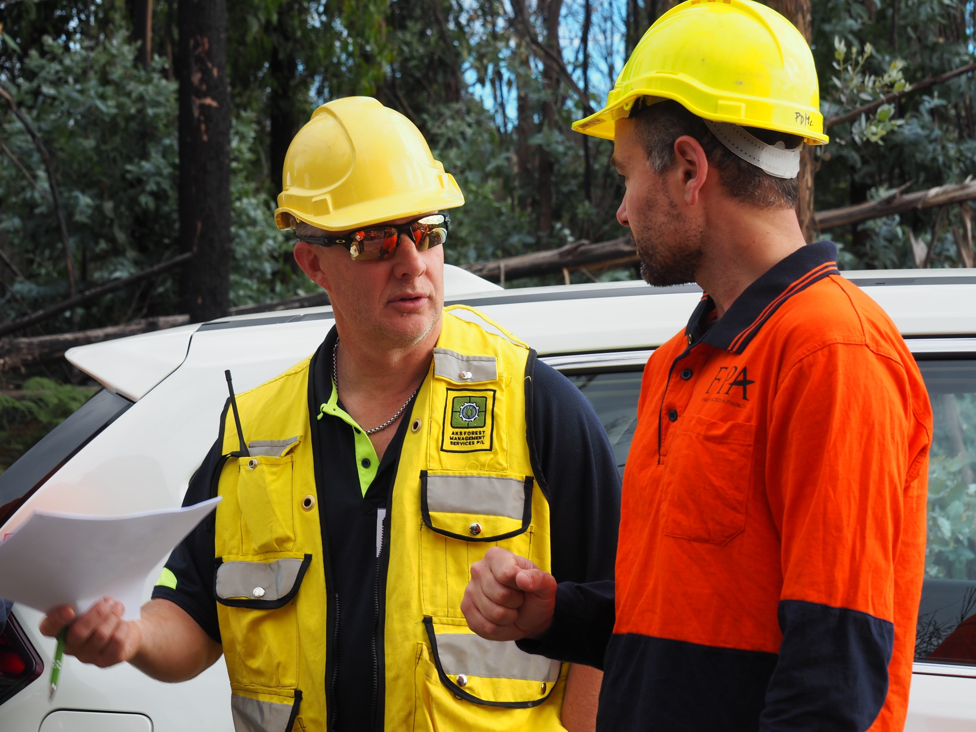
Stakeholder engagement
Communication for Contractors

Slide 2
Background
This presentation was developed by ForestWorks under the Training and Skills Development Services (TSDS). The TSDS is funded by the Australian and Tasmanian Governments to support the rebuilding and reskilling of the Tasmanian forest and timber industry.
Copyright statement
© 2021 ForestWorks Ltd
You are free to reuse this work under a Creative Commons Attribution 4.0 International Licence provided any extracts are fully acknowledged, you indicate if changes were made and you comply with the other licence terms. The licence does not apply to any third-party material, images, branding or logos.
Further information
Enquiries about this publication should be directed to:
ForestWorks Ltd
PO Box 612
North Melbourne Victoria 3051
Telephone: 03 9321 3500
Email: forestworks@forestworks.com.au
Website: www.forestworks.com.au
First Published: 2021
Version: 1.2, December 2021
Why has this Facilitator Presentation been developed?
This presentation supports the unit of competency FWPHARXXX Communicate effectively with public members or stakeholders concerned about industry practices. It is part of a set of materials that has been developed to support forest workers who are required to communicate with external stakeholders in Tasmania’s forest industry.
The complete set of materials includes the following:
Communication for Contractors – Learner Guide
Communication for Contractors – Learner Questionnaire
Communication for Contractors – Facilitator Guide
Communication for Contractors – Facilitator Presentation
Communication for Contractors – Assessor Guide
Communication for Contractors – Mapping Document.
While the materials focus on harvesting and clearing, the same principles apply to roading and site preparation.
Notes:
This PowerPoint presentation has been developed for use with the following contextualised learning and assessment materials:
Communication for Contractors – Facilitator Guide
Communication for Contractors – Learner Guide

Slide 3
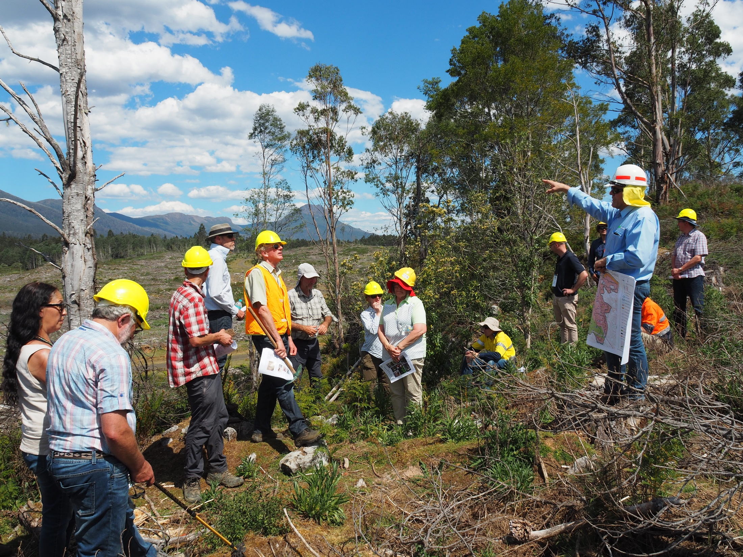
Public relations
what you need to know
Notes:
This topic is aligned to the knowledge evidence component of the unit FWPHARXXX Communicate effectively with public members or stakeholders concerned about industry practices.
It covers the key elements of public relations that a forest worker needs to understand in order to communicate with external stakeholders in Tasmania’s forest industry.

Slide 4
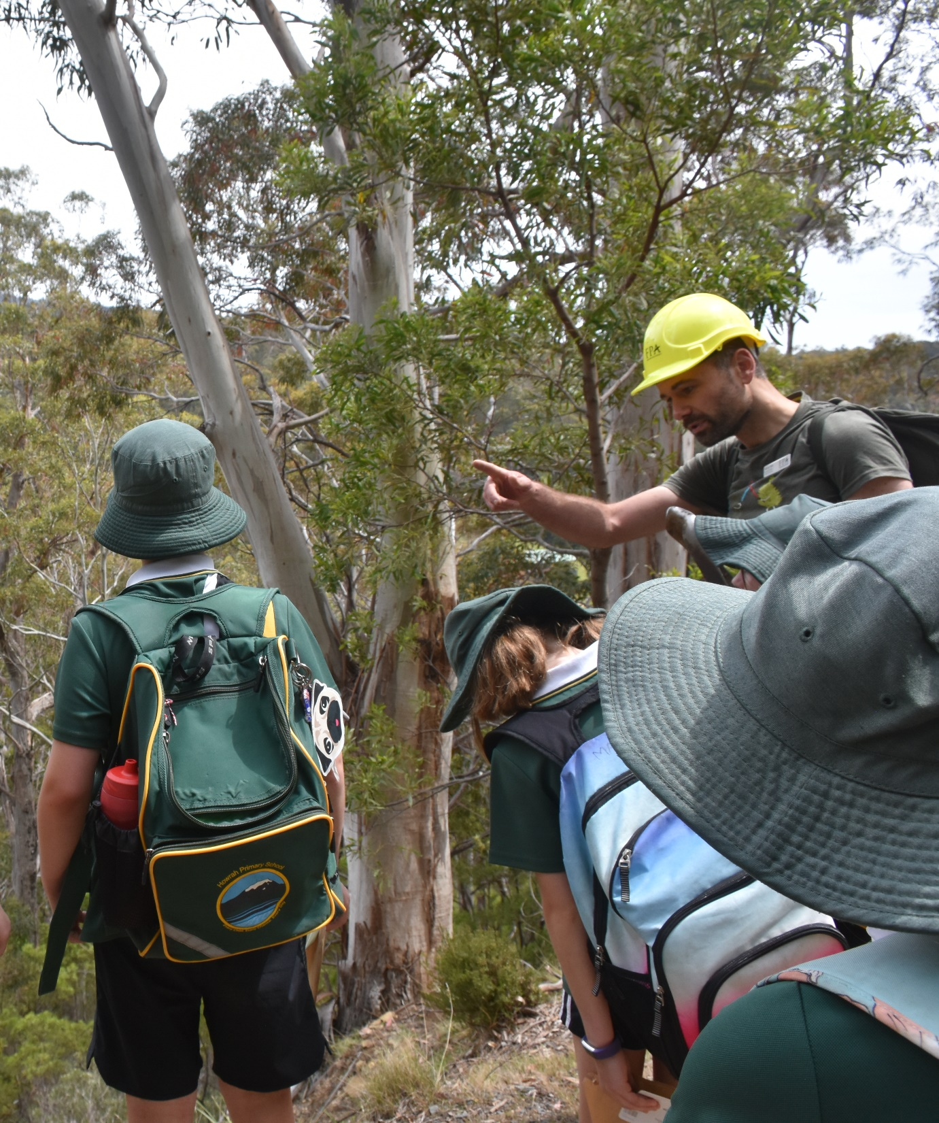
Engaging with people
Forest workers are not required to engage with the public very often.
However, there will be times when you have to engage with others, and these interactions should be:
open
positive
respectful
Notes:
Engaging with the public
The will be times when forest workers have to communicate with people who are not involved in the forest industry, and these conversations should always be open, positive and respectful (as far as is reasonably practicable).

Slide 5
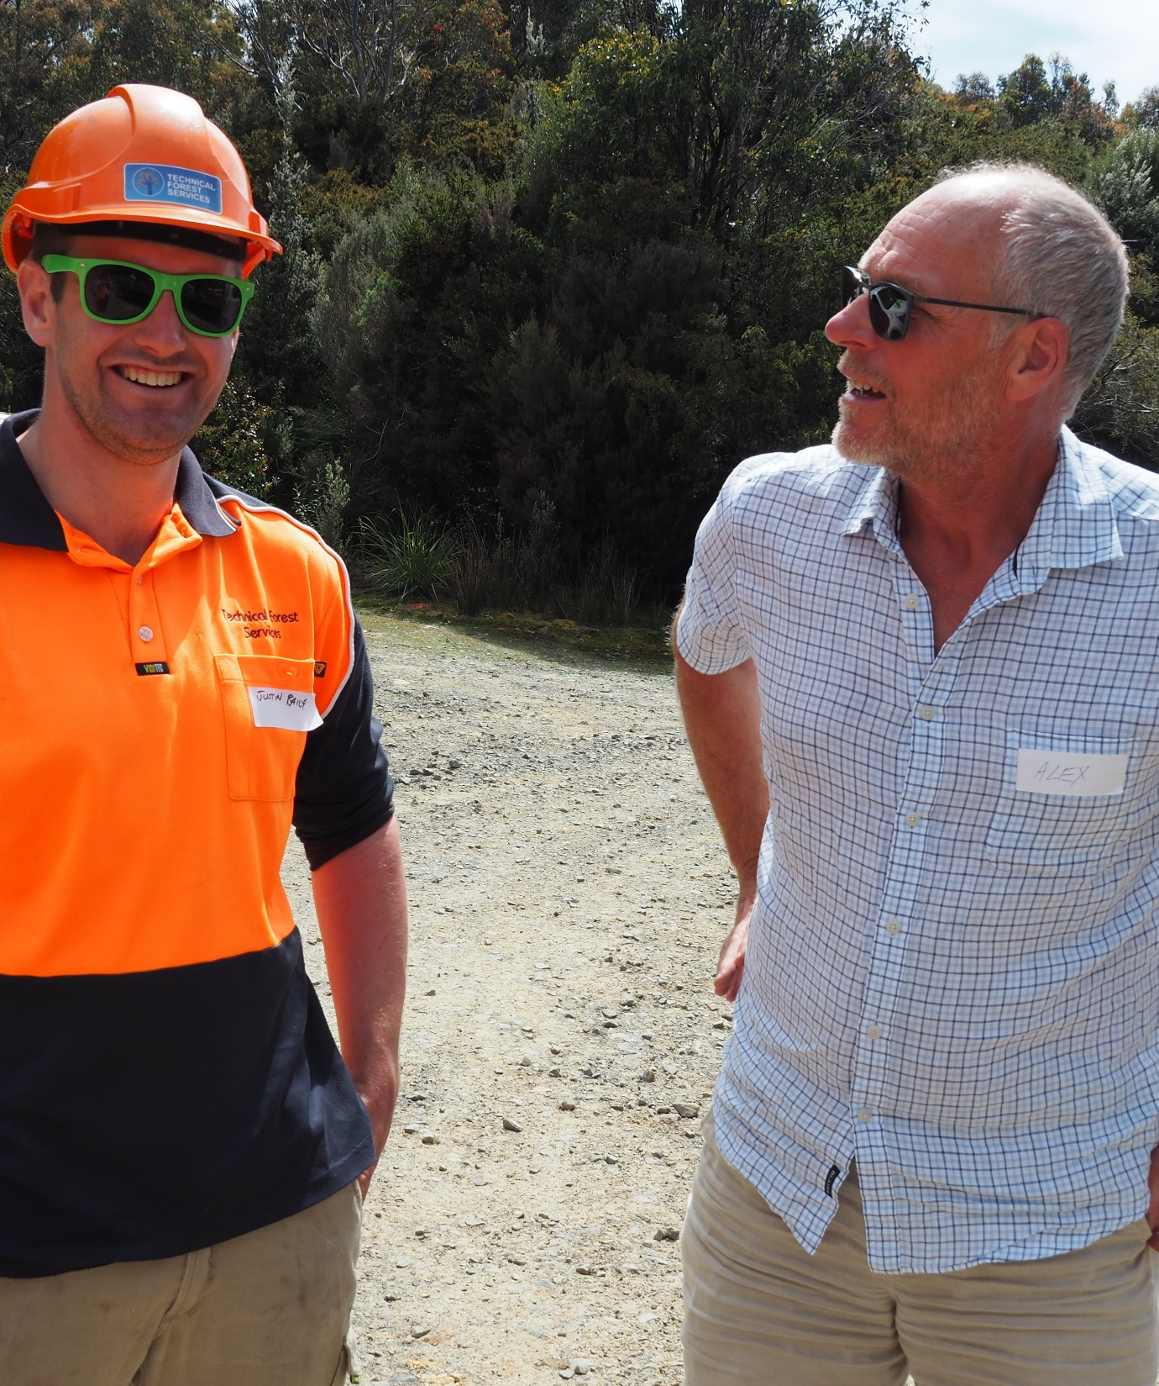
Engaging with people
…at forest worksites
…in your community
…online
Notes:
Engaging with people in the forest
There may be times when forest workers have to respond to people who unexpectedly arrive on-site.
Engaging with your community
There may be times when forest workers have to respond to people in your community.
Engaging with people online
There may be times when forest workers have to respond to someone online.
By the end of this training session, forest workers should know how to:
engage with people in an open, positive and respectful manner
stay within their area of responsibility when participating in forestry-related exchanges.

Slide 6
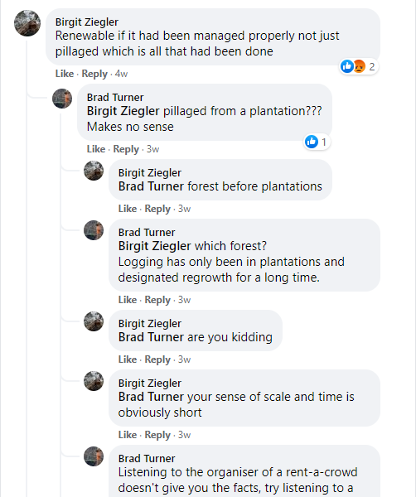
Engaging with people
Online (social media)
An exchange between a member of the public and a forest worker
Discussing Tasmanian timber as ‘the ultimate renewable’
Starts well, but doesn’t end well
Notes:
Engaging with people online
The extract on the right is from the Facebook page of the Tasmanian Forest Products Association. It’s an exchange between a member of the public and a forest worker. They are debating the portrayal of Tasmanian timber as ‘the ultimate renewable’. The exchange starts reasonably well, but it doesn’t end well. Rather than staying on the topic, both parties start making negative responses.
Activity
Use this as an early example of how NOT to engage with members of the public. If you have additional examples, use them here.

Slide 7
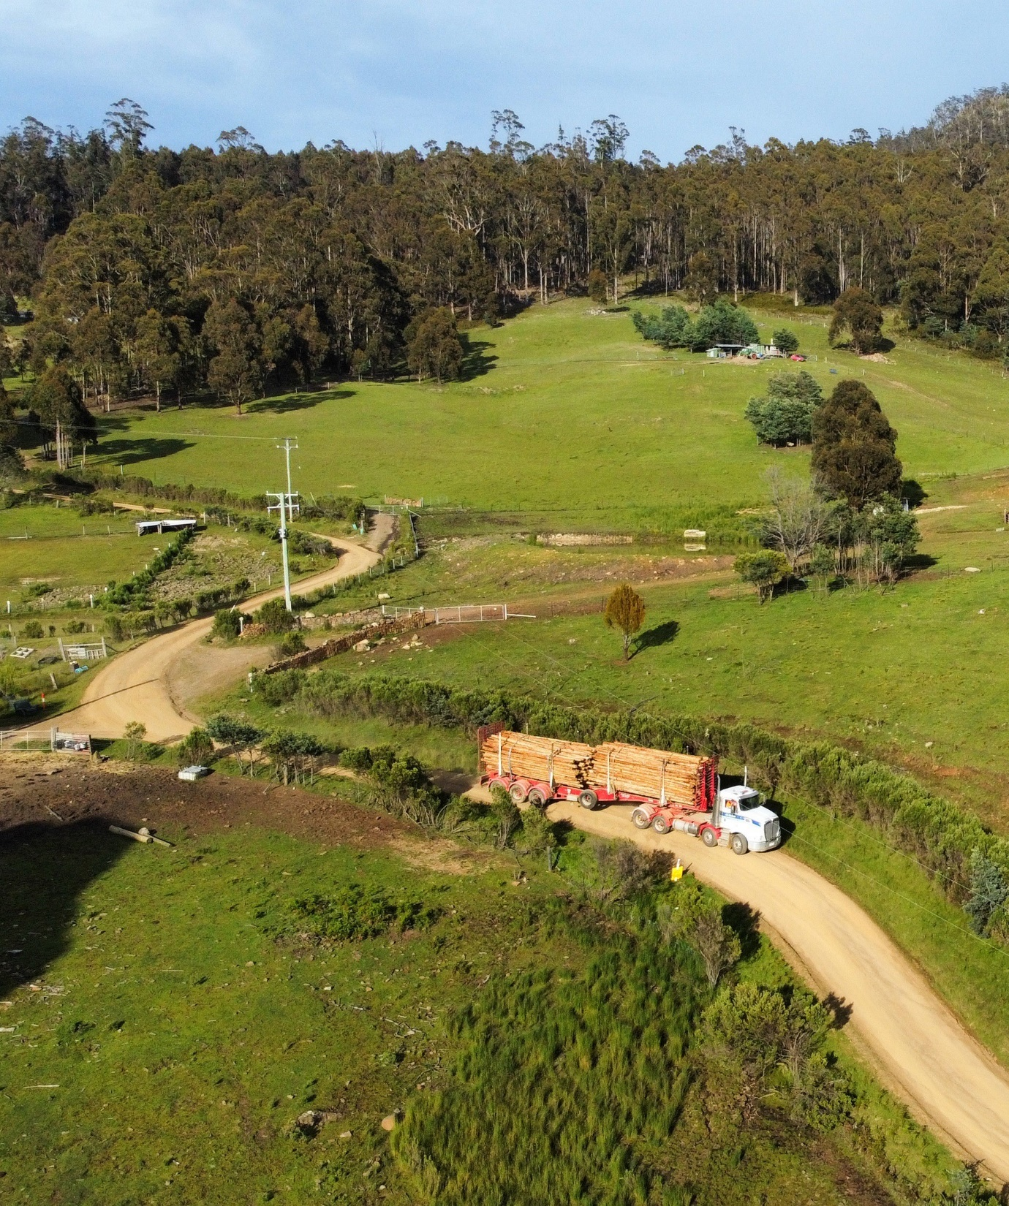
External stakeholders
Stakeholders in the forest industry are divided into two groups:
Affected stakeholders
Interested stakeholders

Slide 8
External stakeholders
Affected stakeholders
Landowners, neighbours and residents
Local businesses
Local communities
Local councils
Forest contractors / workers
Forest managers
Notes:
Stakeholders in the forest industry
These are groups and individuals who live or work near a forest operation and are directly impacted by issues such as road closures, increased traffic, noise, dust, smoke haze, spray drift, water quality, weed infestation, fence damage and game control measures.
Affected stakeholders include:
landowners, neighbours and residents
local businesses (including tourism operators)
local communities
local councils
beekeepers
farmers
forest contractors
forest managers
forest workers

Slide 9
External stakeholders
Interested stakeholders
Community organisations
ENGOs
Government organisations
Industry associations
Recreational organisations
Regional Aboriginal communities
Utility organisations
Notes:
Stakeholders in the forest industry
These are groups and individuals who have interests in a defined forest area but are not directly impacted by forest operations in the area.
Interested stakeholders include:
community organisations
customers
environmental non-government organisations
government organisations
industry associations
investors
recreational organisations
regional Aboriginal communities
scientific organisations
suppliers
tourists
utility organisations
NB: An interested stakeholder can become an affected stakeholder at any stage (depending on the site-specific circumstances).

Slide 10
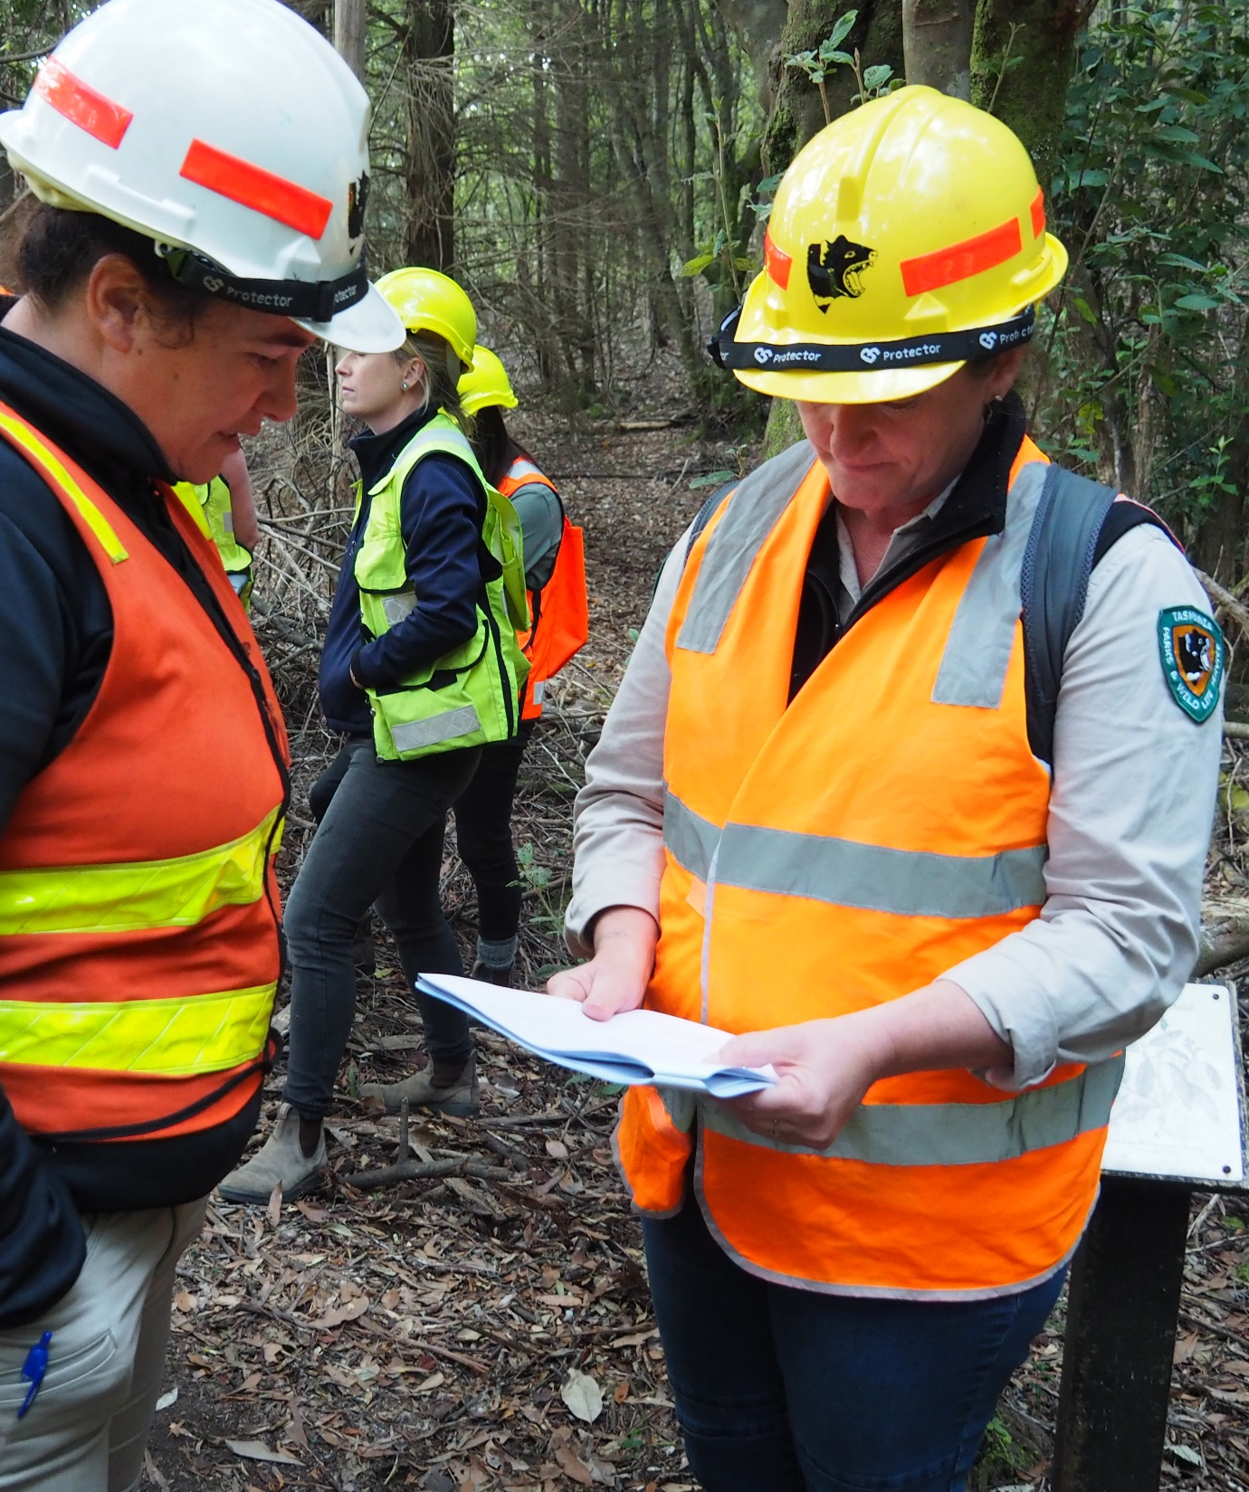
Positive relationships
Engaging with stakeholders in the forest industry is a requirement of the following industry initiatives:
Forest certification
Good neighbour protocol
Notes:
Building positive relationships
Engaging with external stakeholders in the forest industry isn’t just a warm and fuzzy thing to do. It is a requirement of the following (voluntary) initiatives:
forest certification
good neighbour protocol
Most forest managers in Tasmania are certified against a forest management standard, and most have signed up to the good neighbour protocol.

Slide 11
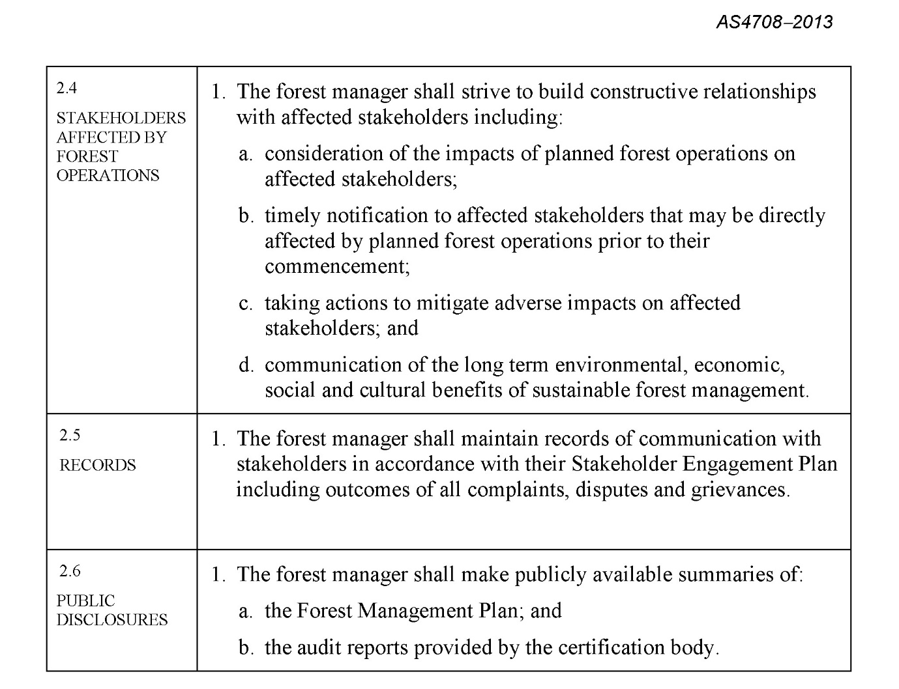
Positive relationships
Forest certification
Forest Stewardship Standard
Sustainable Forest Management
To achieve certification against these standards, forest managers must build positive relationships with their stakeholders.
Extract: AS4708-2013 Sustainable Forest Management (p27)
Notes:
Building positive relationships
Most forest managers have achieved certification against one (or both) of the following standards:
FSC® Australia Forest Stewardship Standard®
Sustainable Forest Management (AS 4708)
These national standards support the responsible and sustainable management of our forests.
To be certified against them, forest managers must build constructive relationships with their stakeholders.

Slide 12
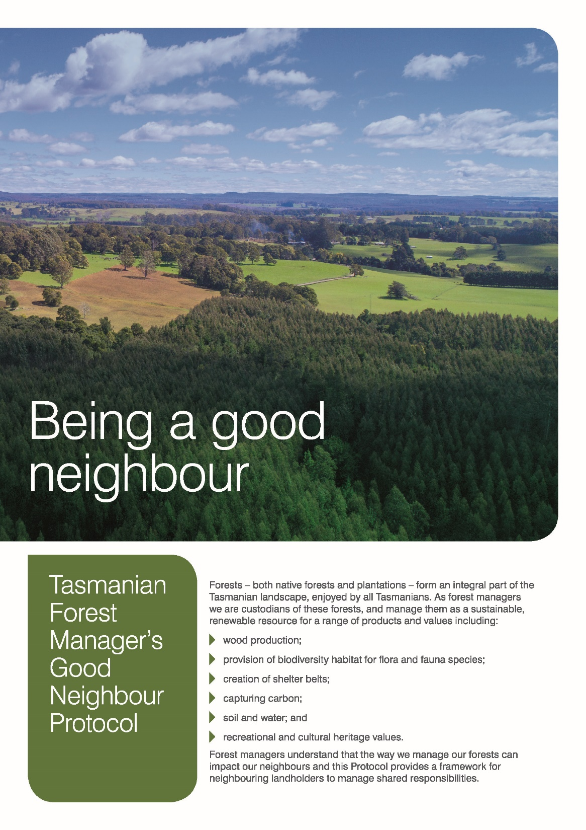
Positive relationships
Good neighbour protocol
By signing up to this protocol, forest managers agree to build positive relationships with their stakeholders.
Version 1.2
Slide 12
Notes:
Building positive relationships
This protocol is an initiative of the Tasmanian forest industry, and one of its main aims is to build positive relationships between forest managers, neighbours and local communities.
By signing up to this protocol, forest managers are agreeing to establish open, positive and respectful relationships with their stakeholders.
Forest workers must to be able to communicate with neighbours and local communities in a positive and respectful manner.

Slide 13
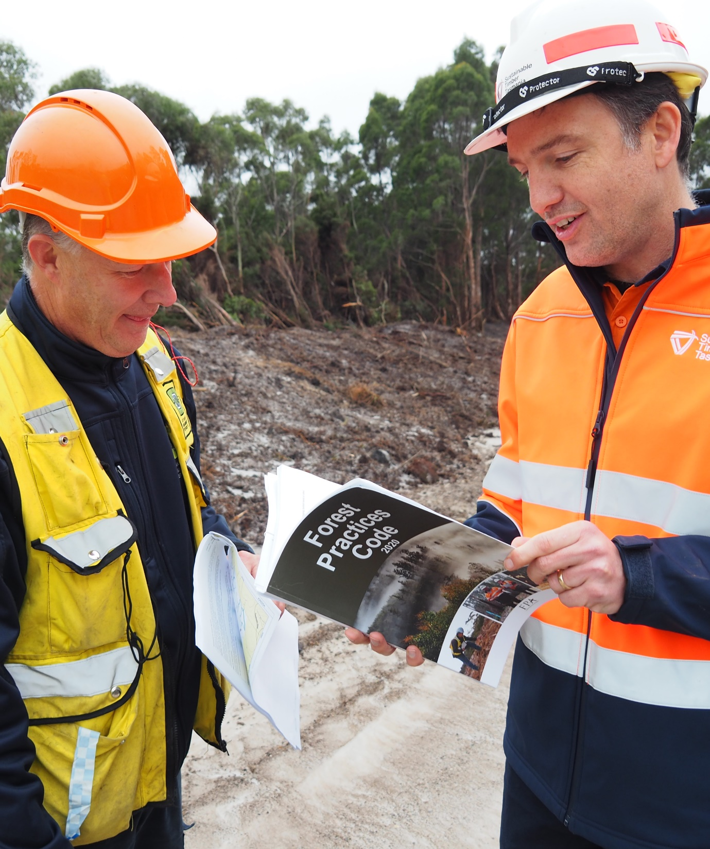
Regulatory conditions
Forest Practices Code 2020
Engaging with stakeholders in the forest industry is also a regulatory requirement in Tasmania.
Stakeholders who own land within 100 m of an operational boundary must be notified of planned forest practices.
Notes:
Meeting regulatory requirements
Engaging with external stakeholders in the forest industry is also a regulatory requirement in Tasmania.
The Forest Practices Code 2020 specifies that local councils and landowners within 100 metres of an operational boundary must be notified of any planned forest practices.
This is not a forest worker’s responsibility, but they may need to respond to questions from local councils and landowners.

Slide 14
Interacting effectively
Communication is effective when:
everyone is positive and respectful
everyone’s message is clear, honest and accurate.
Notes:
Communicating effectively
Communication is effective when:
everyone is positive and respectful
everyone’s message is clear, honest and accurate.
You don’t have to reach an agreement or resolve any issues. You simply have to understand each other’s message.
Forest workers will most likely have to convey the person’s message to their bush boss or supervisor, so it’s important they are 100% clear on what the person is trying to say.

Slide 15
Interacting effectively
Tips for effective communication
Check the person’s mood
Check your own mood
Listen to their message
Check your response
Notes:
1. Check the person’s mood
Are they calm, and will they be able to convey their message in a respectful way?
2. Check your own mood
Are you calm, and will you be able to listen to their message in a respectful way?
If you feel the exchange will not be open, positive and respectful, excuse yourself from the situation and let your bush boss know immediately.
3. Listen to their message
Be attentive and show interest
Use positive body language and maintain eye contact
Try to be empathetic to their point of view
If they feel you’re prepared to listen, they may positively influence other local people in the community
4. Check your response
Can you provide a clear and accurate response?
If you can’t, take their details and let them know you will pass on their message to your bush boss or supervisor
And make sure you do!

Slide 16
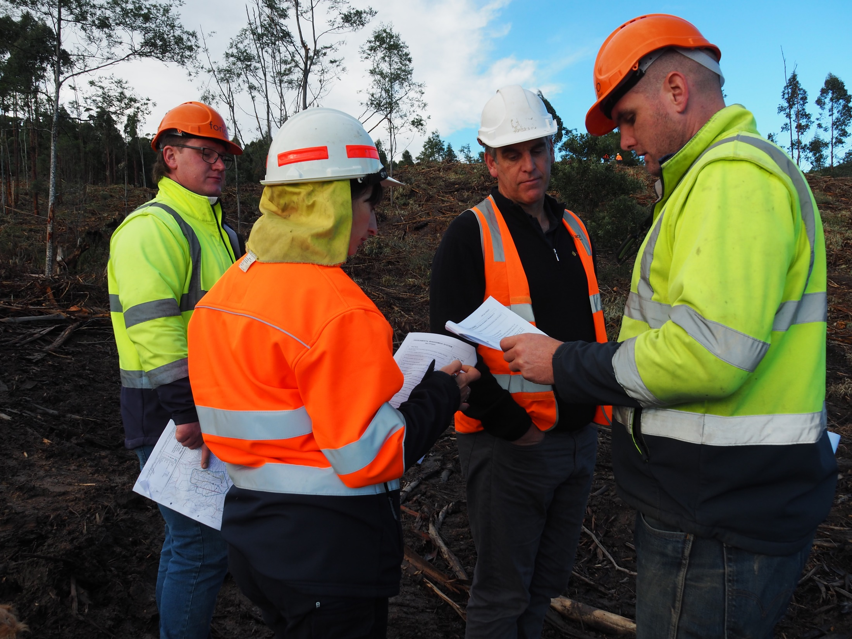
Identify
Engagement strategies
Notes:
This topic is aligned to Element 1: Identify communication and engagement strategies.
It also covers some foundation skills and knowledge/performance evidence components.
Before starting work, forest workers must check if any specific stakeholder engagement strategies apply at the site.
For example, if they’re working at a coupe and the forest manager is certified against a national forest management standard, they will need to be familiar with any site-specific strategies the forest manager has in place for engaging with stakeholders.
At the very least, they’ll need to know what to do if an external stakeholder arrives on-site and wants to make a complaint.

Slide 17
Stakeholder concerns
Before engaging with someone, it is important to quickly assess:
the type of stakeholder they are
the concerns they may have.
Notes:
Key stakeholders and their concerns
Before engaging with a member of the public, it is important to quickly assess:
the type of stakeholder they are
the type of concerns they may have.

Slide 18
Activity: Identifying stakeholder concerns
Key stakeholders | Common concerns
Landowners, neighbours & residents
Local businesses
Local communities
Local councils
Environmental non-government organisations
Government organisations
Industry associations
Recreational organisations
Regional Aboriginal communities
Utility organisations
Notes:
Activity
Ask forest workers to identify the concerns that key stakeholders commonly have with forest operations.
Landowners, neighbours & residents (noise, hours of operation, dust, smoke haze, spray drift, weed infestation, water quality, road closures, increased traffic, fence damage, game control measures)
Local businesses – including tourism operators (impact on trade and the state’s clean, green image)
Local communities & community organisations (impact on community safety & wellbeing, such as proximity of cartage routes to school bus routes)
Local councils (impact on assets, such as community facilities, properties, roads, bridges)
Environmental non-government organisations & scientific organisations (impact on forest biodiversity)
Government organisations (impact on assets, such as national parks, reserves, heritage sites; & compliance with regulations)
Industry associations (impact on trade for local businesses)
Recreational organisations (access to forests, such as camping areas, walking tracks, bike tracks, vehicle tracks)
Regional Aboriginal communities (impact on Aboriginal heritage)
Utility organisations (impact on assets, such as power poles, power lines, water mains, sewer mains)

Slide 19
Social benefits
Forest-related activities in Tasmania generate a number of social benefits.
3,000+ direct jobs
generated by the forest industry
2,600+ indirect jobs
generated by other industries
Notes:
Benefits of forest-related activities
If forest workers are approached by stakeholders with concerns about forest operations in Tasmania, they may find it helpful to point out:
the number of jobs generated by the industry (including indirect jobs such as mechanics and retail workers)
the significant economic contribution that the industry makes to the state
the positive impact that the industry is having on pressing environmental issues (such as climate change).

Slide 20
Economic benefits
Forest-related activities in Tasmania generate a number of economic benefits.
$712 million
direct economic value
$1.2 billion
total economic value
Notes:
Benefits of forest-related activities
If forest workers are approached by stakeholders with concerns about forest operations in Tasmania, they may find it helpful to point out:
the number of jobs generated by the industry (including indirect jobs such as mechanics and retail workers)
the significant economic contribution that the industry makes to the state
the positive impact that the industry is having on pressing environmental issues (such as climate change).
Please note: Total economic value includes the direct economic value and flow-on effects.

Slide 21
Environmental benefits
Forest-related activities in Tasmania generate a number of environmental benefits.
Carbon positive
Tasmania’s plantations are storing 31 million tonnes of carbon
Positive climate outcomes
Active forest management has a positive impact on climate change
Notes:
Benefits of forest-related activities
If forest workers are approached by stakeholders with concerns about forest operations in Tasmania, they may find it helpful to point out:
the number of jobs generated by the industry (including indirect jobs such as mechanics and retail workers)
the significant economic contribution that the industry makes to the state
the positive impact that the industry is having on pressing environmental issues (such as climate change).

Slide 22
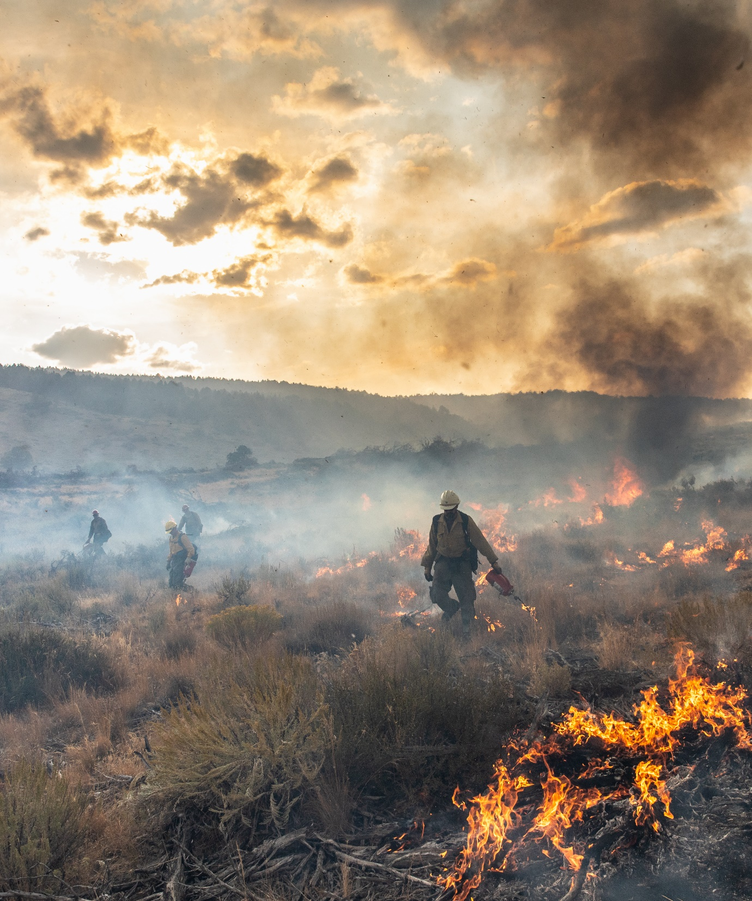
Notification protocols
Notifying neighbours
Stakeholders who own land within 100 m of an operational boundary must be notified of planned forest activities (such as planned burns).
People who live outside the 100 m zone are not always notified.
These people may approach you on-site with their concerns.
Notes:
Regulatory requirements
People who own land or reside within 100 metres of an operational boundary must be informed of any planned forest operations at least 30 days before start-up.
This is a regulatory requirement of the Forest Practices Code 2020.
Forest managers usually send a Notice of Intent (NOI) to let people know when the work is likely to start.
NOIs are not sent to everyone, so people may approach forest workers at the start of an operation with queries or concerns.

Slide 23
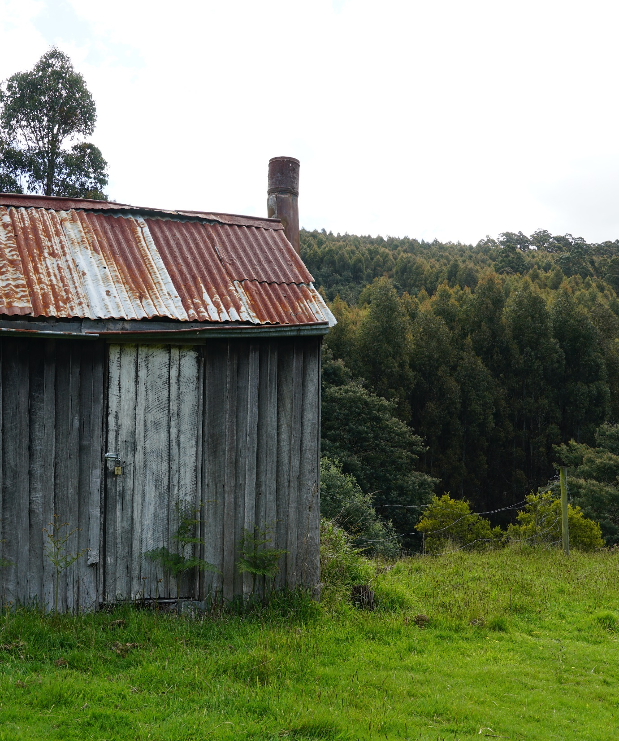
Good neighbours
Communicating with neighbours
Most forest managers subscribe to the ‘good neighbour protocol’.
This is a voluntary agreement to communicate positively with all neighbouring landowners.
Forest workers are also expected to communicate positively with all neighbouring landowners.
Notes:
Non-regulatory initiatives
Nearly all forest managers in Tasmania subscribe to an industry initiative known as the ‘good neighbour protocol’.
By signing up to this voluntary protocol, forest managers agree to communicate in a positive and respectful manner with their neighbours and local communities.
Forest contractors and workers are also expected to communicate appropriately with all neighbouring landowners.

Slide 24
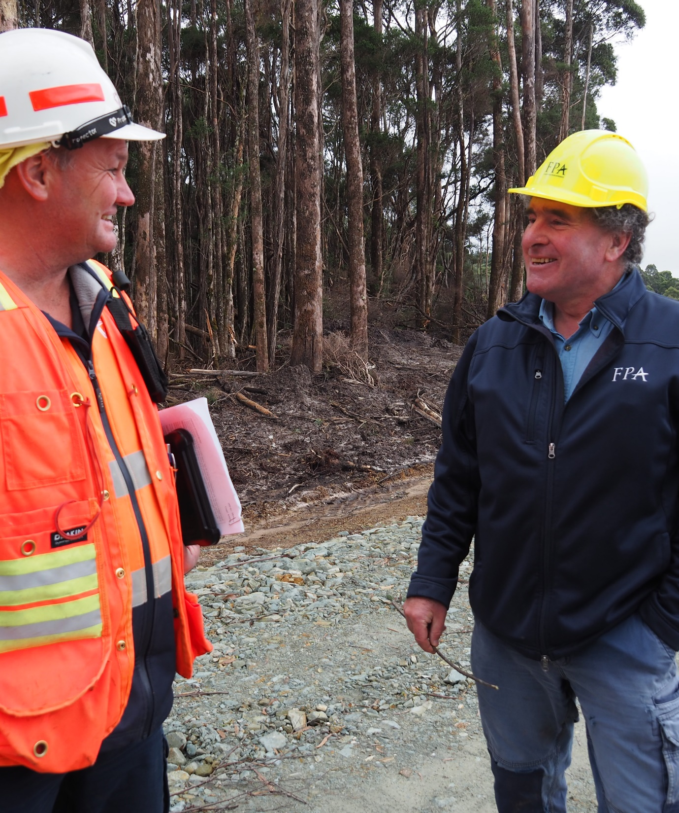
Strategies
Listen carefully
Maintain eye contact
Use appropriate language
Use appropriate body language
Be open, positive and respectful
Be empathetic
Avoid judging the person
Personalise the conversation
Notes:
Communication strategies
If a forest worker is approached by someone with concerns about forest operations, there are a number of strategies they can use to avoid a negative interaction:
listen carefully
maintain eye contact
use appropriate language
use appropriate body language
be open, positive and respectful
try to avoid judging the person
try to imagine how you would feel in their situation (i.e. be empathetic)
try to personalise the conversation (e.g. let them know if you live locally)

Slide 25
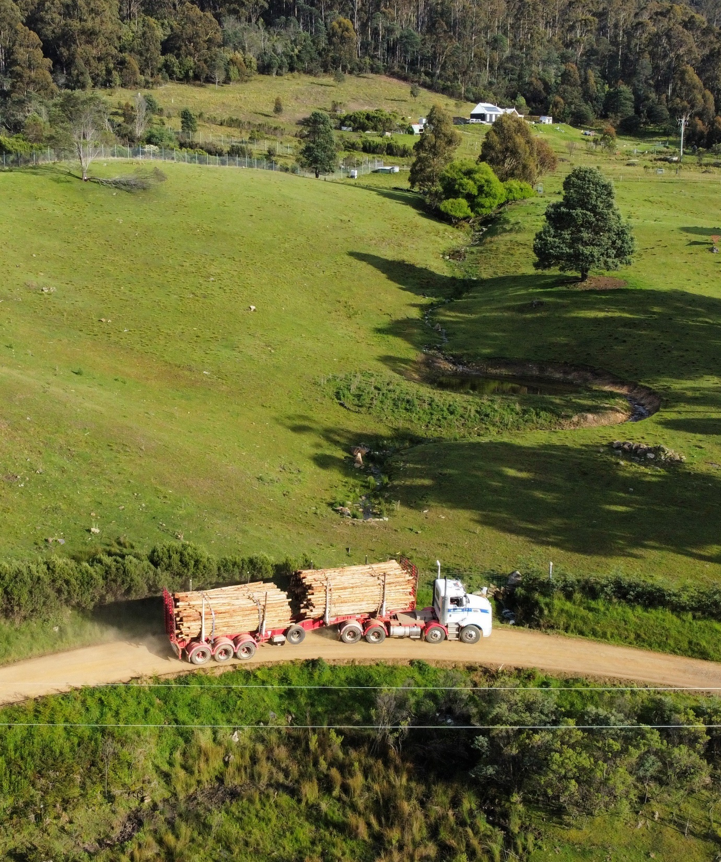
Strategies
If someone approaches you with concerns about forest operations, there are two main strategies you can use to ease their concerns:
convey their concerns to your bush boss
respond to their concerns yourself
Notes:
Alleviation strategies
If a forest worker is approached by someone with concerns about forest operations, there are two main strategies they can use to alleviate (ease) the person’s concerns:
convey their concerns to your bush boss, supervisor or forest manager
respond to their concerns yourself
In most (if not all) instances, forest workers should take the person’s details and convey their concerns to their bush boss.
Forest workers are NOT required to negotiate with the person or resolve their concerns. This is the forest manager’s responsibility.

Slide 26
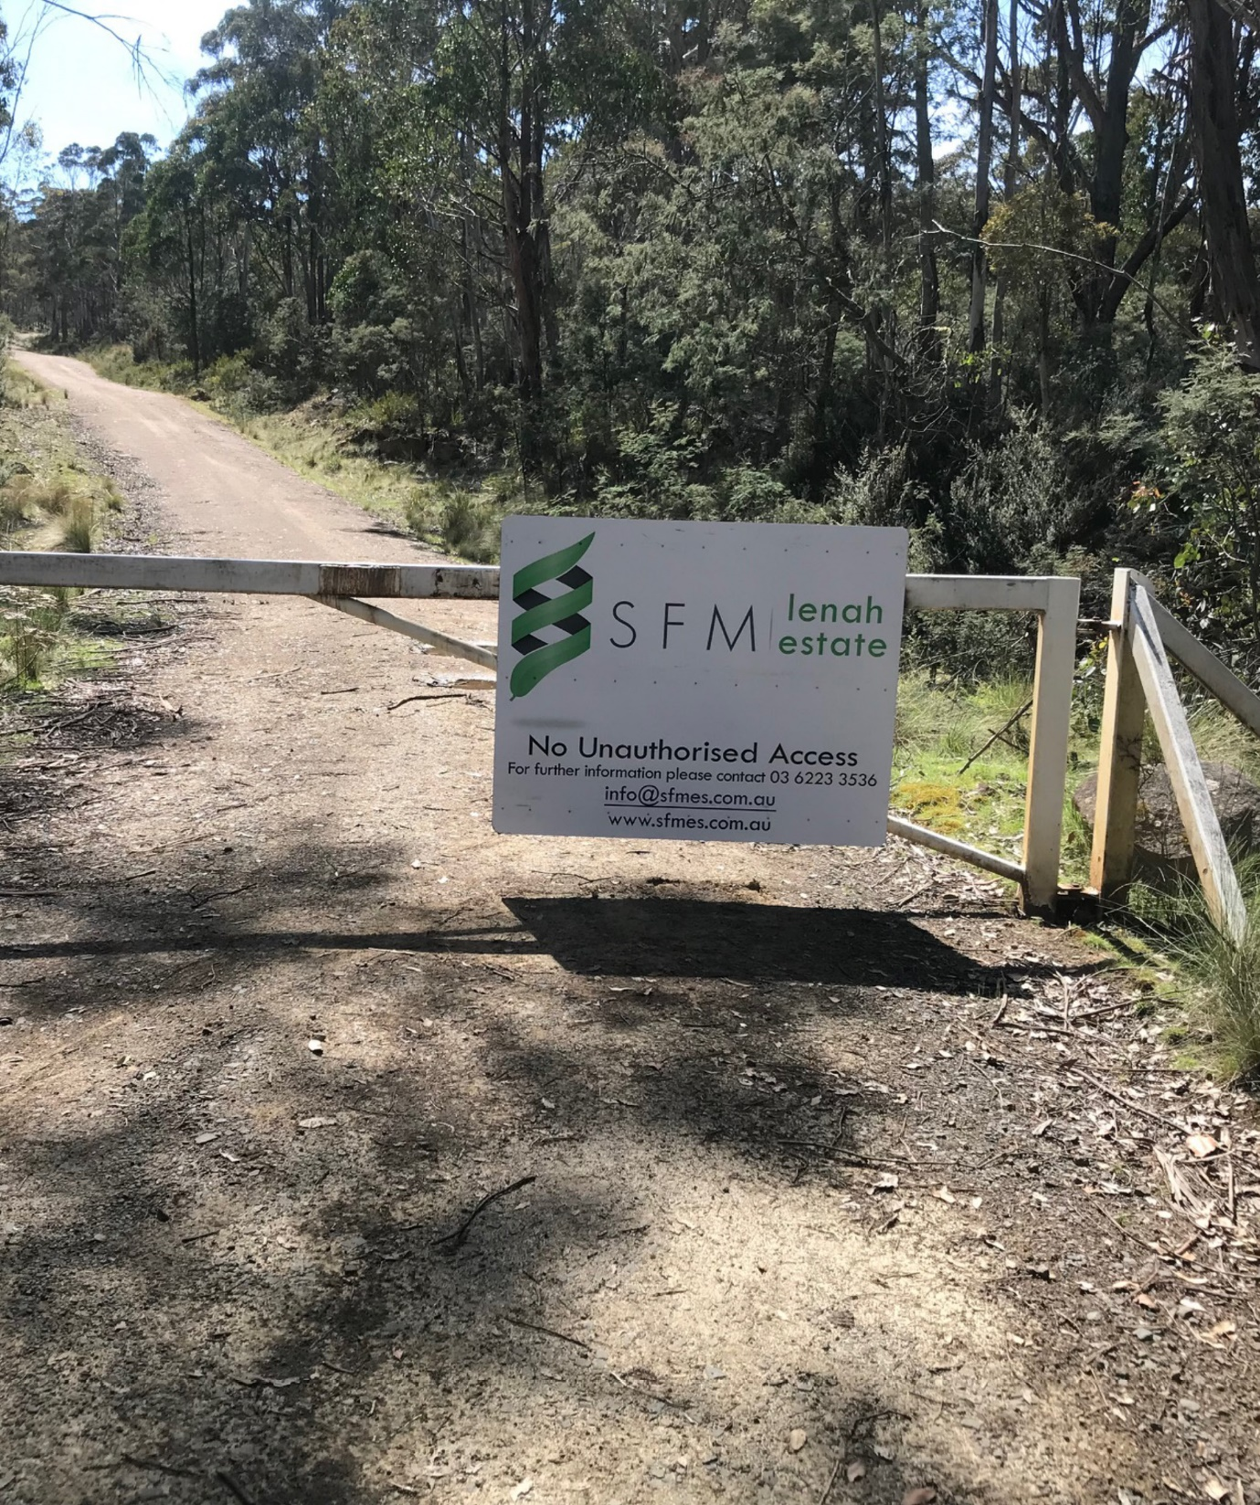
Strategies
If someone arrives on-site with a question but refuses to give their details, tell them to call the forest manager directly.
There should be a contact number on a sign at the site’s entrance.
Notes:
Alleviation strategies
If someone arrives on-site with a query but refuses to give their details, forest workers can always point them to the signage at the site’s entrance.
There should be a contact number for the forest manager on one of the signs.
If the person is uncomfortable sharing their contact details (or they don’t have time to wait for a response), they can call the forest manager directly.

Slide 27
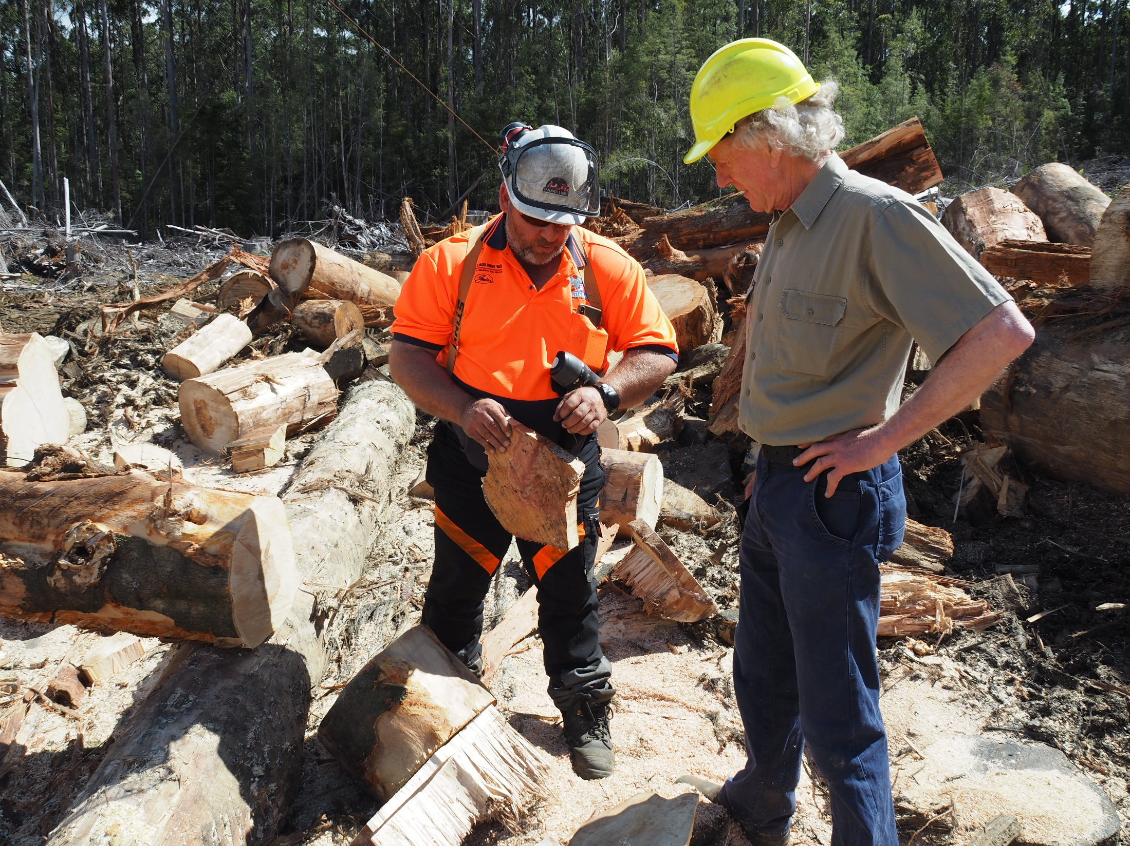
Use
engagement strategies
Notes:
This topic is aligned to Element 2: Utilise communication and engagement strategies.
It also covers some foundation skills and knowledge/performance evidence components.
Forest workers have a key role to play in communicating with stakeholders at forest worksites and in public settings.

Slide 28
Safety
Safety first
Before engaging with anyone, you must ensure the setting is safe.
For example, if trail bike riders accidentally venture onto a forest worksite, you’ll need to stop work and secure the equipment before you can engage with them.
Notes:
Engage with stakeholders
Before forest workers engage with anyone, they must ensure the setting is safe.
For example, if trail bike riders accidentally venture onto a worksite, forest workers will need to follow the site’s ‘unauthorised entry’ procedure (e.g. stop work and secure equipment) before they can engage with the riders.

Slide 29
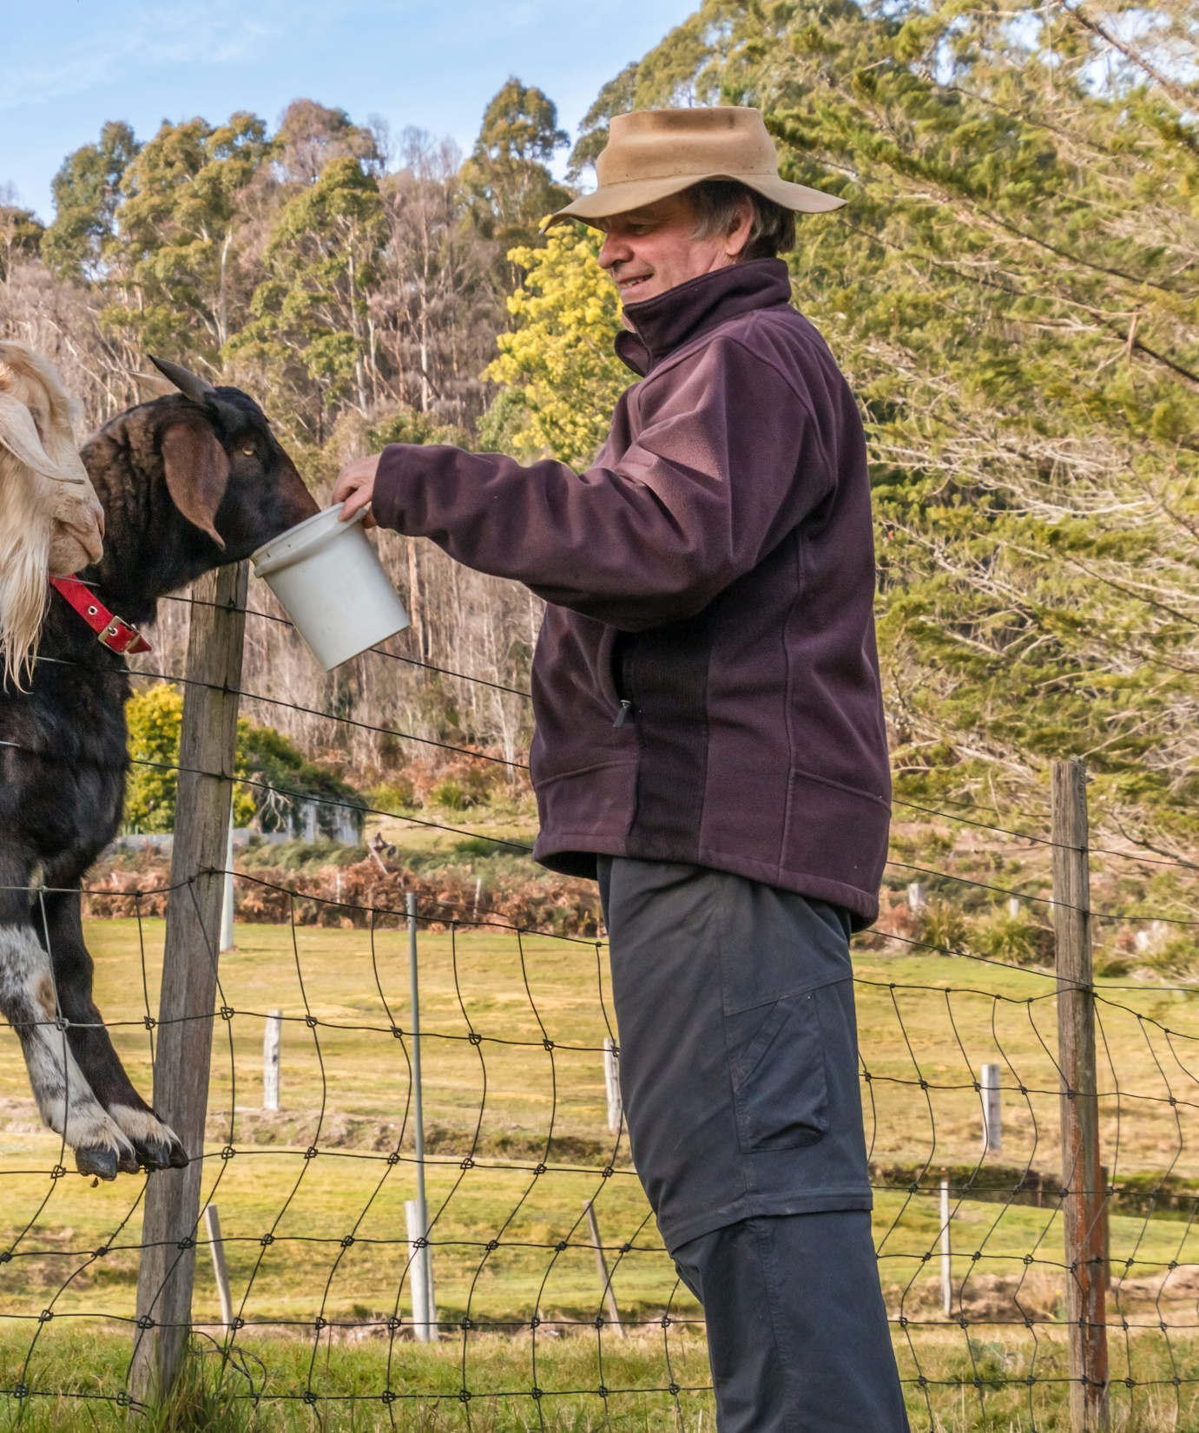
Strategies
Listen carefully
When someone is telling you their concerns about a forest operation, you need to be clear about what they are saying.
To do this, you’ll need to:
listen carefully
ask them questions
rephrase their concerns
Notes:
If a forest worker is approached by someone with concerns about forest operations, they will need to understand what the person is trying to tell them, because they’ll have to pass this on to their bush boss. When stakeholders feel they are being heard, they’ll be more likely to engage with forest workers in a respectful manner.
Listen carefully
Listen carefully to what they are saying
Focus more on the crux of their concern and less on the terms they are using
For example, if they say: ‘I can’t sleep’, they’re probably concerned about noise levels
Ask them questions
If you’re not 100% sure what they are saying, ask simple questions to clarify their concern
For example, you may ask: ‘Are you unable to sleep because of the noise?’
Rephrase their concern
When you understand their concern, rephrase it and say it back to them (out loud)
‘So just to clarify, you want to make a complaint about the noise?’
‘So just to clarify, you want to know if chemicals are being used on-site?’
Accuracy is critical here. If they are happy with the way you’ve rephrased their concern, you can pass it on to your bush boss (along with their details).

Slide 30
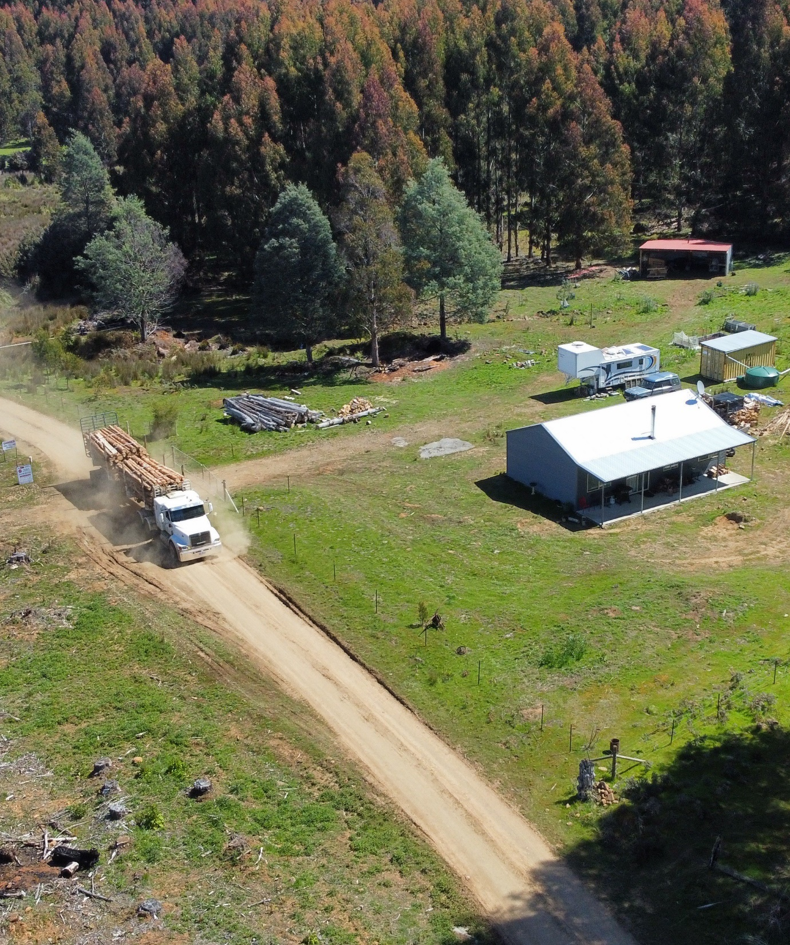
Strategies
Conveying a question
If someone asks you a question, let them know that you’ll convey their question to you bush boss.
All you need to get from them is:
their name
their phone number
a summary of their question.
Notes:
Conveying a question
Forest workers are NOT expected to answer questions from stakeholders, regardless of whether a person turns up on-site, stops them in the street or engages with them online.
They may be asking about operating times, cartage routes, chemical spraying areas or planned burns, and forest workers may not have the most up-to-date information on these topics.
Forest workers simply need to take the person’s details and assure them they will pass on the question to their bush boss. And they must follow through on this!
They’ll need to gather the person’s name and phone number at a minimum, and possibly their home address.
The bush boss will log the interaction and forward the person’s details to the forest manager, who will then contact them with an accurate response.

Slide 31
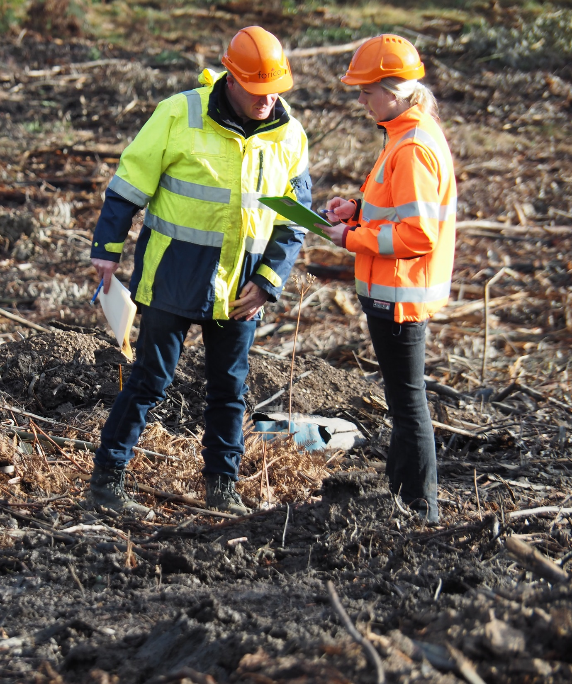
Strategies
Answering a question
Explain your role
Value your experience
Provide a clear, honest and accurate response
Only respond within your area of responsibility
Only respond with facts
Don’t respond with opinions
Notes:
Responding to a question
If forest workers feel they can respond to a person’s question themselves, there are a number of strategies they can use to ensure the interaction is positive:
explain their role at the worksite
value themselves and their industry experience
provide a clear, honest and accurate response
only respond within their area of responsibility
only respond with facts
do not respond with opinions
Forest workers should only respond to a person’s questions if they are 100% certain their facts are accurate.
They must inform their bush boss when they engage with stakeholders, as these interactions need to be logged with the forest manager.

Slide 32
Strategies
Difficult verbal situations
Depending on the circumstance, there are two strategies you can use in difficult verbal situations:
focus on the issue, not the person
step away from the situation
Notes:
Ease the concerns of stakeholders
Forest workers may be approached by people who feel very strongly about a specific forest operation.
They may be very defensive and aggressive, and this may lead to a difficult verbal situation.
There are two strategies that forest workers can use in difficult verbal situations:
focus on the issue, not the person
step away from the situation

Slide 33
Two strategies for difficult verbal situations
Focus on the issue, not the person
Step away from the situation
Confirm your safety is not at risk
Remain calm and objective
Focus on the issue, not each other
Agree to disagree (if necessary)
Share positive aspects of forestry
If someone verbally abuses you at a worksite, in the street or online, step away from the situation and let your bush boss know
Notes:
Focus on the issue, not the person
If forest workers finds themselves in difficult verbal situations with people who feel strongly about forest activities, they can try working through the following steps:
confirm that their safety is not at risk
remain calm and objective (both parties)
focus on the issues, and not on each other
agree to disagree (if necessary)
share the positive aspects of forestry, such as:
the mandatory use of forest practices plans
the regulatory focus on environmental care
the ratio of plantations and re-growth forests
the importance of forest certification
the growing demand for wood-based products sourced from sustainably managed forests
Step away from the situation
In 2017, the union for retail workers in Australia launched the No One Deserves a Serve campaign to raise awareness of the abusive behaviours that retail workers face every day:
there’s no excuse for verbal abuse
if a member of the public verbally abuses you at a worksite, in the street or online, step away from the situation and let your bush boss know

Slide 34
Follow procedures
If a worksite is invaded, follow the unauthorised entry procedure:
cease all activity
secure equipment and site
contact relevant authorities
politely ask people to leave
be mindful of recording devices
move to EMP
Notes:
Follow workplace procedures
There will be times when forest workers encounter people on-site who feel very strongly about forest practices, and they will not be able to ease their concerns.
In these situations, forest workers must follow the site’s ‘unauthorised entry’ procedure:
cease all activity
secure equipment and site
contact relevant authorities
politely ask people to leave
be mindful of recording devices
move to emergency meeting point

Slide 35
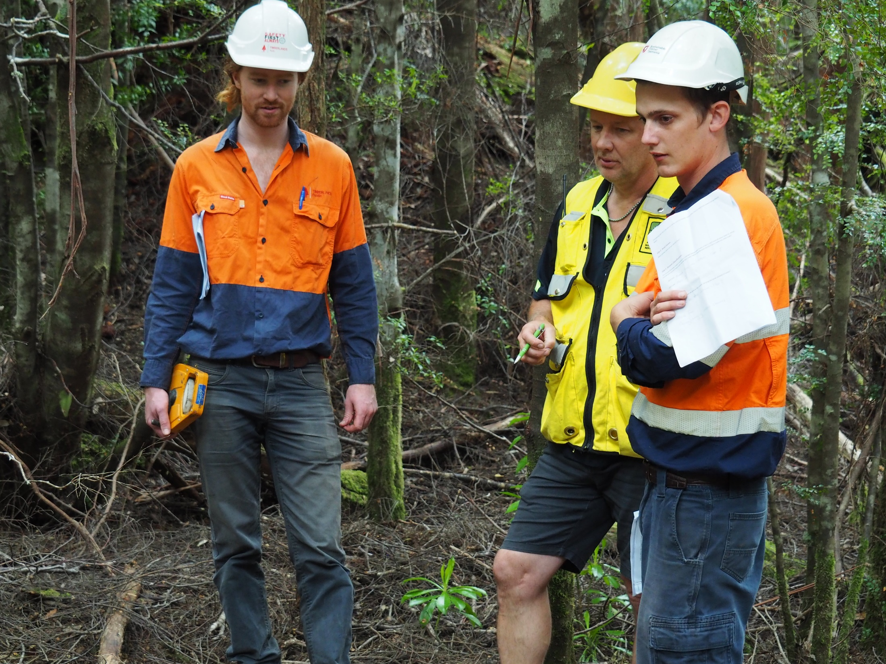
Review
stakeholder interactions
Notes:
This topic is aligned to Element 3: Review participation in community and stakeholder interactions.
It also covers some foundation skills and knowledge/performance evidence components.
Forest workers should always reflect on their interactions with external stakeholders, as this allows them to identify areas where they can improve their approach..

Slide 36
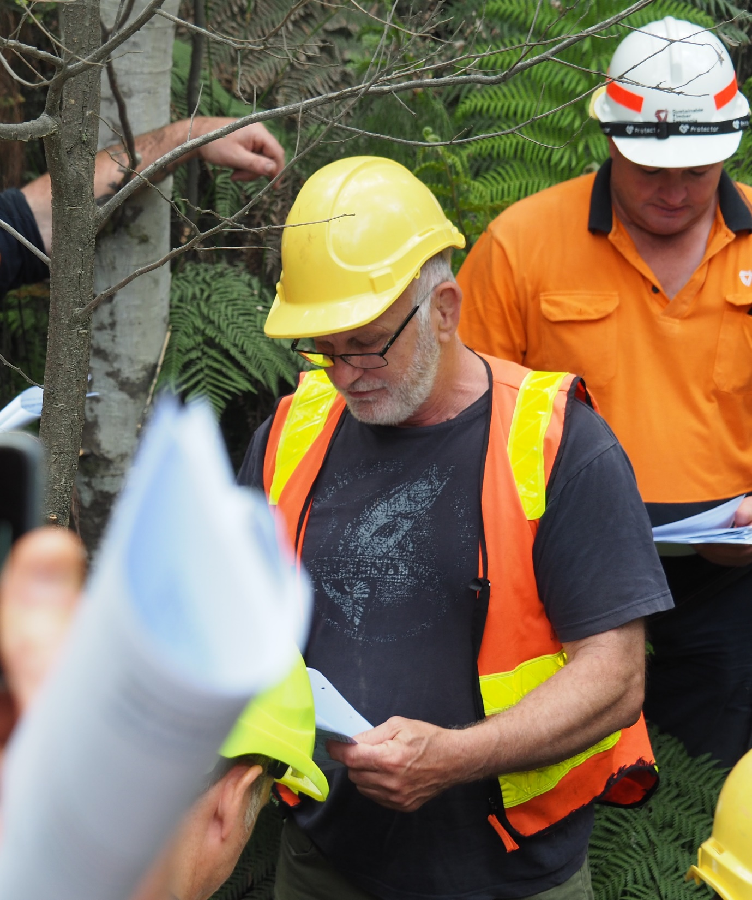
Reflective practice
Reflect on your interactions
You can improve your interactions with stakeholders through ‘reflective practice’.
Think about your past interactions with stakeholders (either on-site, in the street or online).
What worked and what didn’t?
Be honest…
Notes:
Reflect on your interactions
Forest managers want to build positive relationships with all stakeholders.
It will therefore benefit the industry if forest workers can improve their stakeholder engagement skills, and an effective way to do this is through ‘reflective practice’.
This is where you take time to reflect on your past interactions with stakeholders (either on-site, in the street or online).
What worked and what didn’t?
Try to be as honest and constructive as possible.

Slide 37
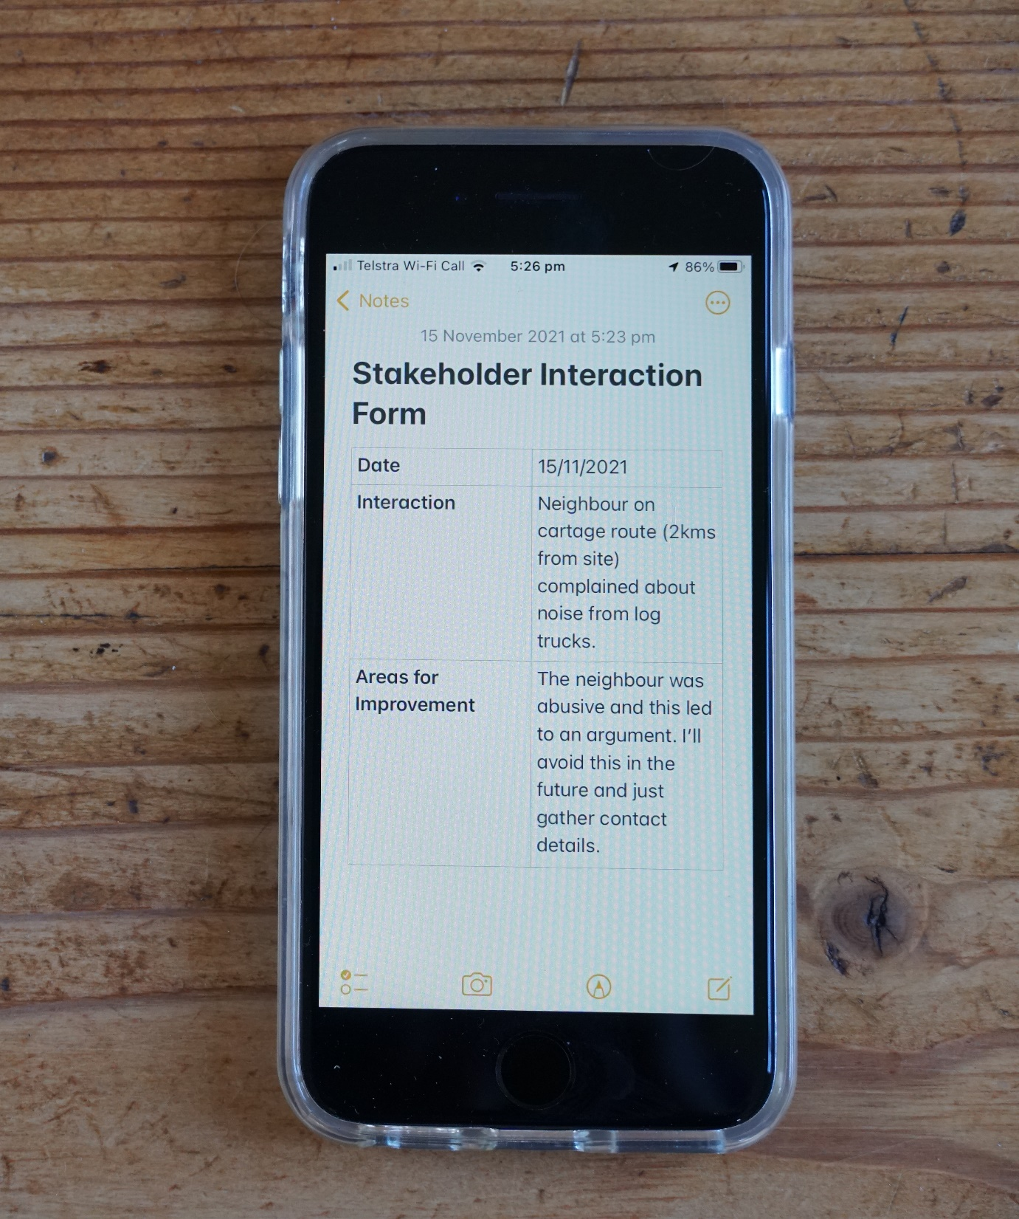
Reflective practice
Evaluate your interactions
The main aim of reflective practice is to pinpoint areas where you can improve the way you interact with external stakeholders.
It is important to record the areas where you can improve (either on your phone or on a form).
Notes:
Evaluate your interactions
The main aim of reflective practice is to pinpoint areas where forest workers can improve, and it is very important that forest workers record these areas (either on their phone or on a form).

Slide 38
Reflective practice
Discuss your interactions
Stakeholder interactions can have a negative impact on your health and well-being, especially if they:
are aggressive
involve abusive language
cause a site shutdown
Talk to your bush boss if you feel an interaction has impacted you.
Notes:
Discuss your interactions
Some stakeholders have strong views about forest practices in Tasmania, and engaging with these people can impact a forest worker’s health and wellbeing, especially if the interaction:
is aggressive
involves abusive language
causes a site shutdown.
Forest workers should always discuss an interaction with their bush boss if they feel it has (in any way) impacted their psychological health.

Slide 39
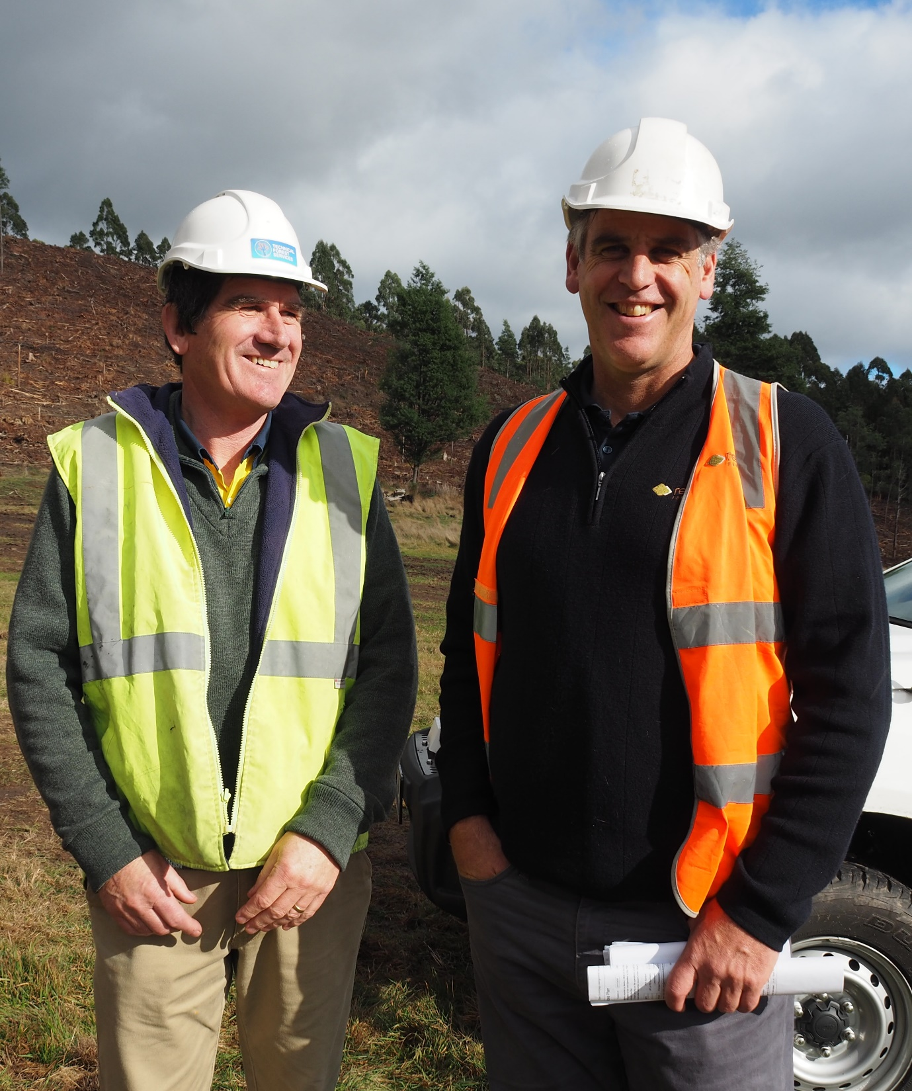
A final word…
If you’re not sure how to interact with external stakeholders on-site, in a community setting or online, ask your bush boss or supervisor.

Slide 40
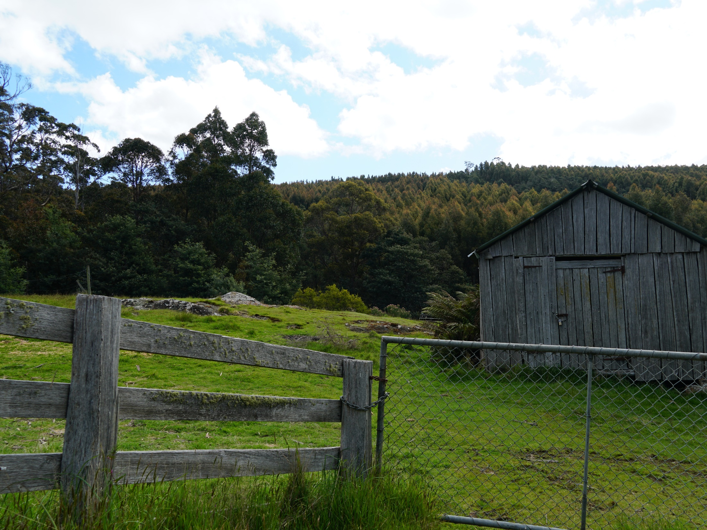
Where to from here?
How to reinforce and validate your training
Notes:
A number of learning and assessment materials have been developed to reinforce and validate the structured training you provide to forest workers.

Slide 41
Where to from here?
Complete the communication checklist
this will only take a minute, and it will give you a useful summary of the topics covered in today’s training.
Take a copy of the following self-paced learning materials and work through them in your own time:
Communication for Contractors – Learner Guide
Communication for Contractors – Learner Questionnaire.
Organise a convenient date/time to undertake an assessment.
Notes:
Communication checklist
This has been provided at Appendix A of the Facilitator Guide. Ask forest workers to complete the checklist at the end of the training session. It will only take a minute or so, and it will provide them with a useful summary of the topics they’ve covered. You will need to print the checklist prior to the training, and you will need to ensure each forest worker has a copy. This is not an assessment process – it’s simply a tool to reinforce learning.
Self-paced learning materials
Hand out copies of the following materials to each forest worker at the end of the training:
Communication for Contractors – Learner Guide
Communication for Contractors – Learner Questionnaire.
These have been designed as self-paced learning materials, and they aim to reinforce the knowledge and skills attained through structured training. Encourage everyone to work through the materials in their own time, especially the learner questionnaire (which includes all answers at the back). Once again, this is not a formal assessment process – it’s simply a tool to reinforce learning.
Assessment tool
If you intend to assess forest workers at the end of the training, an assessment tool is included in the Communication for Contractors – Assessor Guide.

Slide 42
Acknowledgements / disclaimer
Acknowledgements
A number of key industry stakeholders supported the development of this presentation, including:
AKS Forest Management Services
AKS Forest Solutions
CFMEU Manufacturing Division
Forest Practices Authority
Forico
Reliance Forest Fibre
SFM Environmental Solutions
Sustainable Timber Tasmania
Tasmanian Forest Products Association
TasTAFE
Timberlands Pacific
ForestWorks is indebted to the open, generous and cooperative nature of all those who contributed.
The photographs used in this presentation are attributable as follows:
AKS Forest Management Services (s7, 25, 30)
Forest Practices Authority (s1, 3-5, 8, 10, 13, 16, 24, 27, 31, 35, 36, 39)
Mountain Huts Preservation Society (s43)
Pexels (s8, 9, 14, 15, 17, 28, 29, 32, 34, 38)
purple infinity (s23, 37, 40)
Raw Pixel (s22)
SFM Environmental Solutions (s26)
Disclaimer
This work is the result of consultations with Australian forestry industry participants. It is a collaborative view and does not necessarily represent the view of the developers or any specific body. For the sake of brevity, it may omit factors which could be pertinent in particular cases.
The developers do not accept any liability for any damage or loss (including direct and consequential loss) incurred by any person as a result of relying on the information contained in this material.
The developers do not accept any liability to any person for the information or advice (or the use of such information or advice) which is provided in this presentation or incorporated into it by reference. The information is provided on the basis that all persons accessing this material undertake responsibility for assessing the relevance and accuracy of its content. No liability is accepted for any information or services which may appear in any other format. No responsibility is taken for any information or services which may appear on any linked websites.
Notes:
Let forest workers know that the materials used in this training session were developed in close collaboration with the Tasmanian forest industry.

Slide 43
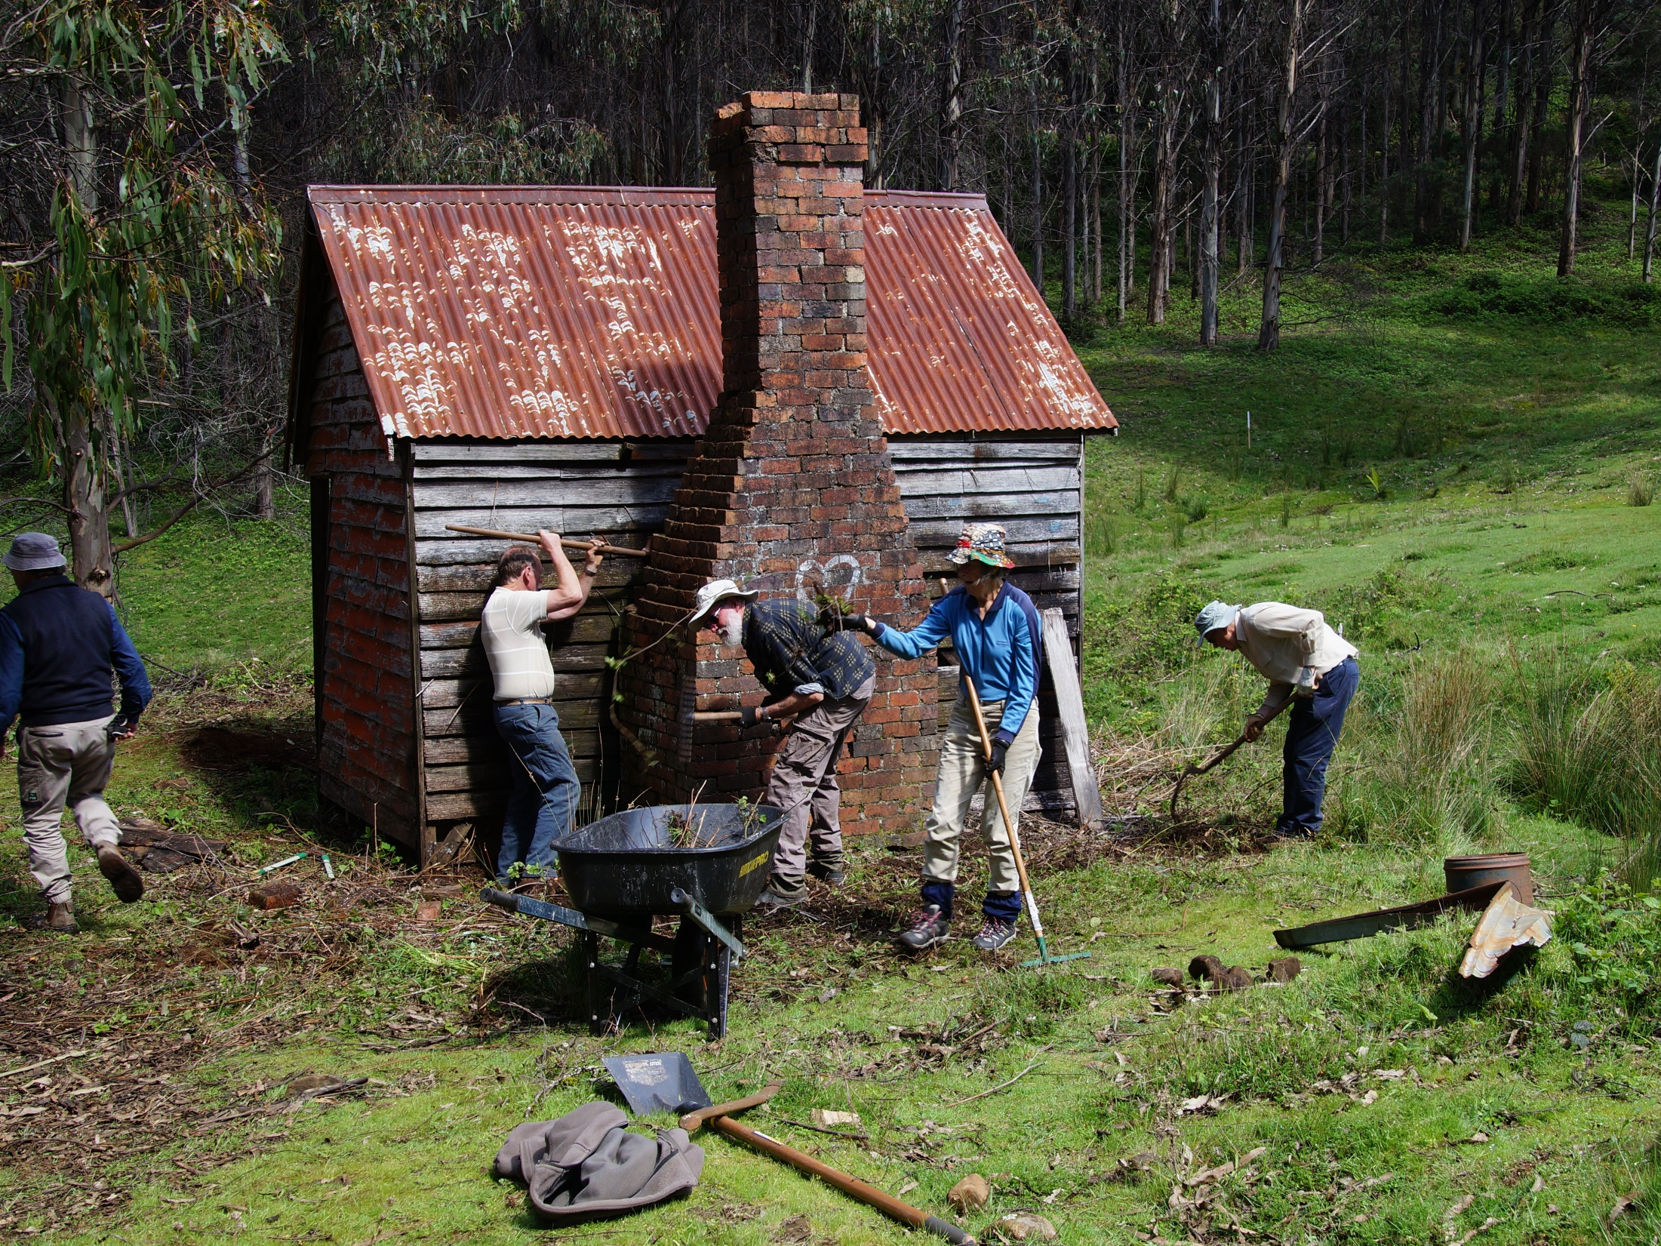
…positive community relationships
Notes:
…positive community relationships

