Slide 1
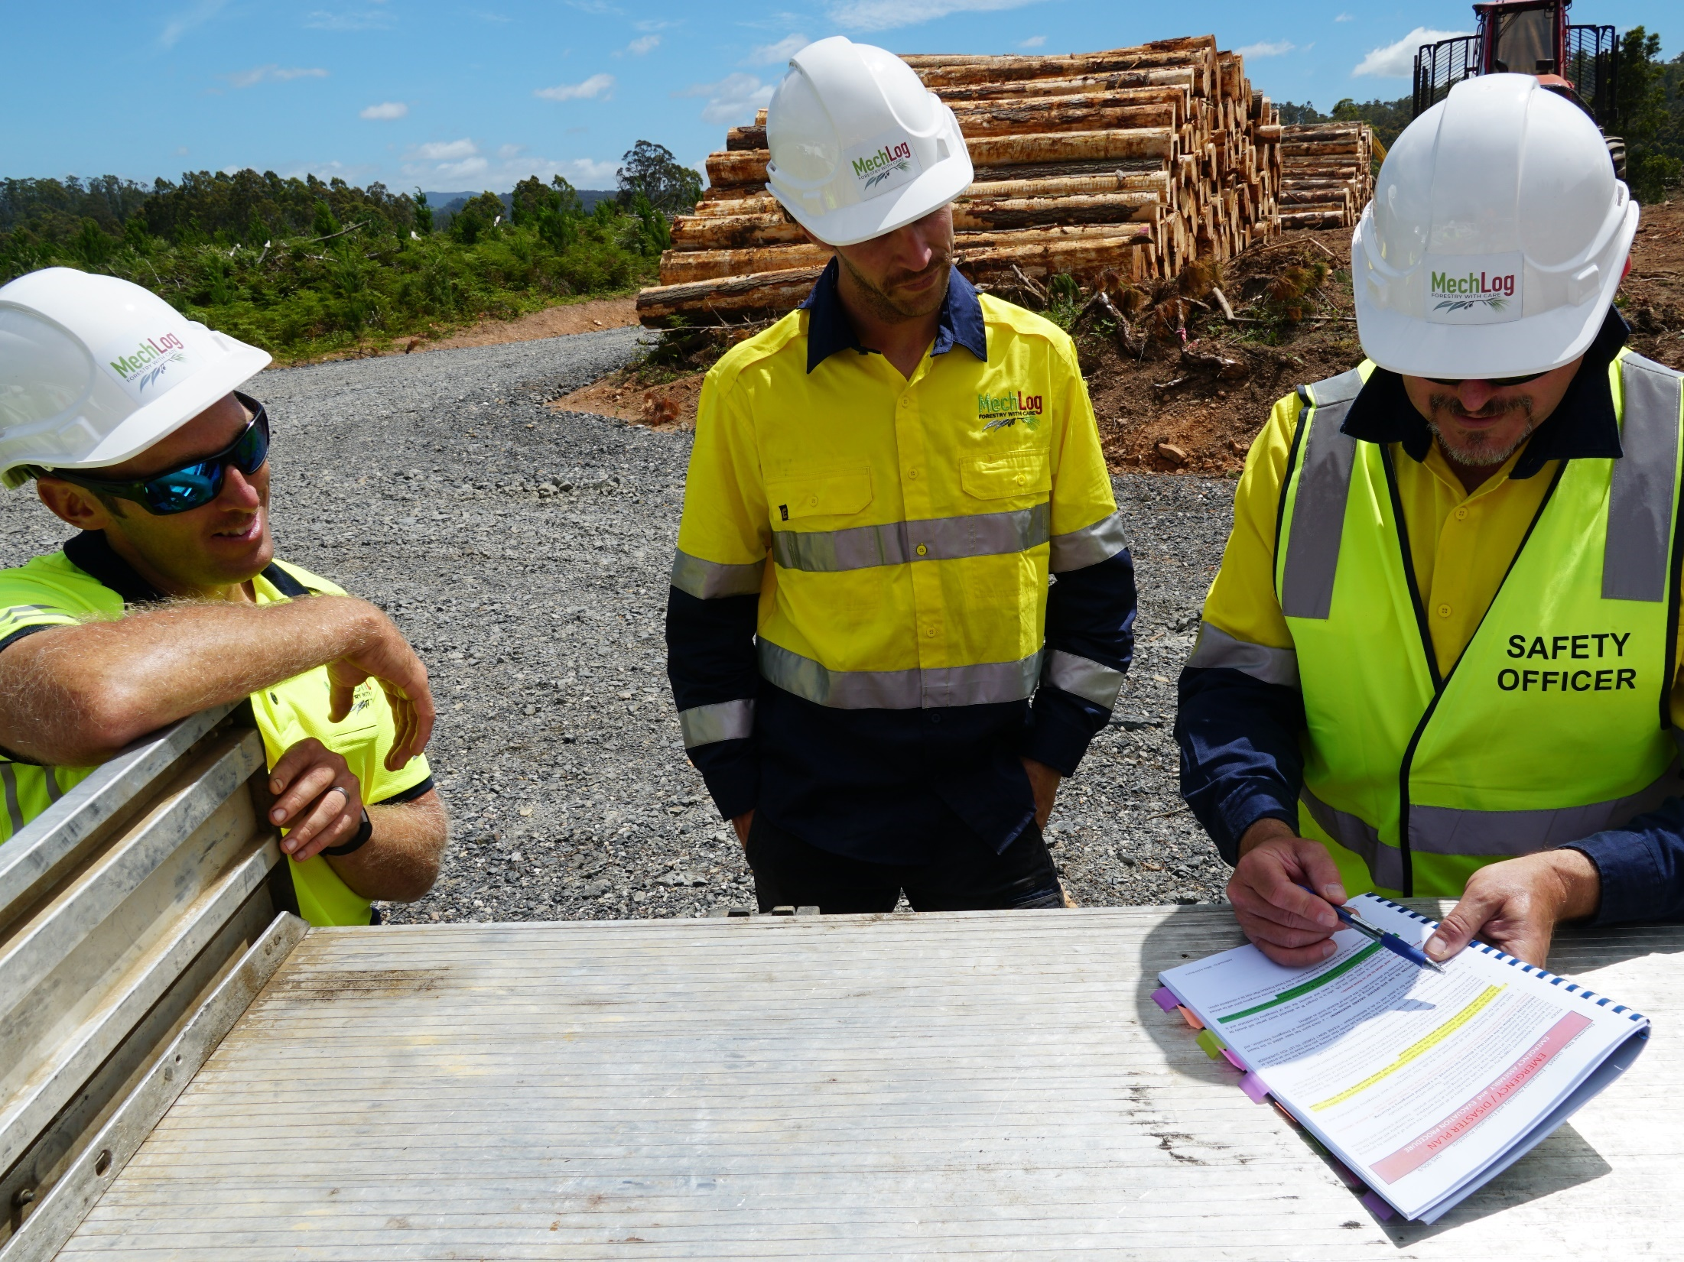

Work health & safety
Forest Safety for Contractors

Slide 2


Background
This presentation was developed by ForestWorks under the Training and Skills Development Services (TSDS). The TSDS is funded by the Australian and Tasmanian Governments to support the rebuilding and reskilling of the Tasmanian forest and timber industry.
Copyright statement
© 2021 ForestWorks Ltd
You are free to reuse this work under a Creative Commons Attribution 4.0 International Licence provided any extracts are fully acknowledged, you indicate if changes were made and you comply with the other licence terms. The licence does not apply to any third-party material, images, branding or logos.
Further information
Enquiries about this publication should be directed to:
ForestWorks Ltd
PO Box 612
North Melbourne Victoria 3051
Telephone: 03 9321 3500
Email: forestworks@forestworks.com.au
Website: www.forestworks.com.au
First Published: 2020
Version: 1.4, March 2021
Why has this Facilitator Presentation been developed?
This presentation supports the unit of competency FWPCOR2205 Follow WHS policies and procedures. It is part of a set of materials that has been developed to support forest workers who are required to follow health and safety procedures in Tasmania’s forest industry.
The complete set of materials includes the following:
Forest Safety for Contractors – Learner Guide
Forest Safety for Contractors – Learner Questionnaire
Forest Safety for Contractors – Facilitator Guide
Forest Safety for Contractors – Facilitator Presentation
Forest Safety for Contractors – Assessor Guide
Forest Safety for Contractors – Mapping Document.
While the materials focus on harvesting and clearing, the same principles apply to roading and site preparation.
Notes:
This PowerPoint presentation has been developed for use with the following contextualised learning and assessment materials:
Forest Safety for Contractors – Facilitator Guide
Forest Safety for Contractors – Learner Guide

Slide 3
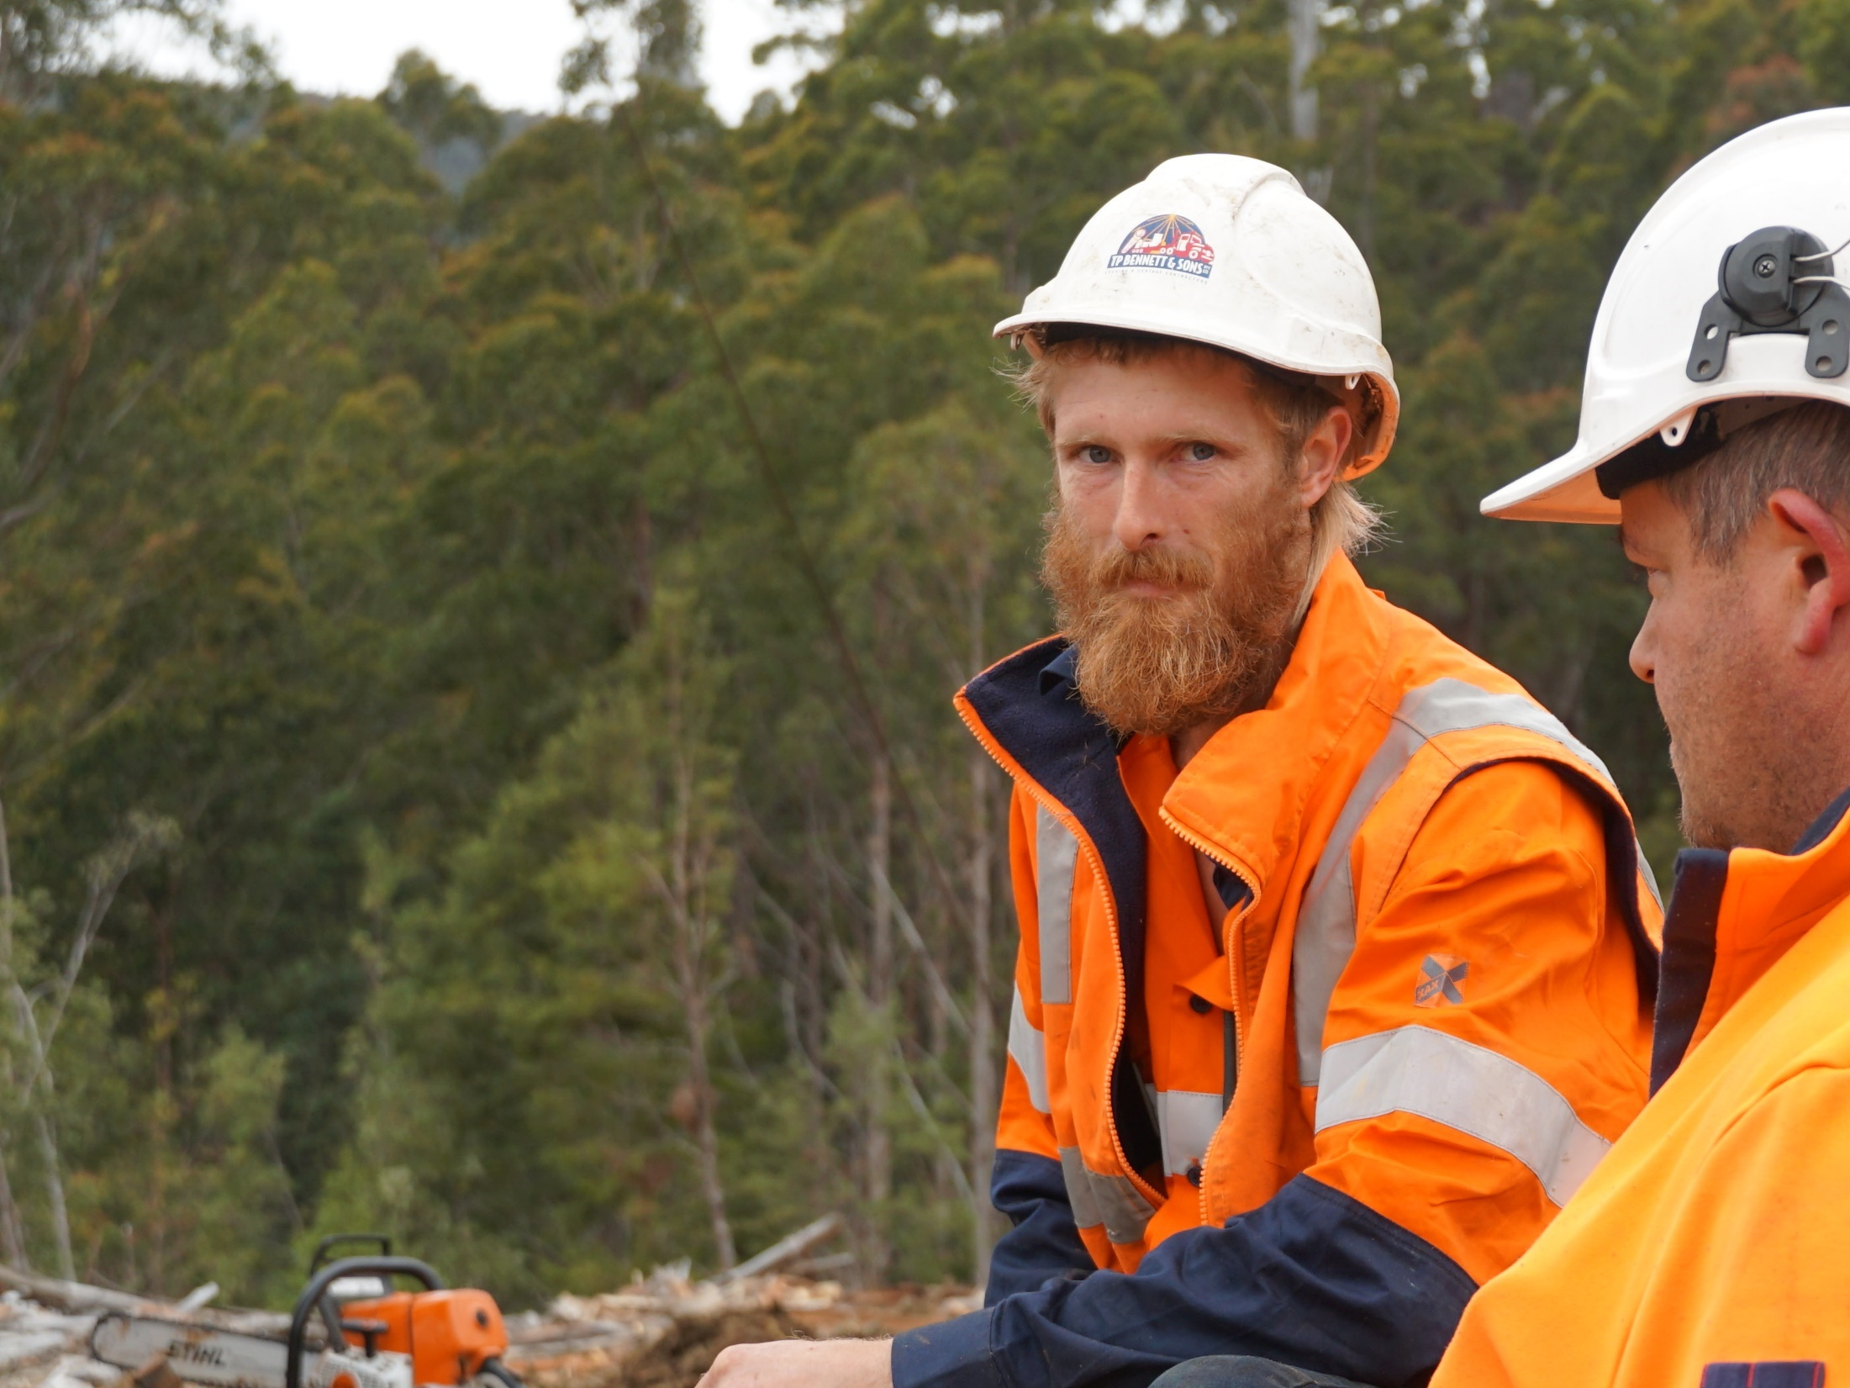
Forest safety
what you need to know
Notes:
This topic is aligned to the knowledge evidence component of the unit FWPCOR2205 Follow WHS policies and procedures.
It covers the key regulatory requirements that a worker needs to understand in order to work in Tasmania’s forests.

Slide 4
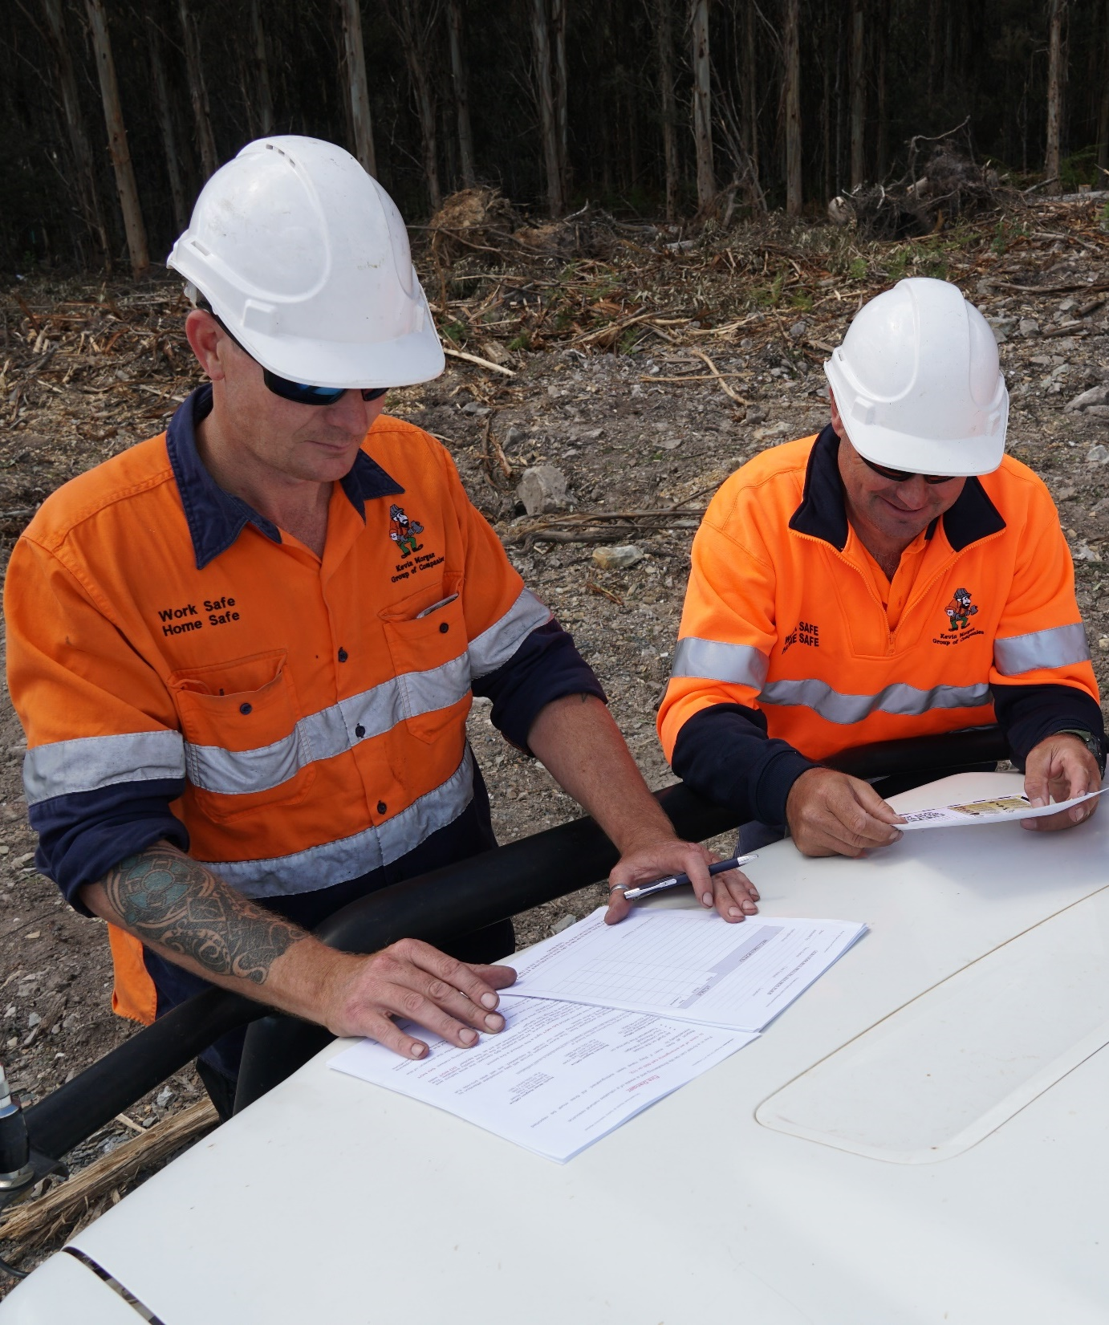
Building a positive safety culture
There is a high risk of injury in the forest industry, and this is due to:
the physical demands of the job
the use of heavy machinery
the unpredictable conditions.
One of the most effective ways to keep yourself safe is to follow safe work procedures.
Notes:
Introduce the concept of building a positive safety culture.
For example, by being part of a positive safety culture, you’ll get home safely at the end of each working day.

Slide 5
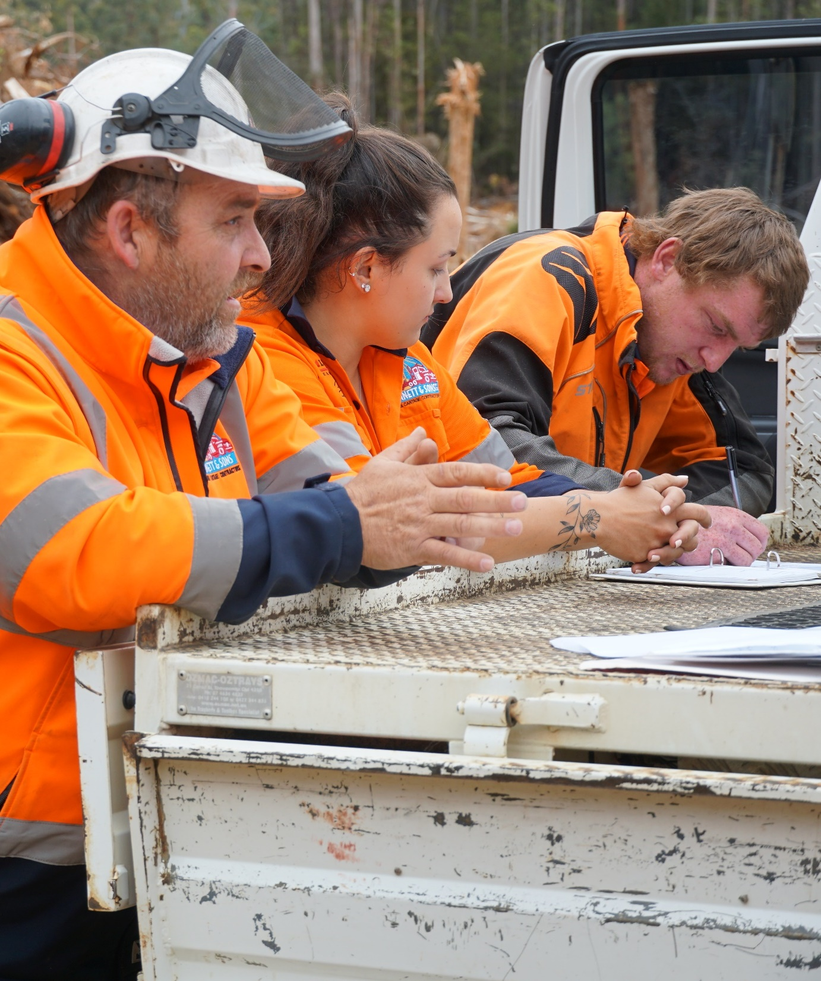
Forest safety in Tasmania
The legislation
The Code
The regulator
The PCBUs
The plan
The workers
Notes:
Forest workers need to understand how safety is regulated in Tasmania’s forests, and they also need to understand their role as a duty holder under the WHS Act.
However, they do not need to understand the legislation and code of practice in intricate detail.
Try not to commit too much time to this during the introductory session of a training program.
WHS regulation is complex, and there are only a few key features that forest workers need to be aware of.
Use the next six slides to introduce the following:
The legislation – Work Health and Safety Act 2012
The Code – Forest Safety Code (Tasmania)
The regulator – WorkSafe Tasmania
The PCBUs – Persons conducting a business or undertaking
The plans – Forest Operations Safety (FOS) Plans
The workers – the people attending this training session!

Slide 6
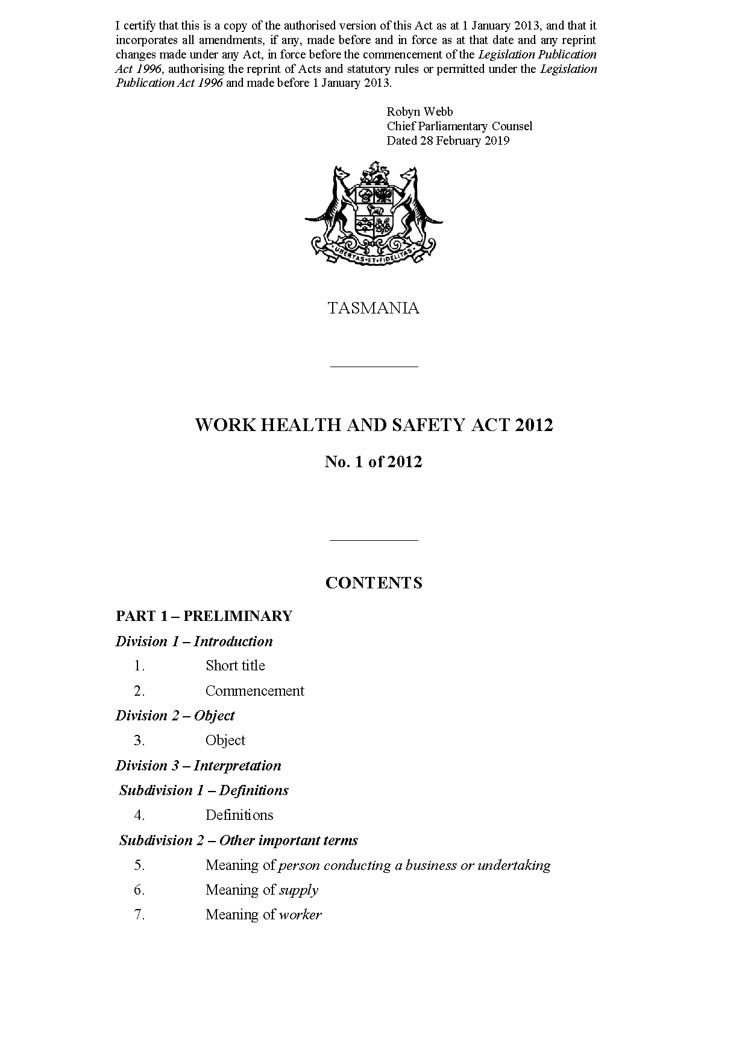
The legislation
Work Health and Safety Act 2012
Sets down the safety rules that all employers and workers have to follow in Tasmania.
Anyone who breaks these rules is breaking the law, and they can be prosecuted.
Notes:
What is the law around safety at a worksite?
Known as the WHS Act.

Slide 7
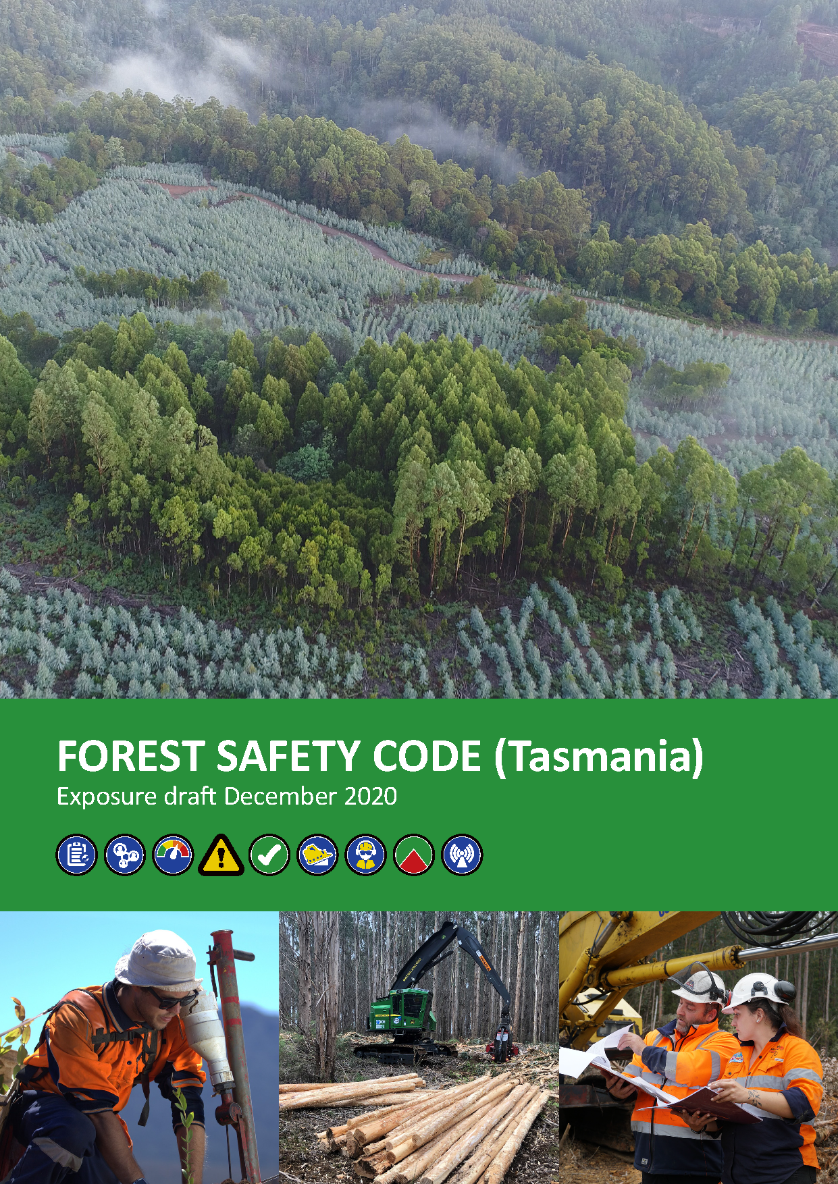
The Code
Forest Safety Code (Tasmania)
Applies under the WHS Act.
Provides practical advice on how to manage safety risks in Tasmania’s forest industry.
Administered by WorkSafe Tasmania.
Notes:
What is the law around safety at a worksite?
Known as the Code.
Key aspects of the Code (for forest workers):
Make sure you’ve been trained to do your job.
Make sure you’ve been inducted to the site.
Check the site-specific WHS procedures.
Check the FOS Plan.
Check your PPE.
Check your tools.
Check the evacuation procedure.
Keep an eye out for safety signs.
Report all accidents, incidents and near misses.
Activity: Forest Safety Code (Tasmania) 2020 Review Update
You may find that some forest workers will only be participating in training to get a quick update on the changes that have been made in the recent review of the Forest Safety Code (Tasmania).
While a precis of the major changes is warranted, try not to spend too much time on these revisions during a training session.
Whenever you discuss the Code during a training session, it must relate to the key outcomes of the unit FWPCOR2205 Follow WHS policies and procedures, which are as follows:
how to follow safe work practices at a forest worksite
how to identify risks at a forest worksite
how to respond to accidents and emergencies at a forest worksite.

Slide 8
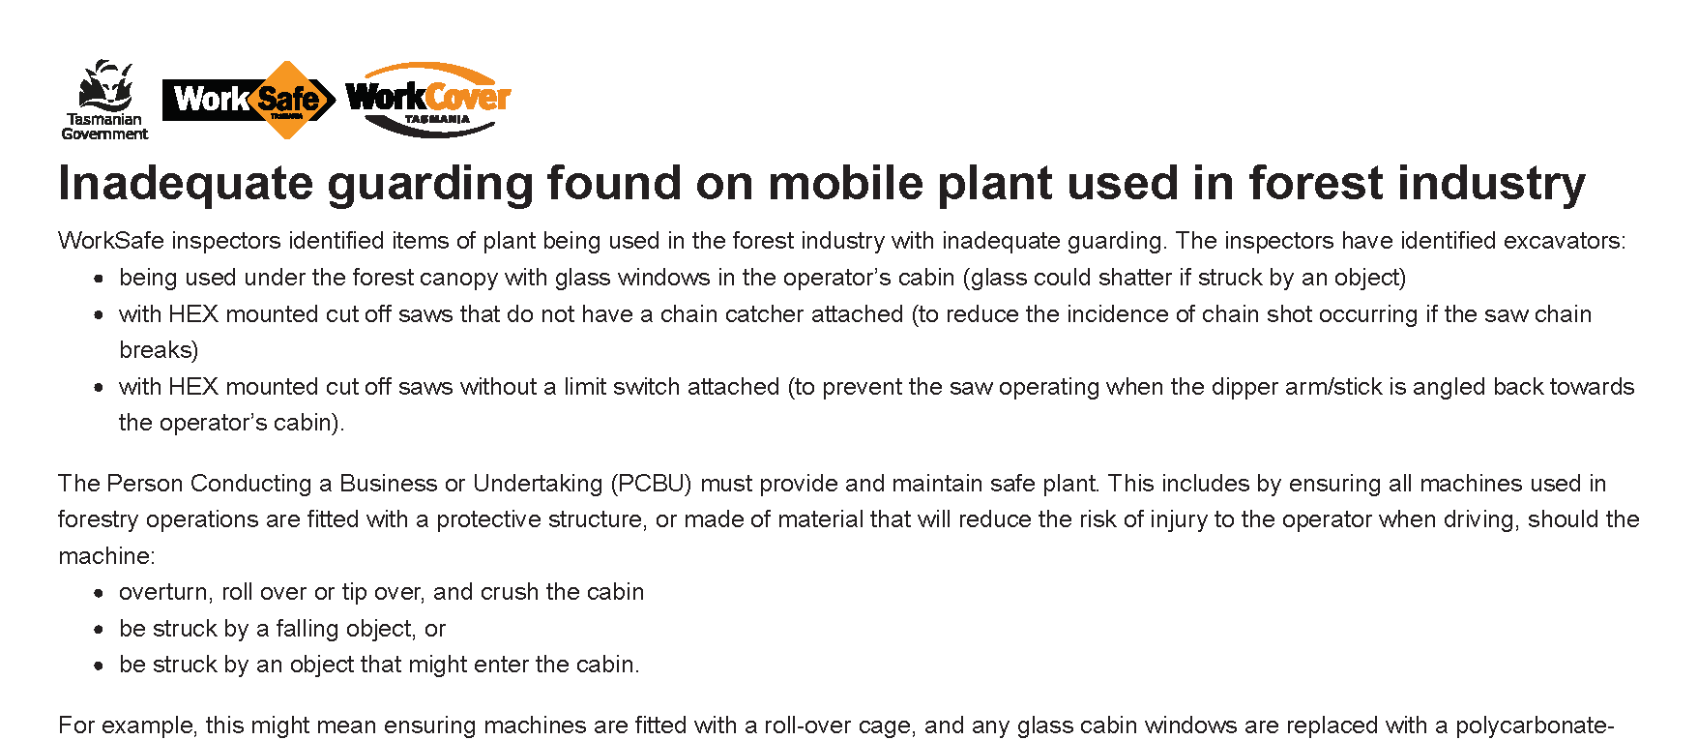
The regulator
WorkSafe Tasmania
Tasmania’s WHS regulator.
Audits workplaces to ensure they are complying with the WHS Act.
Investigates workplace incidents.
Notes:
What is Worksafe Tasmania and what does it do?
Government department.
Safety alert (example)
Inadequate guarding found on mobile plant used in forest industry
https://worksafe.tas.gov.au/topics/Health-and-Safety/safety-alerts/inadequate-guarding-found-on-mobile-plant-used-in-forest-industry

Slide 9
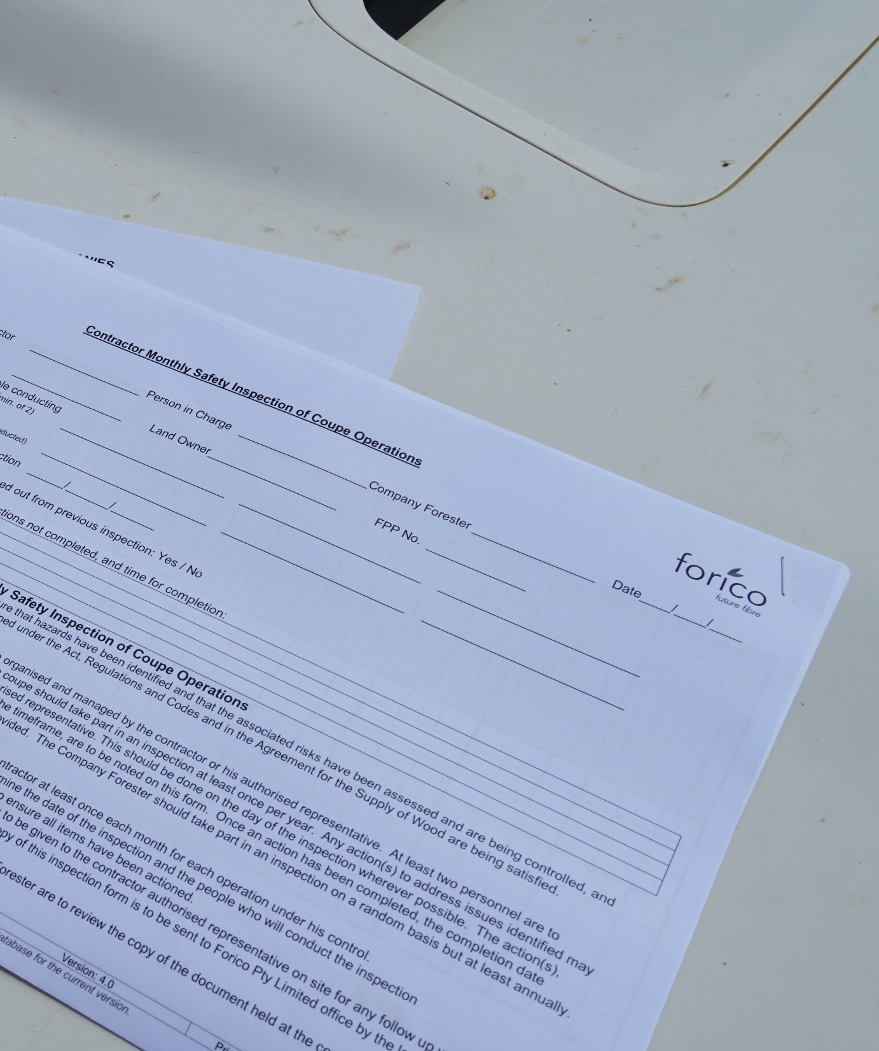
The PCBUs
Person conducting a business or undertaking (PCBU)
This is the term for an ‘employer’ under the WHS Act.
Forest managers, landowners and contractors are all PCBUs.
PCBUs have a duty to ensure workers are not exposed to health and safety risks.
Notes:
Who is responsible overall for safety on site?
PCBUs have the primary duty of care for the health and safety of people operating and visiting forest worksites.
You will need to clarify that a contractor is both a PCBU and a worker under the WHS Act.
They are a PCBU to the forest workers they employ
They are a worker to the forest manager or landowner they have a contract with.

Slide 10
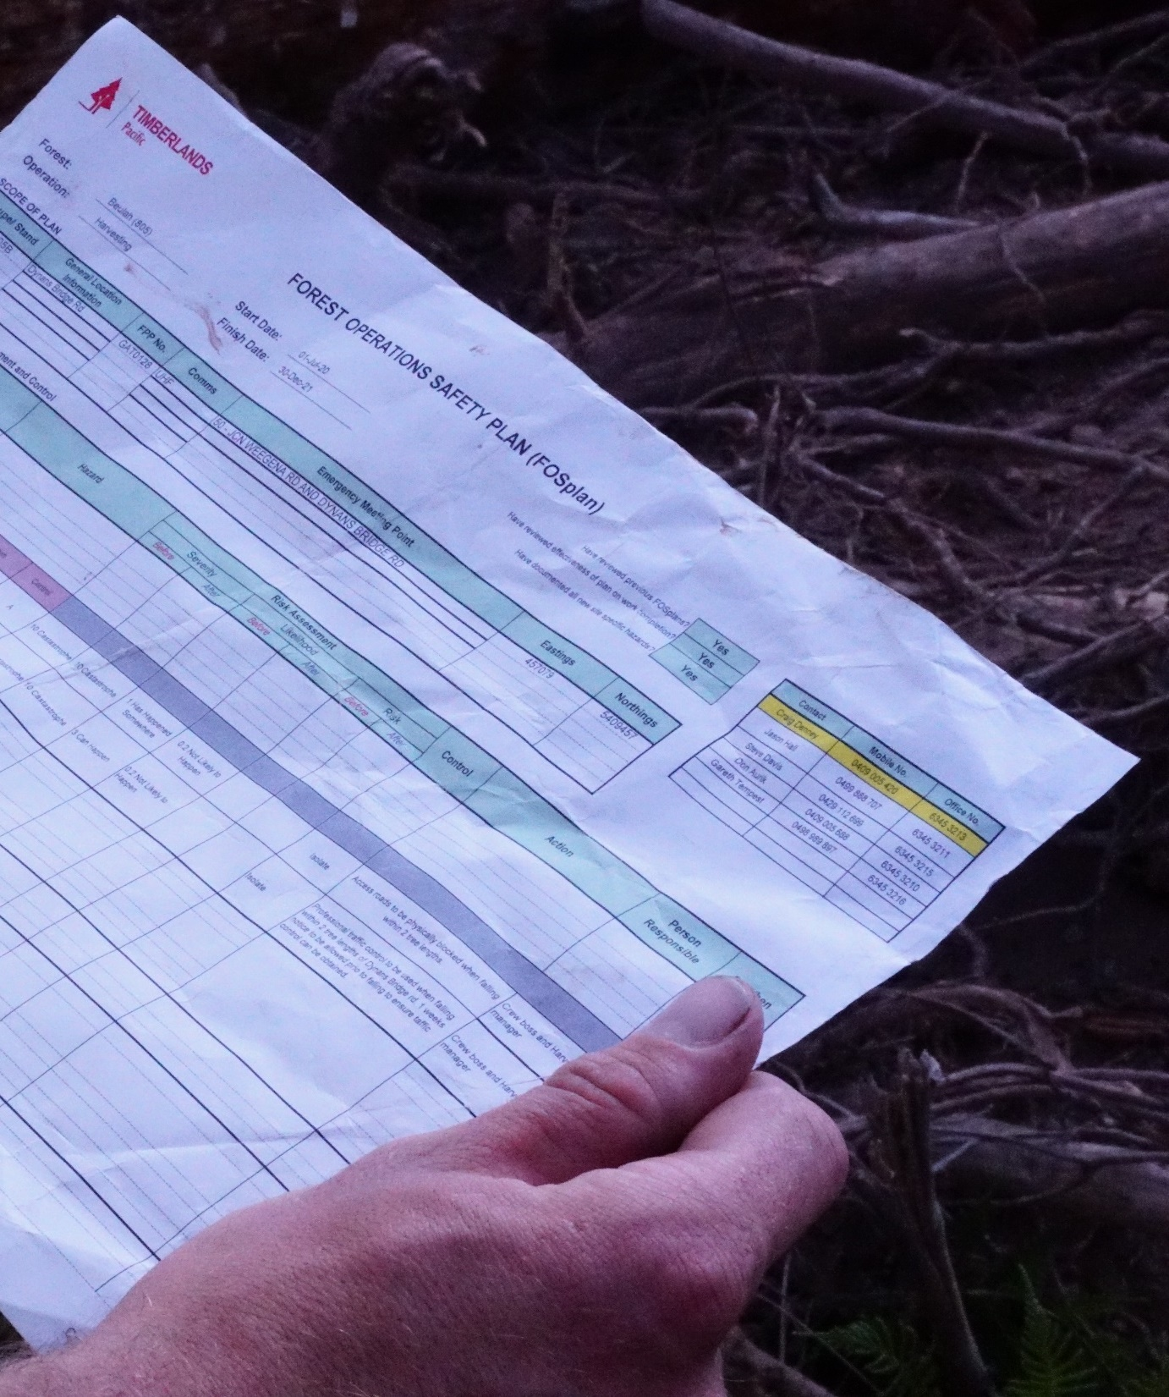
The plan
Forest Operations Safety (FOS) Plan
FOS Plans are required for all new forest operations.
They list the known and likely hazards at a worksite.
They also list the risk controls that will reduce the risk posed by the hazards.
Notes:
What is a FOS Plan?
FOS Plans list the known and likely hazards at a forest worksite, along with the controls that will eliminate or minimise the risks posed by the hazards.
Forest workers must be familiar with the FOS Plan.

Slide 11
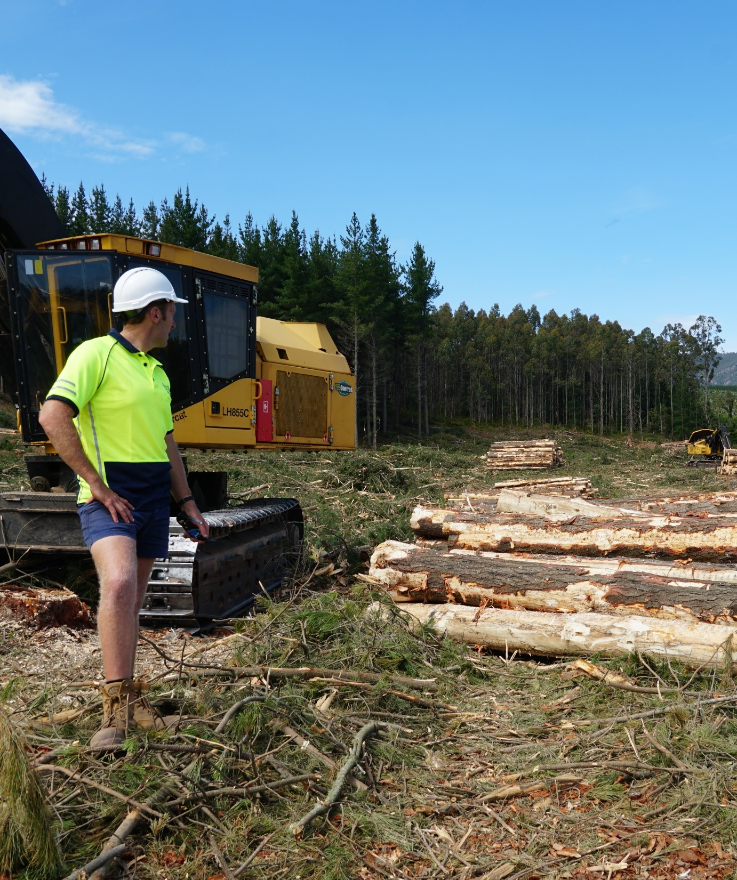
The workers
Forest workers
This is you!
You put FOS Plans into action.
You have a duty to take care of your own safety.
You have a duty not to create safety risks for others.
Notes:
How can my actions make a difference?
Forest workers carry out work for a PCBU.
Forest workers are responsible for improving and protecting their own health and safety.

Slide 12
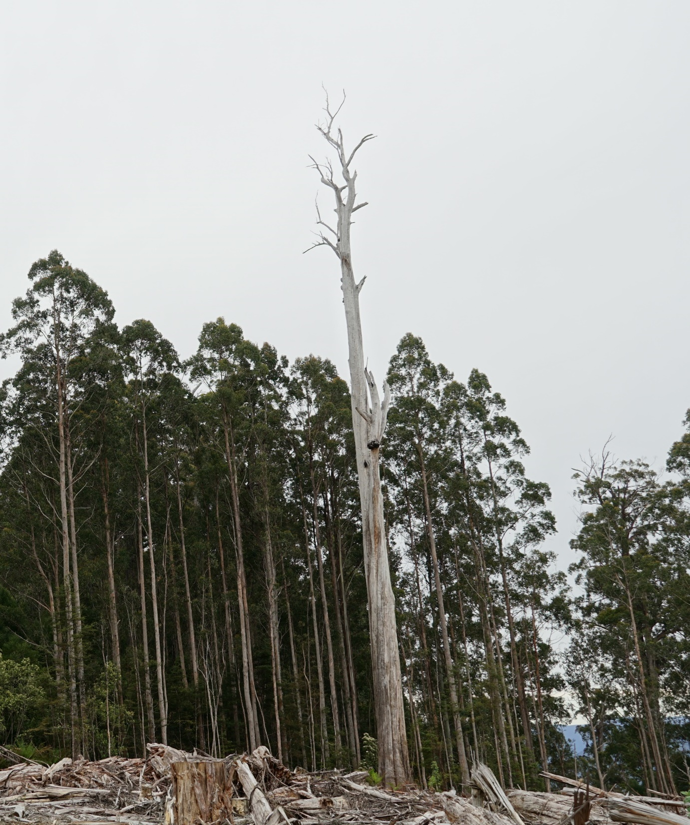
Safety jargon
Hazard
Risk
Risk control
Competent person
Version 1.4
Notes:
What is the difference between a hazard and a risk?
Hazard = Anything that has the potential to cause harm to people at a forest worksite.
Risk = The likelihood of a hazard causing harm to people at a forest worksite.
Risk control = An action taken to eliminate or minimise a risk
Competent person = A person who has sufficient knowledge and skills (acquired through training and experience) to carry out a specific task at a forest worksite.

Slide 13

Safe and Skilled
AFCA and AFPA have signed up to 12 life saving commitments to guide behaviour in Australia’s forest industry.
The commitments must become part of your daily routines.
Poster: Australian Forest Contractors Association (AFCA)
Notes:
The Australian Forest Contractors Association (AFCA) and Australian Forest Products Association (AFPA) have signed up to 12 life saving commitments to guide behaviour in Australia’s forest industry.
By following the commitments, forest workers will get home to their families at the end of each working day.
The commitments are important, and they must become part of a forest worker’s daily routines.

Slide 14
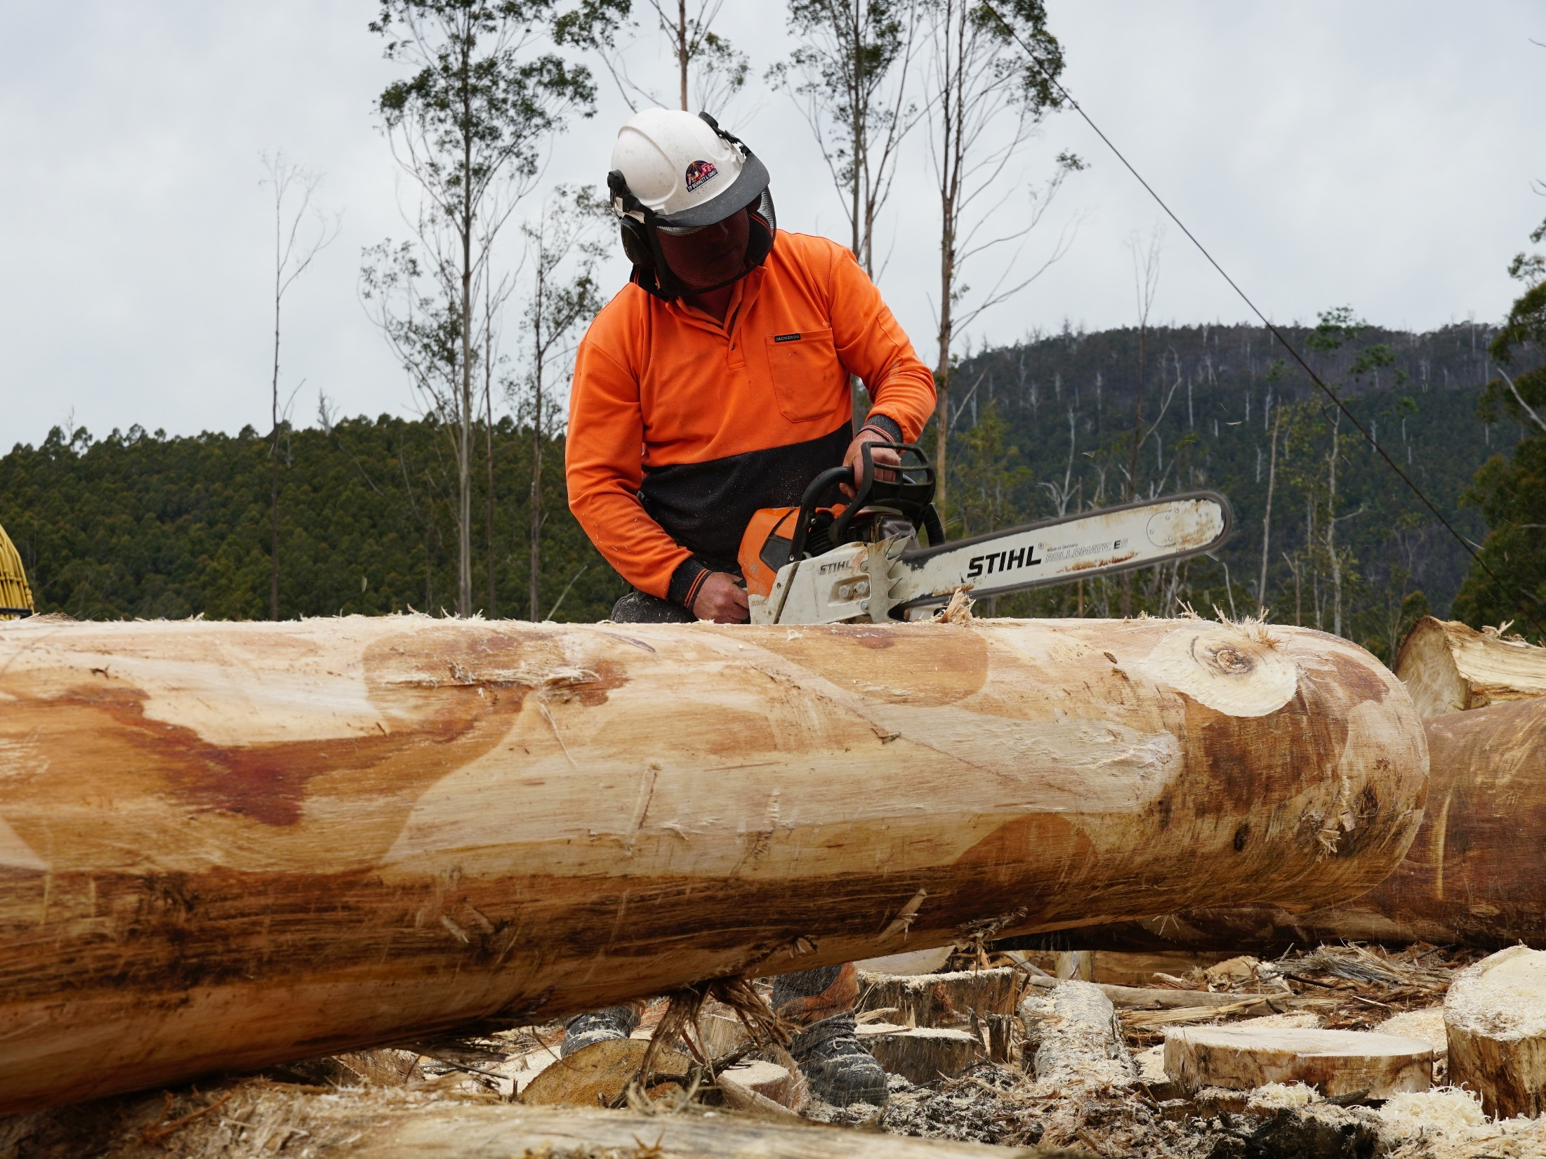
Follow
safe work practices
Notes:
This topic is aligned to Element 1: Follow safe work practices.
It also covers some foundation skills and knowledge/performance evidence components.
Forest workers have an important role to play in building a positive safety culture.
Before they start work, they need to ask themselves the following questions:
Have I been trained to do my job?
Have I been inducted to the worksite?
Have I checked the FOS Plan?
Have I checked if any additional work health and safety procedures apply at the site?

Slide 15
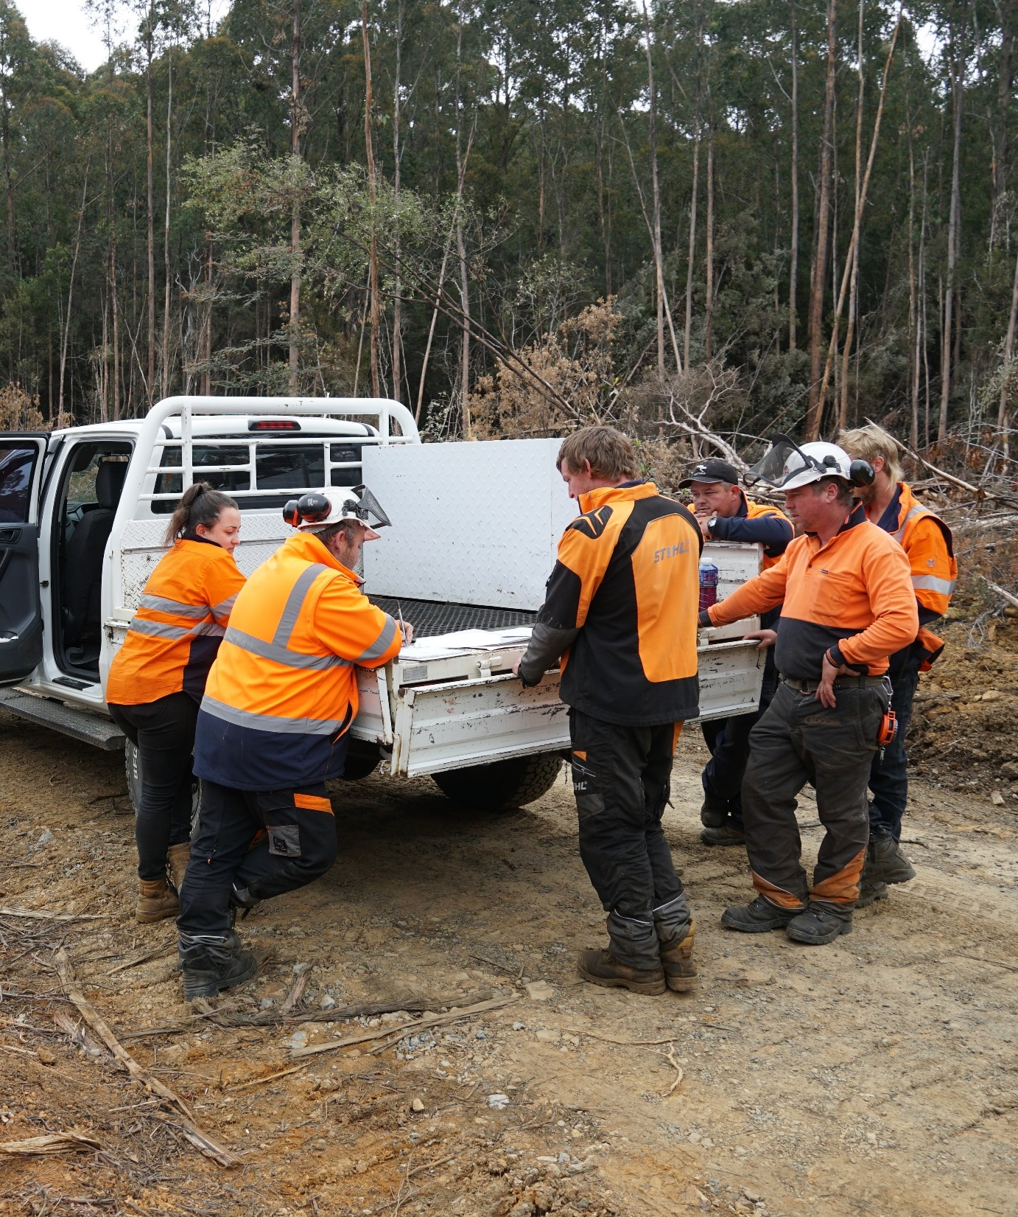
Check your skills
Before you start work
Make sure you’ve been trained to do your job.
If you haven’t been trained, you shouldn’t be working (unless you’re currently being trained and under direct supervision).
Notes:
Forest workers must have been trained to do their job.
For example, if they are using a chainsaw or operating a forwarder, they must have completed a relevant course to ensure you’re competent.
If they haven’t been trained, they shouldn’t be working (unless they’re currently being trained and under direct supervision).

Slide 16
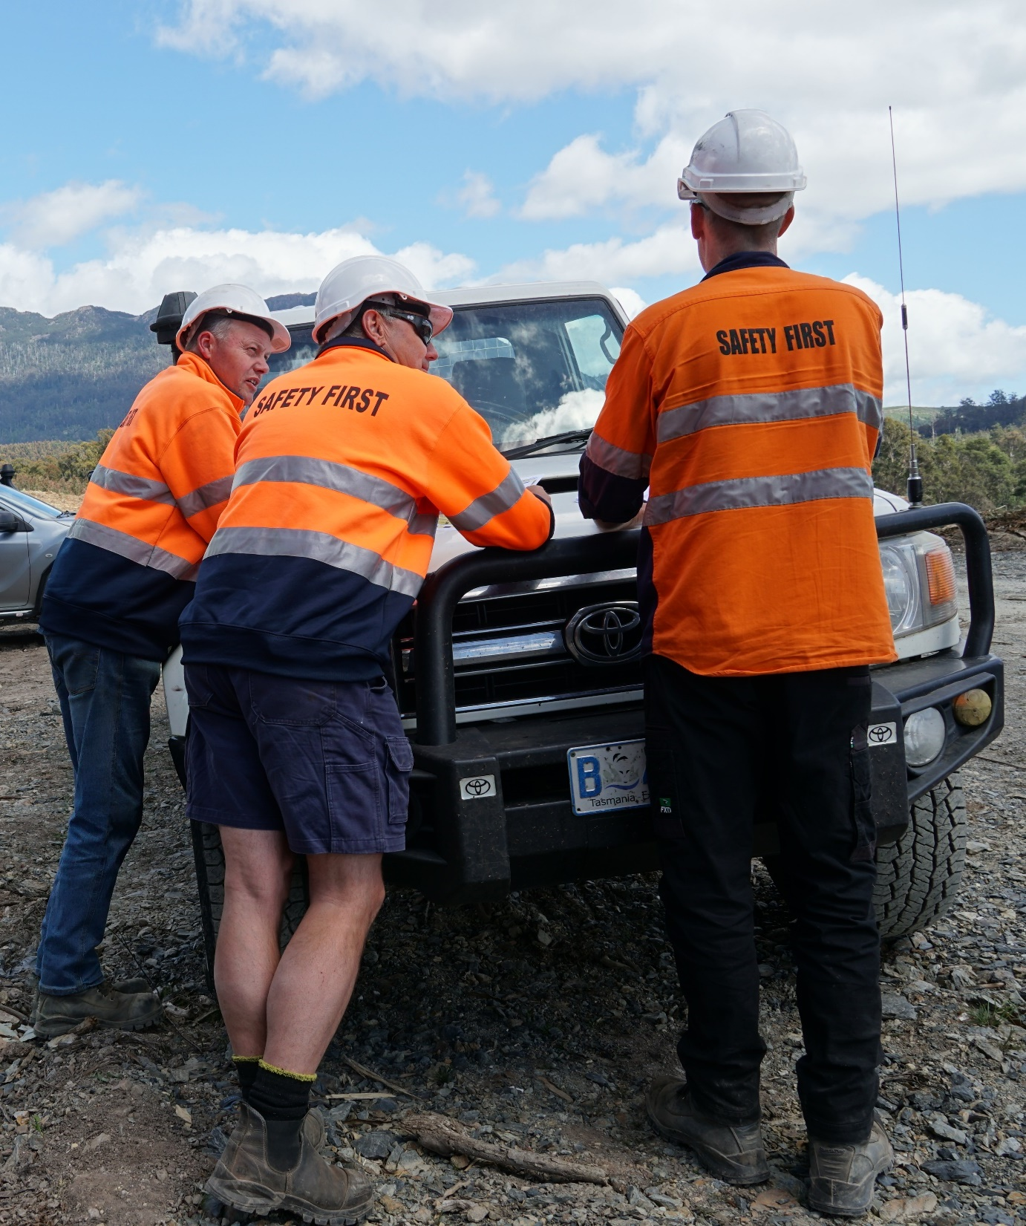
Check the FOS Plan
Before you start work
Check the FOS Plan with your supervisor.
Clarify the hazards at the site, and what you can do to reduce the risks posed by the hazards.
Check if any additional WHS procedures apply at the site.
Notes:
Forest workers must check the FOS Plan with their supervisor at start-up.
If they haven’t had a good briefing on the FOS Plan, they will need to speak up and ask for one.
They will also need to check if there are any additional WHS procedures apply at the site.
For example, they may be working at a site where the forest manager and contractor have site-specific WHS procedures that are additional to those identified in the FOS Plan.
Emphasise the important role that forest workers have to play in building a positive safety culture in Tasmania’s forests.

Slide 17
Check the SWPs
Before you start work
Check the safe work procedures that apply at the site, and follow these at all times.
For example:
  Stay within your designated area or any confirmed safe work areas.
  Only enter an exclusion zone if you are called in by the ‘zone owner’.
Notes:
During the induction, the site supervisor will explain the safe work procedures (SWPs) that apply at the worksite.
Forest workers must follow these at all times.
For example, forest workers must stay in their designated area (this is a critical safe work procedure).
The best way to reduce the risk of serious injury at a forest worksite is to separate everyone into safe work areas and exclusion zones.
A safe work area is a designated area outside another operator’s exclusion zone.
An exclusion zone is a designated area in which others, apart from the operator, are excluded.
The person working in an exclusion zone is known as the ‘zone owner’.
The site supervisor will explain these areas during the site induction and toolbox meetings.
Forest workers must stay in their designated area during operations, and the only way they can enter an exclusion zone is if they are called in by the zone owner.

Slide 18
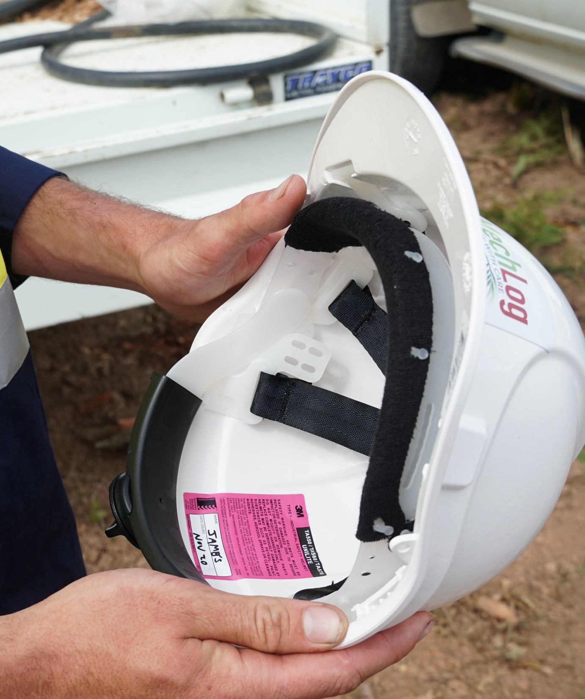
Check your PPE
Before you start work
Check your PPE.
If it is damaged or out-of-date:
  don’t wear it
  let your supervisor know.
Notes:
Forest workers will be provided with the following personal protective equipment (PPE) by their PCBU, and they should always wear this on-site:
eye protection
hearing protection
high visibility clothing
leg protection (for chainsaw use)
respiratory protection (for chemical handling)
safety footwear
safety gloves
safety helmet.
The site supervisor will show forest workers how to use, store and maintain their PPE.
They must wear the PPE they are given, and they must look after it.
They should always check their PPE before starting work.
If it is damaged, defective or uncomfortable:
they must not wear it
they must let their supervisor know immediately.

Slide 19
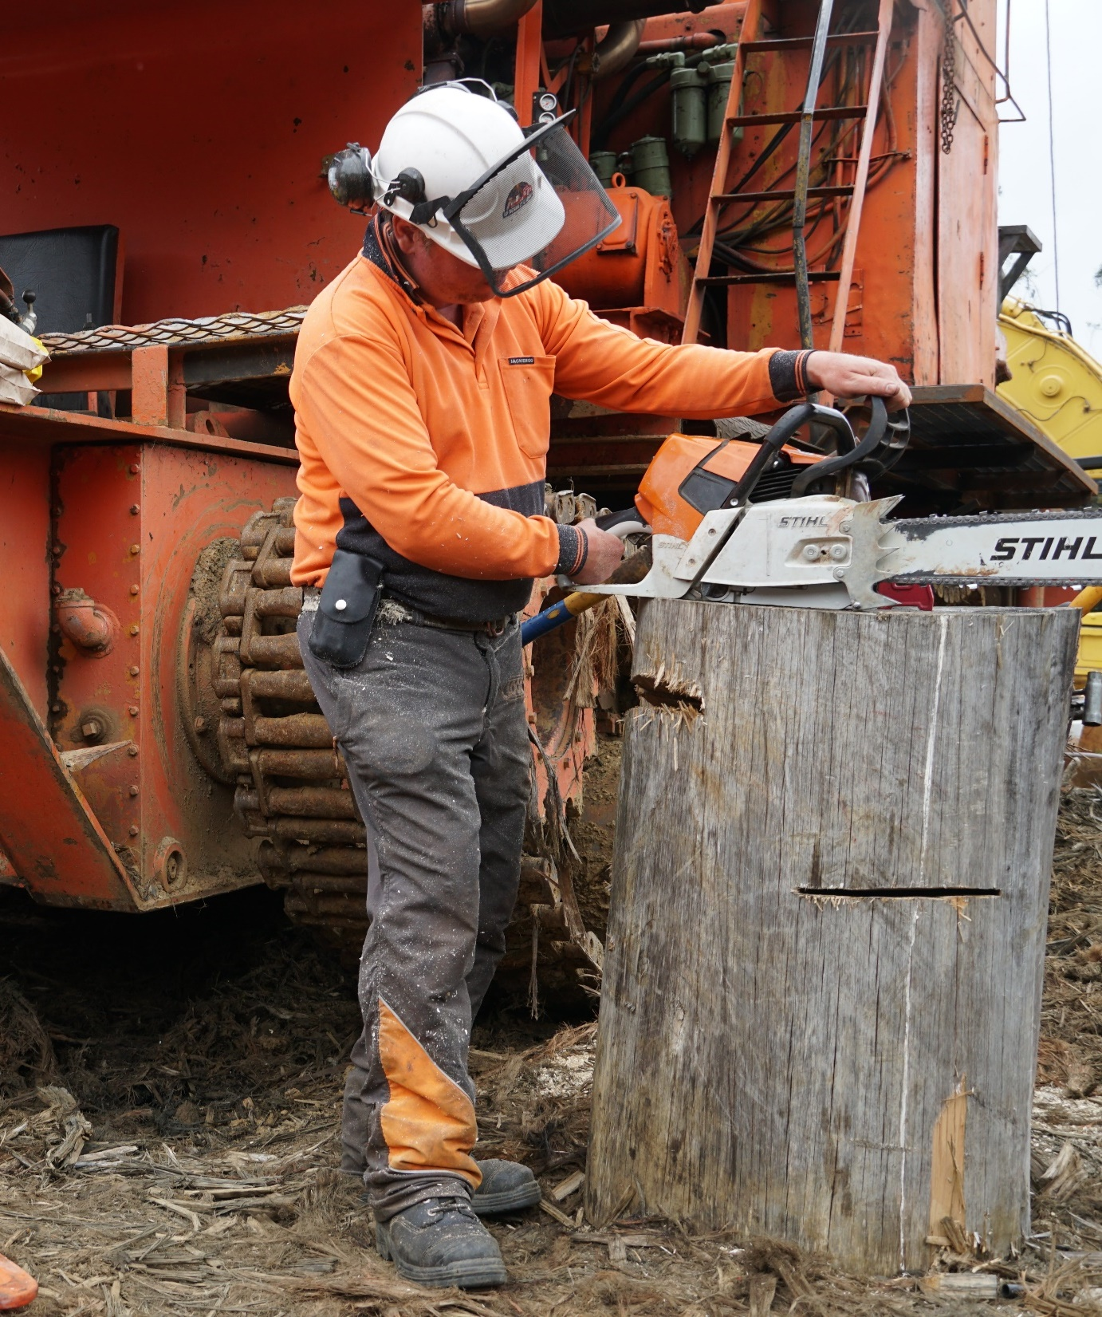
Check your tools
Before you start work
Check your tools, equipment and machinery.
If you find any faults:
  stop using them
  let your supervisor know.
Notes:
Forest workers must check their tools and equipment before they start work (to ensure they are in a safe working condition).
If they find any faults, or if they think the tools may be unsafe, they must:
not use the tools
let their supervisor know immediately.
Check the specifications
Forest workers must check the manufacturer’s specifications before they use any new tools, equipment or machinery, and they must always read the section on safety.
If the machine they’re operating is fitted with a seatbelt, they must wear it!

Slide 20
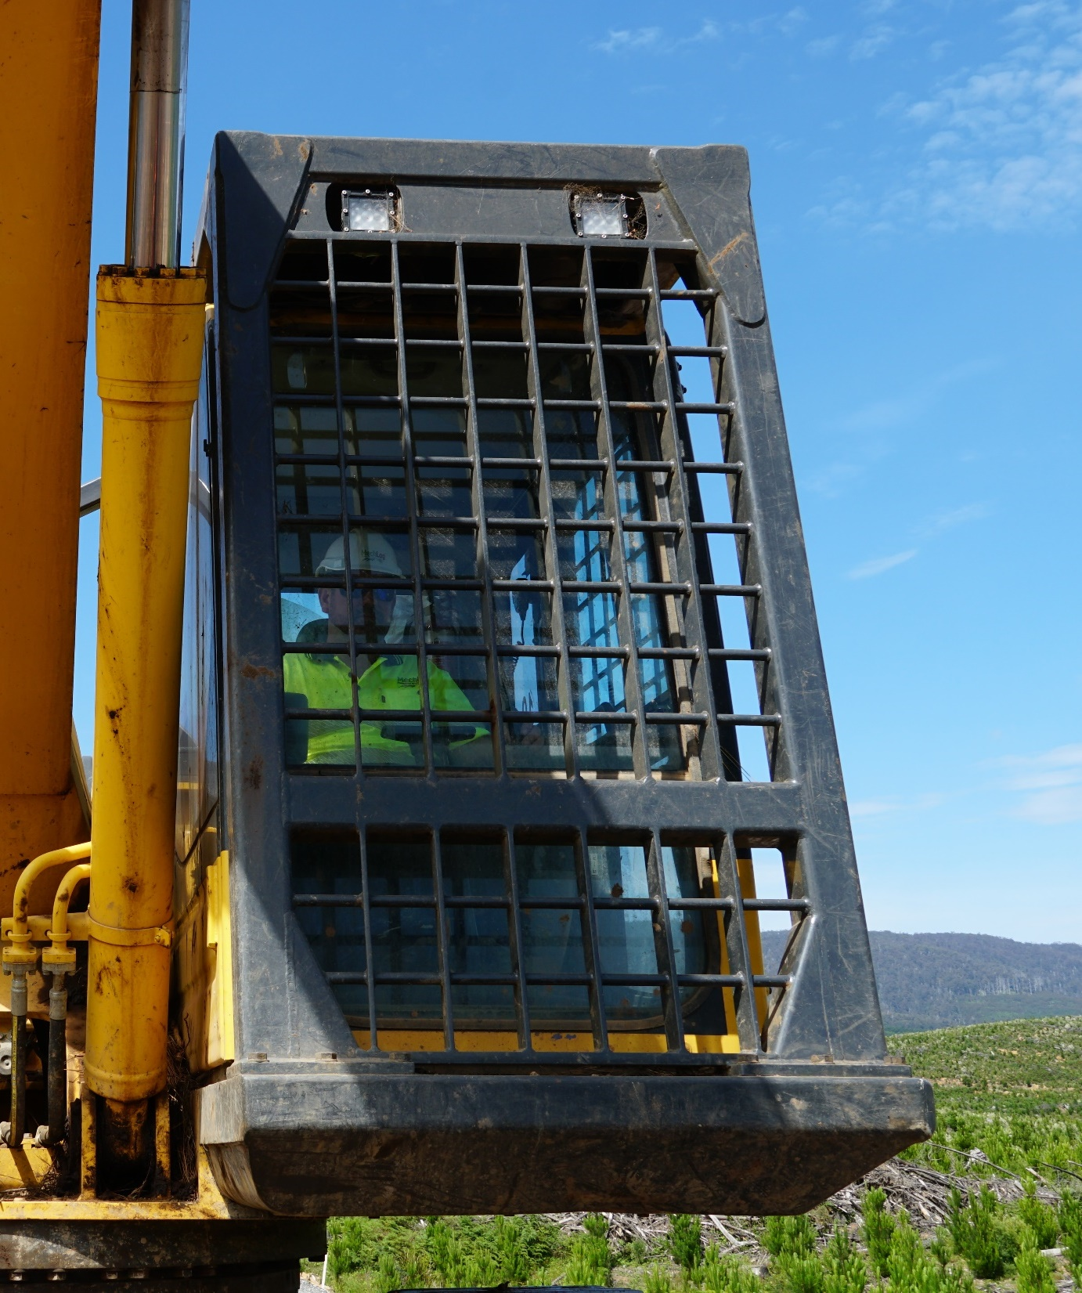
Use equipment guards
Equipment with hot or moving parts can cause serious injuries to forest workers.
To minimise this risk, equipment must be fitted with guarding.
Equipment guards should only be removed for maintenance and cleaning purposes.
Notes:
Any equipment with hot or moving parts can cause serious injuries to forest workers.
To minimise this risk, the equipment must be fitted with guarding.
For example:
Chainsaws must be fitted with hand guards, chain breaks and chain catchers to protect workers from chain shot.
Exhaust systems must be fitted with heat shields to protect workers from burns.
Machinery used for felling and de-limbing trees must be fitted with protective structures such as FOPS, OPS and ROPS to protect workers from falling objects, flying objects and rollovers.
Forest workers must be able to use equipment guards safely, so they should always read the manufacturer’s specifications before they start-up a chainsaw or machinery.
The only time forest workers should ever remove guarding is for maintenance or cleaning purposes.

Slide 21
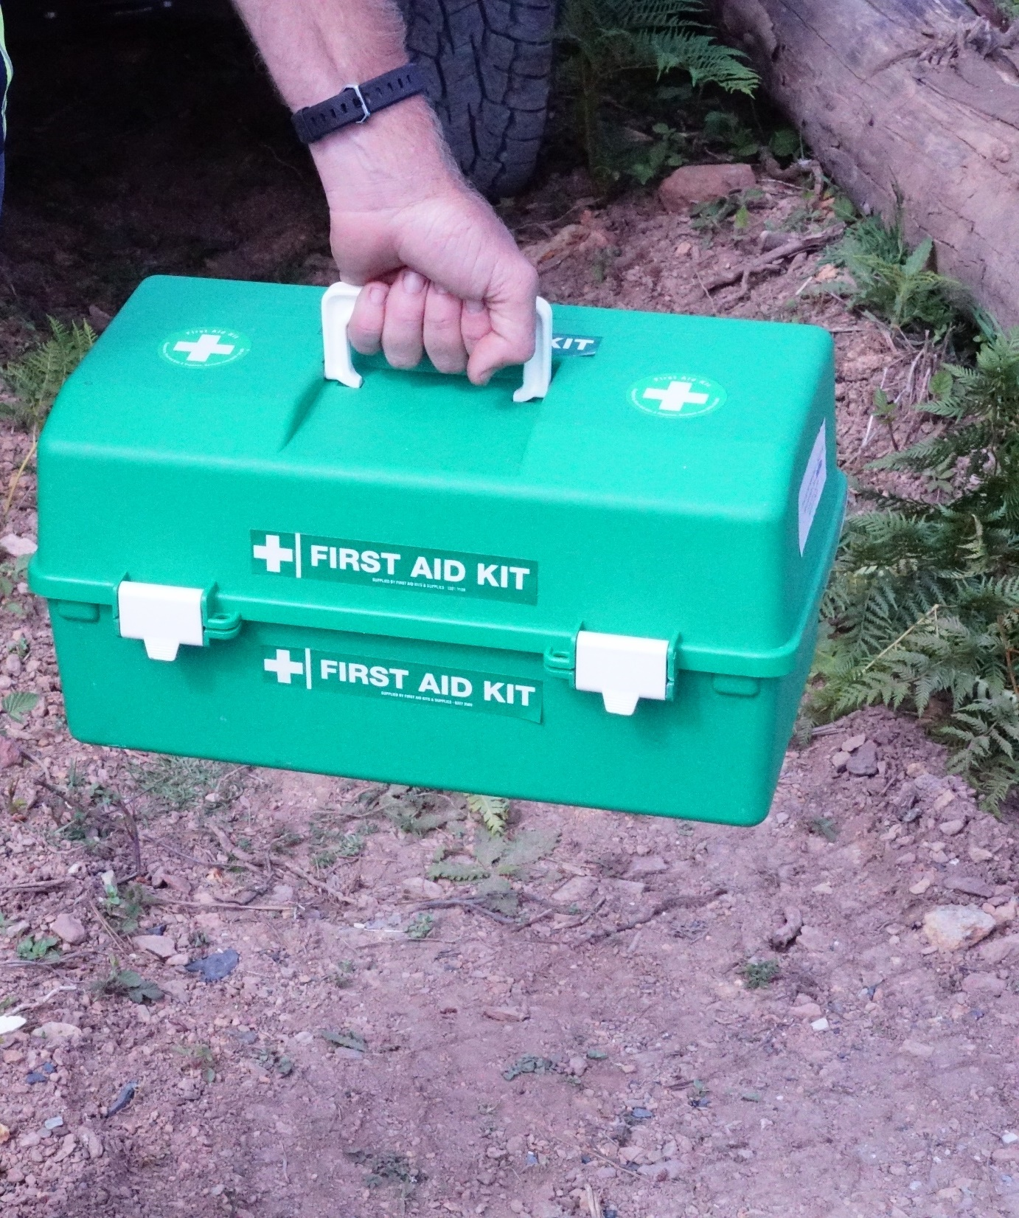
Check the first aid kit
A compliant and in-date first aid kit must be on-site at all times, and it must be easily accessible.
At least one trained first aider must also be on-site.
Common injuries include:
  cuts, scratches and splinters
  bites and stings
  sprains and strains
  burns (including sunburn).
Notes:
A compliant and in-date first aid kit must be on-site at all times during forest operations, and it must be easily accessible.
A trained first aider must also be on-site.
The site supervisor will let forest workers know where the first aid kit is located, and which members of the crew are trained to administer first aid.
Forest workers do not have to be trained first aiders, but they do need some basic first aid knowledge.
The most common injuries at forest worksites are:
cuts, scratches and splinters
bites and stings
sprains and strains
eye injuries
burns (including sunburn)
fractures.

Slide 22
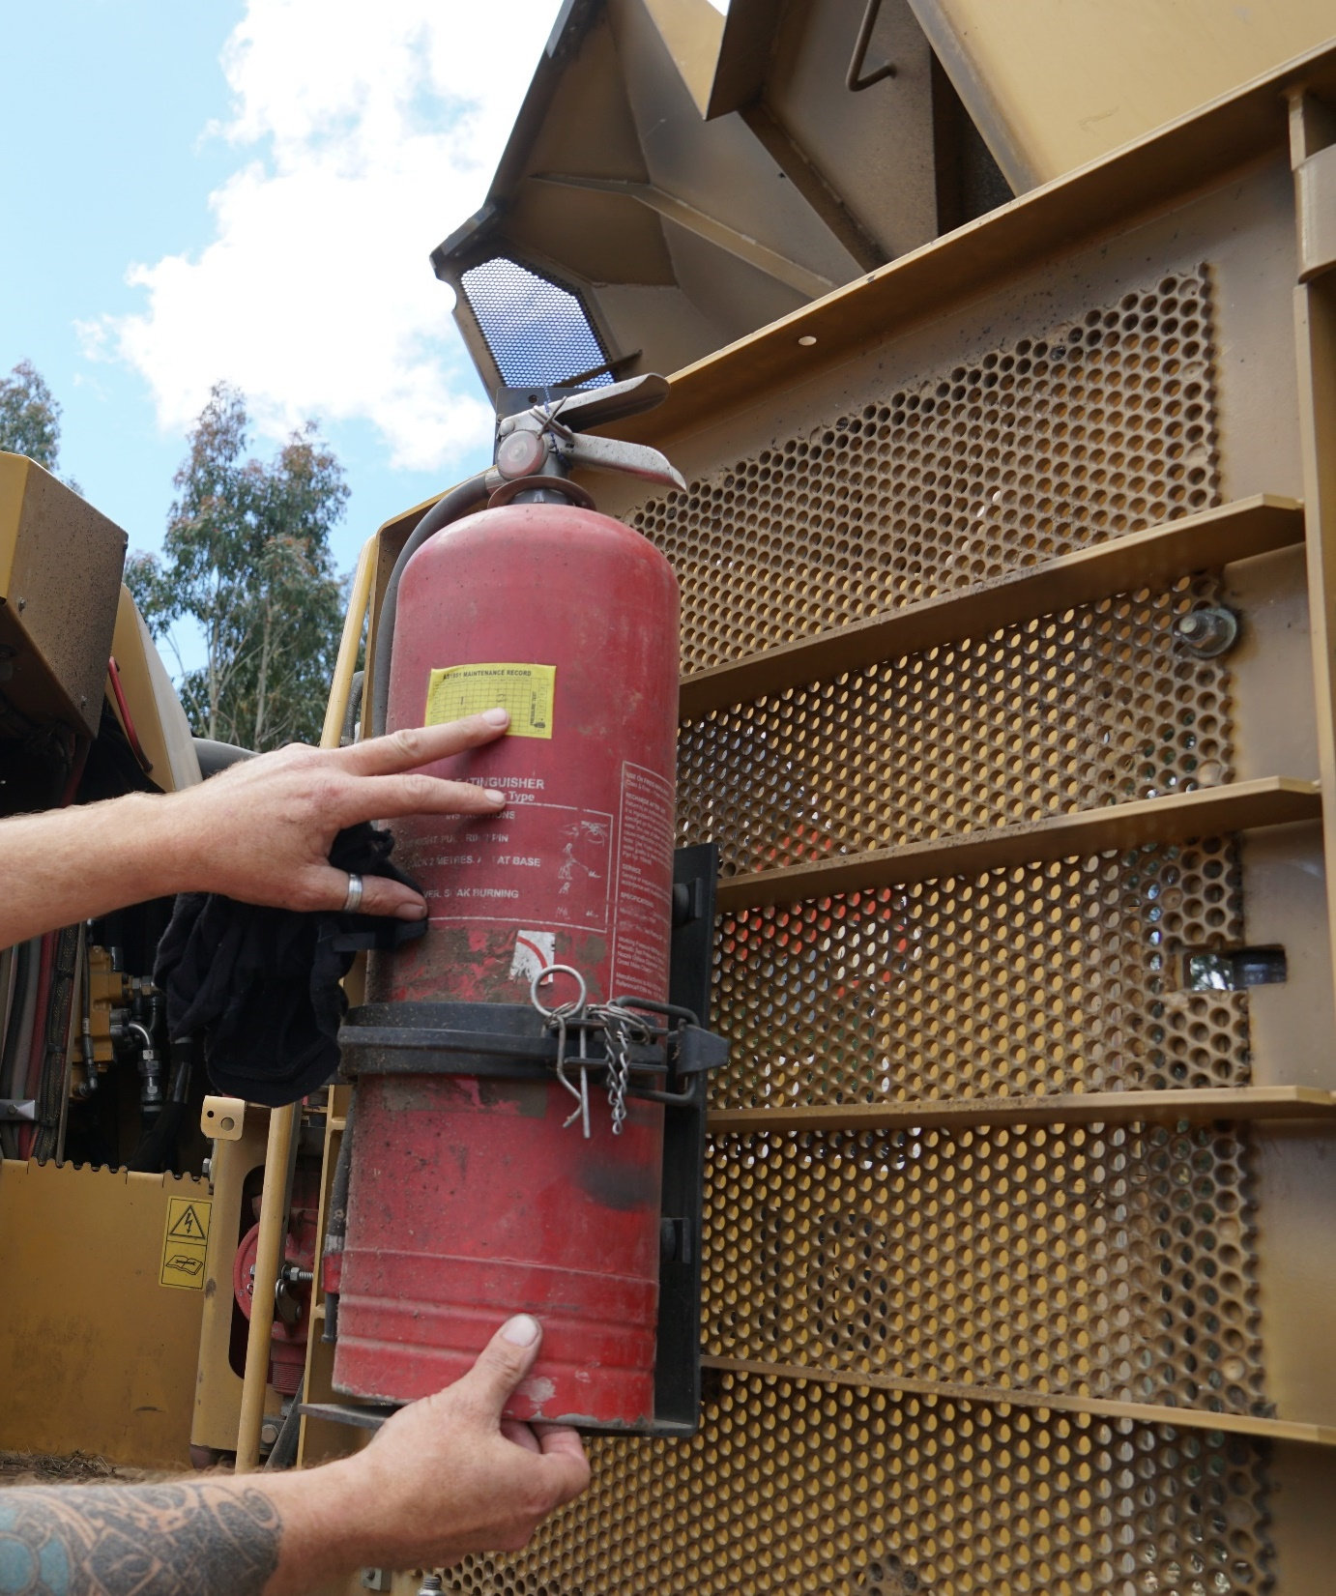
Check the firefighting equipment
1 knapsack pump or air-water extinguisher (9 litres) must be located at each landing site, or on each machine where there is no landing site.
This must be fully assembled and ready for use at all times.
Additional equipment is required during fire season (Oct to Apr).
Notes:
The following firefighting equipment must be fully assembled and ready for use during any high risk hazard forest activity in Tasmania.
All year requirements
1 knapsack pump or air-water extinguisher (9 litres) at each landing site or on each machine where there is no landing site
Fire season requirements (1 October to 30 April)
1 knapsack pump or air-water extinguisher (9 litres) for each chainsaw in use
1 transportable tank full of water (300 litres)
1 self-priming centrifugal pump (400 kPa)
2 rakehoes
60 metres of 19mm+ nominal bore delivery hose and a variable jet nozzle with couplings or adapters to suit TFS and STT equipment.
The site supervisor must show forest workers how to maintain this equipment so that it is ready for use at all times.
Additional firefighting equipment is required at cable harvesting operations.
Refer: Tasmanian Forest Industry Fire Management Council (FIFMC), Fire Prevention at Forest Operations, Version 16 (September 2020)
http://www.sfmc.tas.gov.au/document/fire-prevention-forest-operations-procedure-and-preparedness-audit-form-2020

Slide 23
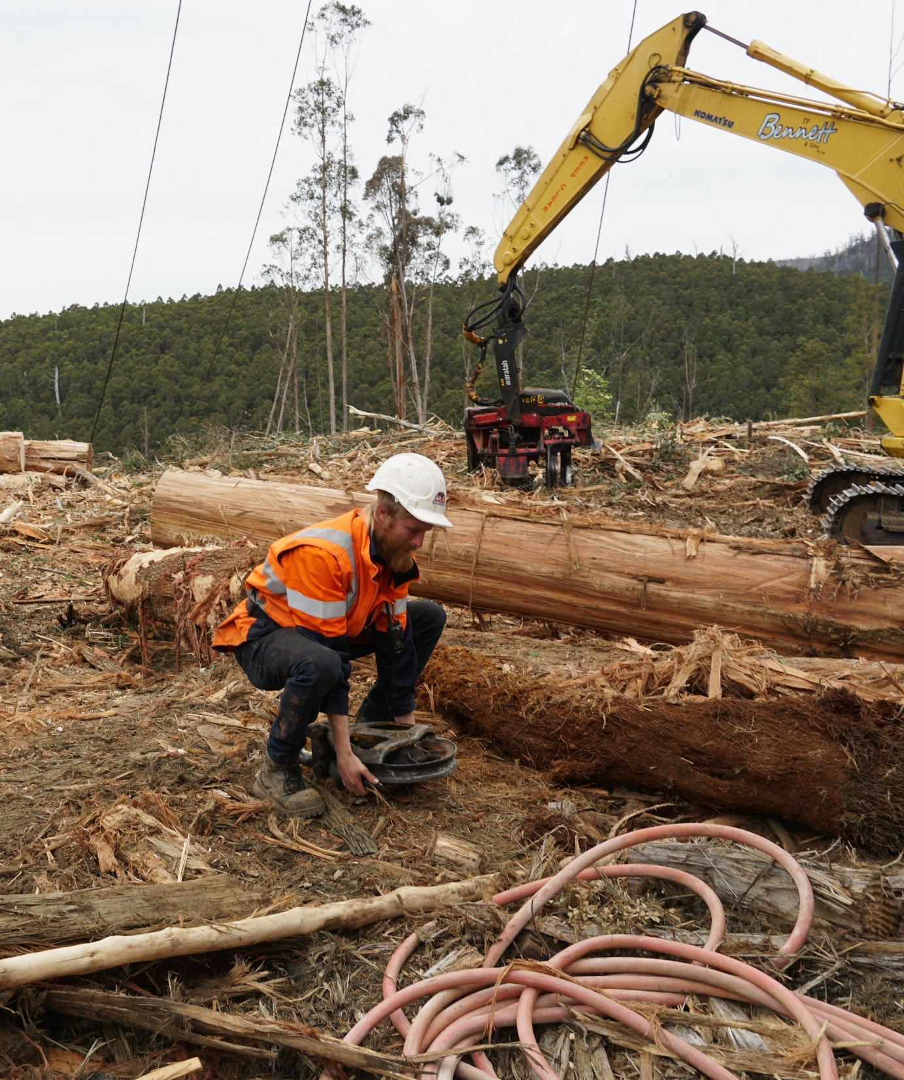
Lift things safely
Musculoskeletal disorders are the most common work-related condition in Australia.
They are caused by hazardous manual tasks such as lifting, lowering, carrying, holding and restraining loads.
If you have to lift something at a forest worksite, use the semi-squat approach.
Notes:
Musculoskeletal disorders are the most common work-related condition in Australia, and they are caused by hazardous manual tasks such as lifting, lowering, carrying, holding and restraining loads.
If forest workers have to lift something at a forest worksite, encourage them to use the following semi-squat approach:
Stand close to the load with your feet apart.
Lean forward and position your shoulders over the centre of gravity of the load.
Bend your hips and knees to a squat position.
Test the weight of the load by lifting one side – if it’s too heavy, stop and get help.
Keep the load close to your body, with your back, abdomen, shoulders and elbows braced.
Keep your head and chest up.
Straighten up by extending your hips and knees (lifting with your thigh muscles).
Avoid twisting when you are carrying the load.
Refer: WorkSafe Tasmania, The Semi-Squat Approach to Lifting
https://worksafe.tas.gov.au/topics/Health-and-Safety/safety-forms-and-guides/safety-publications

Slide 24
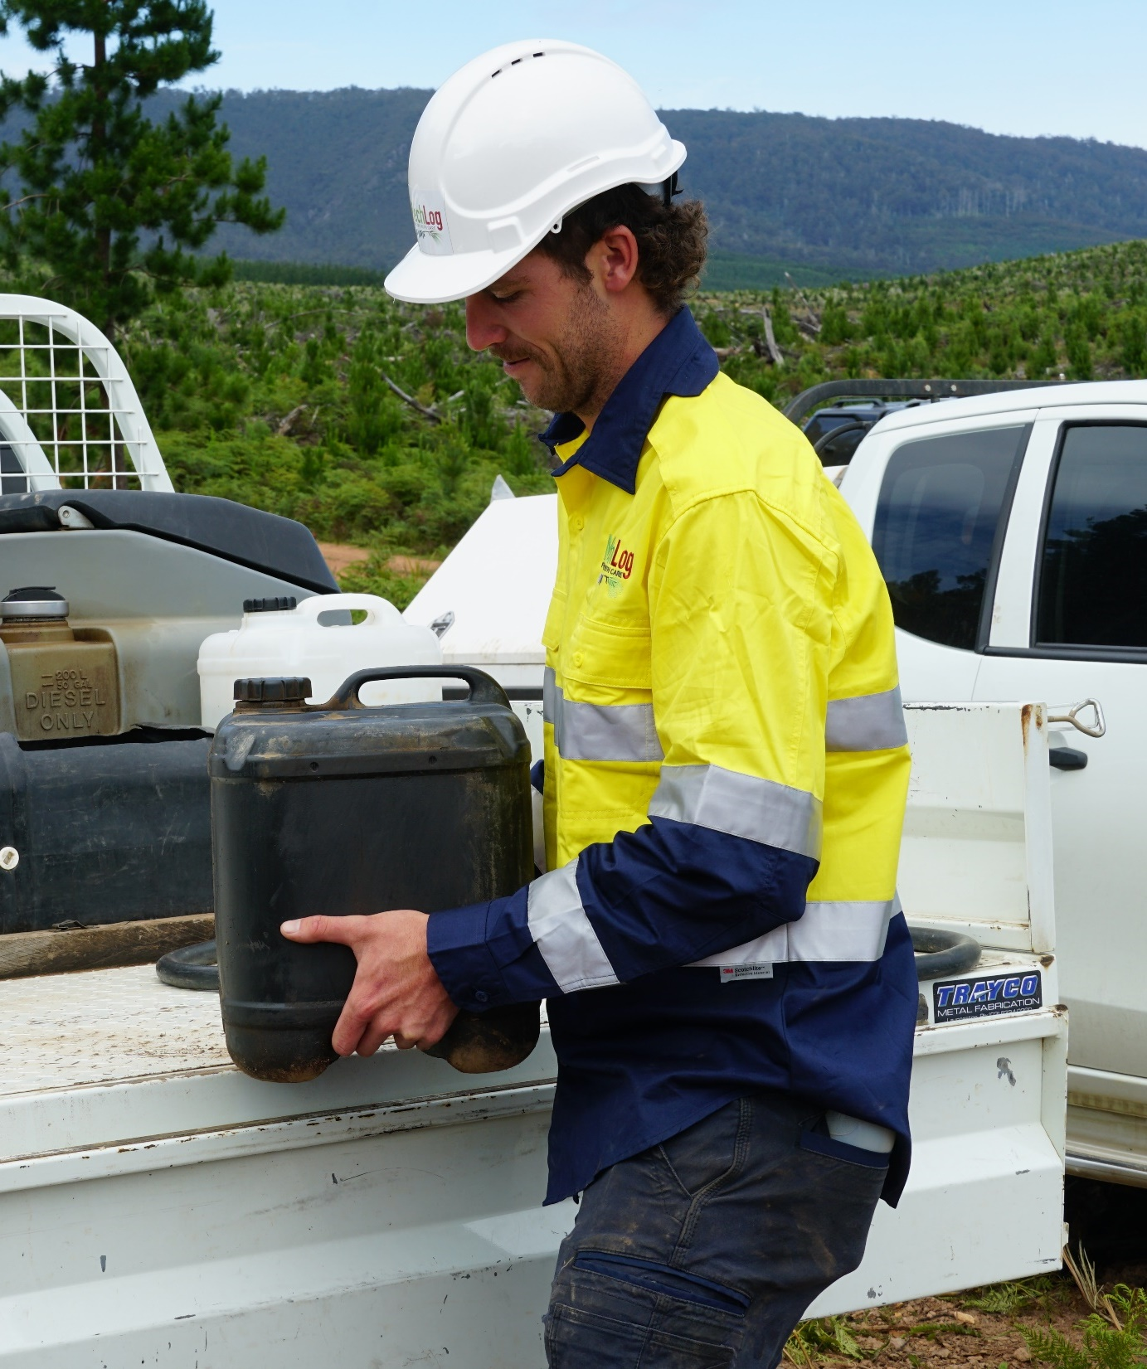
Estimate weight
Before you lift anything on-site…
…estimate the weight of the load by comparing it to the weight of a familiar object .
For example, a forestry chainsaw weighs around 6 kg.
If you think the load is about the same as a chainsaw, you should be able to lift it without needing a mechanical aid.
Notes:
Shift, lift and carry things safely
Estimating weight
Before lifting a load on-site, forest workers should always try to estimate its weight.
They can do this by comparing the load to the weight of a familiar object.
For example, a forestry chainsaw weighs around 6 kg.
If a forest worker is about to lift a log offcut and they think it’s equivalent to three chainsaws (18 kg), they should consider using a mechanical aid or getting help.
Estimating volume
Before shifting a container on-site, it’s a good idea for forest workers to estimate its volume.
There’s a standard formula for this (height x width x depth), and it’s measured in cubic metres (m3).
For example, if an on-site recycling bin is 1m high, 0.55 m wide and 0.65 m deep, it will have a volume of 0.36 cubic metres.
If you multiply this by 1000, you get its capacity in litres (360 litres).
If the bin is full, it will be far less stressful on a forest worker’s body to push it (using their body weight to assist) rather than pulling it.

Slide 25
Activity: Estimating weight
Column A Object | Column B Your estimate (kilograms) | Column C Actual weight (kilograms)
Chainsaw
Toolbox
Fuel container
Fire extinguisher
Spare tyre
Complete the table above using the following steps:
Estimate the weight of each object in Column A
Record your estimate in Column B
Check the weight with some handheld weighing scales
Record the actual weight in Column C.
Notes:
To complete this activity, forest workers will need a pen and some handheld weighing scales.
Ask them to draw two columns (B/C) on a piece of paper and then follow the instructions on this slide.
When they check their estimates, they must be within an error ratio of 0.2 (20%).
For example, if the actual weight is 6 kilograms, the estimated weight will need to be within 4.8 and 7.2 kilograms.

Slide 26
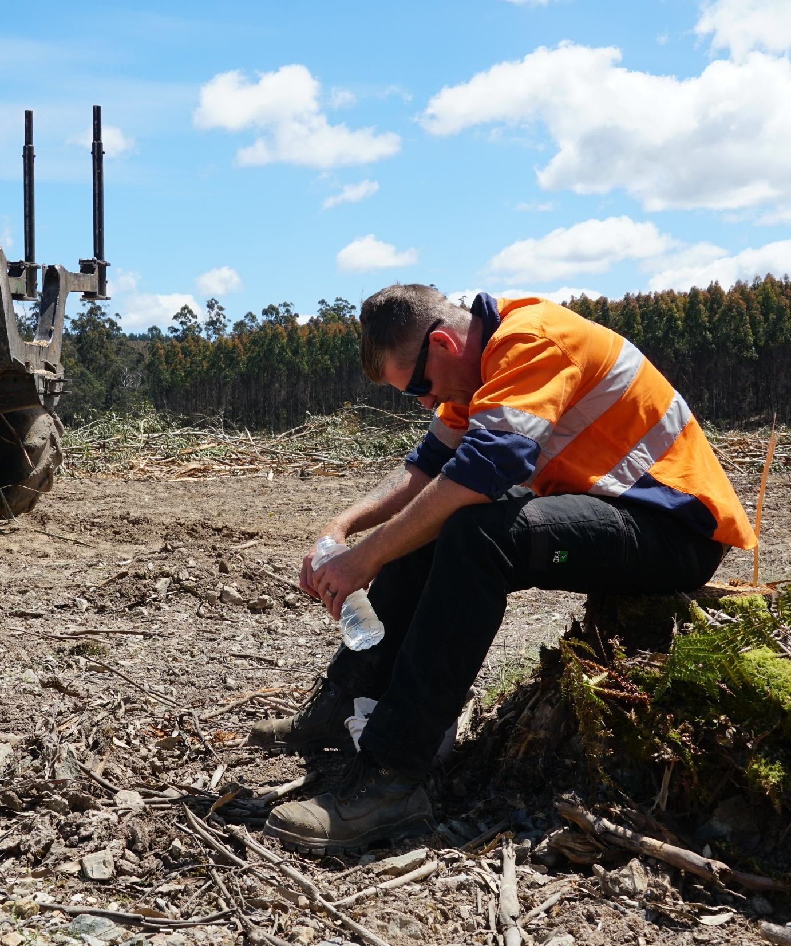
Look out for fatigue
Fatigue is a major safety risk at forest worksites.
If anyone shows the following signs, let your supervisor know:
  tiredness (even after sleep)
  slow reflexes
  short-term memory problems
  inability to concentrate
  blurred vision.
Notes:
Fatigue is more than just feeling tired and drowsy.
It is a level of exhaustion that reduces a forest worker’s ability to work safely and effectively.
Fatigue can be caused by physical tasks (such as operating a chainsaw for long periods) and mental tasks (such as long periods of concentration).
Fatigue is a major health and safety risk at forest worksites.
It can cause errors in judgement which may lead to injury or death.
If forest workers or their work mates start to show any of the following tell-tale signs, they must let their supervisor know immediately:
tiredness (even after sleep)
slow reflexes
short-term memory problems
inability to concentrate
blurred vision.

Slide 27
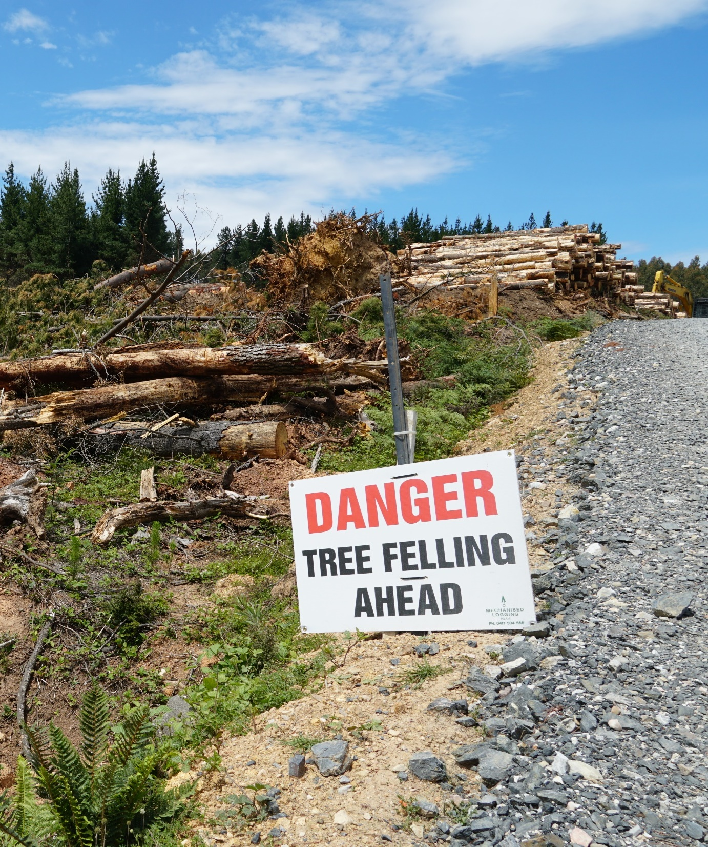
Follow safety signs
Safety signs are important communication tools at forest worksites, because they:
  alert you to hazards
  let you know where safety equipment is located
  point out the PPE you need to be wearing.
You must follow safety signs at all times.
Notes:
Safety signs are important communication tools at forest worksites.
They alert forest workers to hazards, let them know where safety equipment is located and point out the PPE they need to be wearing.
There are six sign ‘types’:
Mandatory signs tell you what you must do (e.g. Safety Equipment Must Be Worn).
Prohibition signs tell you what you can’t do (e.g. Do Not Proceed Past This Point).
Danger signs alert you to life-threatening hazards (e.g. Danger – Tree Felling Ahead).
Warning signs alert you to non-life-threatening hazards (e.g. Slippery When Wet).
Emergency signs help you locate emergency facilities (e.g. Emergency Assembly Point).
Fire signs help you locate firefighting equipment (e.g. Fire Extinguisher).

Slide 28
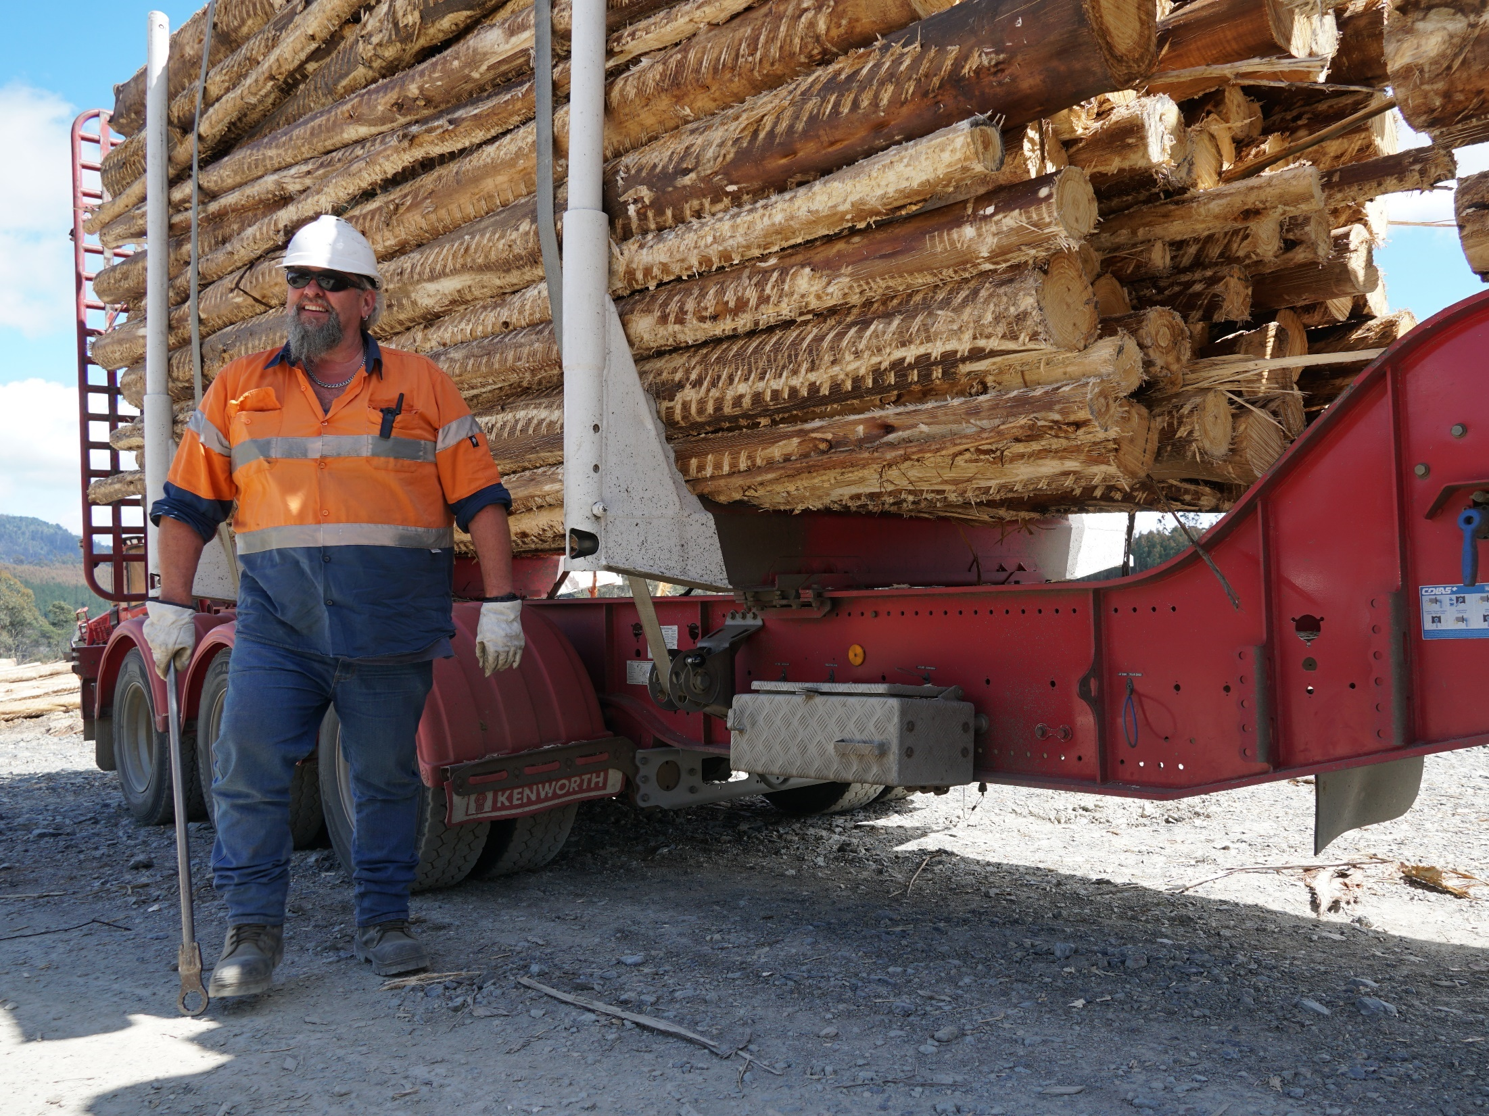
Identify
risks
Notes:
This topic is aligned to Element 2: Identify risks.
It also covers some foundation skills and knowledge/performance evidence components.
Forest workers have an important role to play in identifying hazards and risks at forest worksites, and following safe work procedures to control the risks.

Slide 29
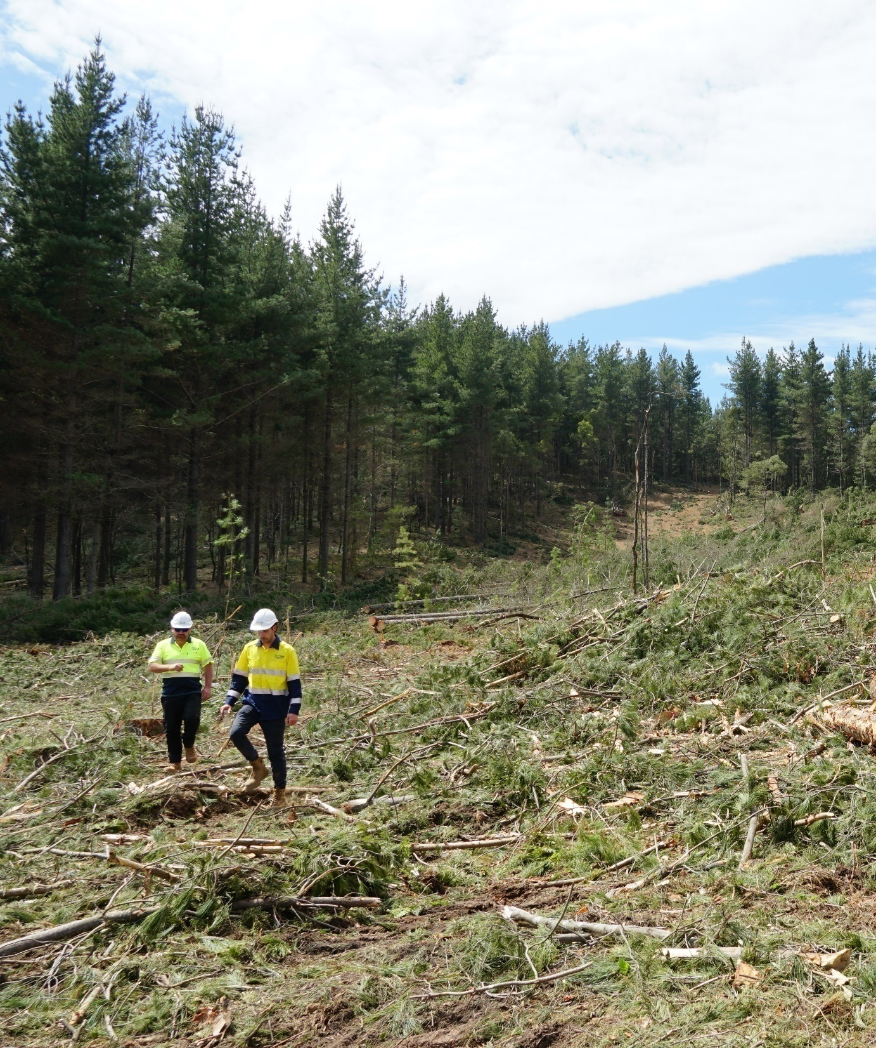
Identify hazards
Always look out for hazards in your work area.
Your supervisor will identify the known and likely hazards on-site during the site induction.
However, some hazards will appear over time, and you must report these to your supervisor.
Notes:
Take forest workers through the process of identifying WHS hazards.
Forest workers should always look out for hazards in their work area.
The site supervisor will point out all of the existing and potential hazards during the site induction.
However, some hazards may appear over time, and forest workers need to report these to their supervisor as soon as they notice them.
A list of common safety hazards (and the potential harm they can cause) has been provided below.
Chemicals (skin damage, poisoning, lung disease, cancer)
Equipment and machinery operation (injury caused by falling or flying objects)
Excessive noise (hearing loss)
Extreme weather (heat stress/hypothermia)
Hazardous manual tasks (musculoskeletal disorders)
Hazardous trees (injury caused by falling limbs)
Power lines - overhead or underground (electrocution)
Sloping, rough, uneven or unstable ground (injury caused by rollovers, slips, trips and falls)
Snakes, spiders and insects (toxic reaction, severe allergic reaction)
Sunlight - ultraviolet radiation (sunburn, eye damage, sunspots, skin cancer)
Unmaintained equipment and machinery (injury caused by chain shot)
Workers who are fatigued (higher likelihood of workplace incidents)
Workers who are influenced by drugs or alcohol (higher likelihood of workplace incidents)
Workers who do not observe separation distances (higher likelihood of workplace incidents)
Workers who do not take safety seriously (higher likelihood of workplace incidents)
Working alone - isolation (declining health while waiting for help, if injured)

Slide 30
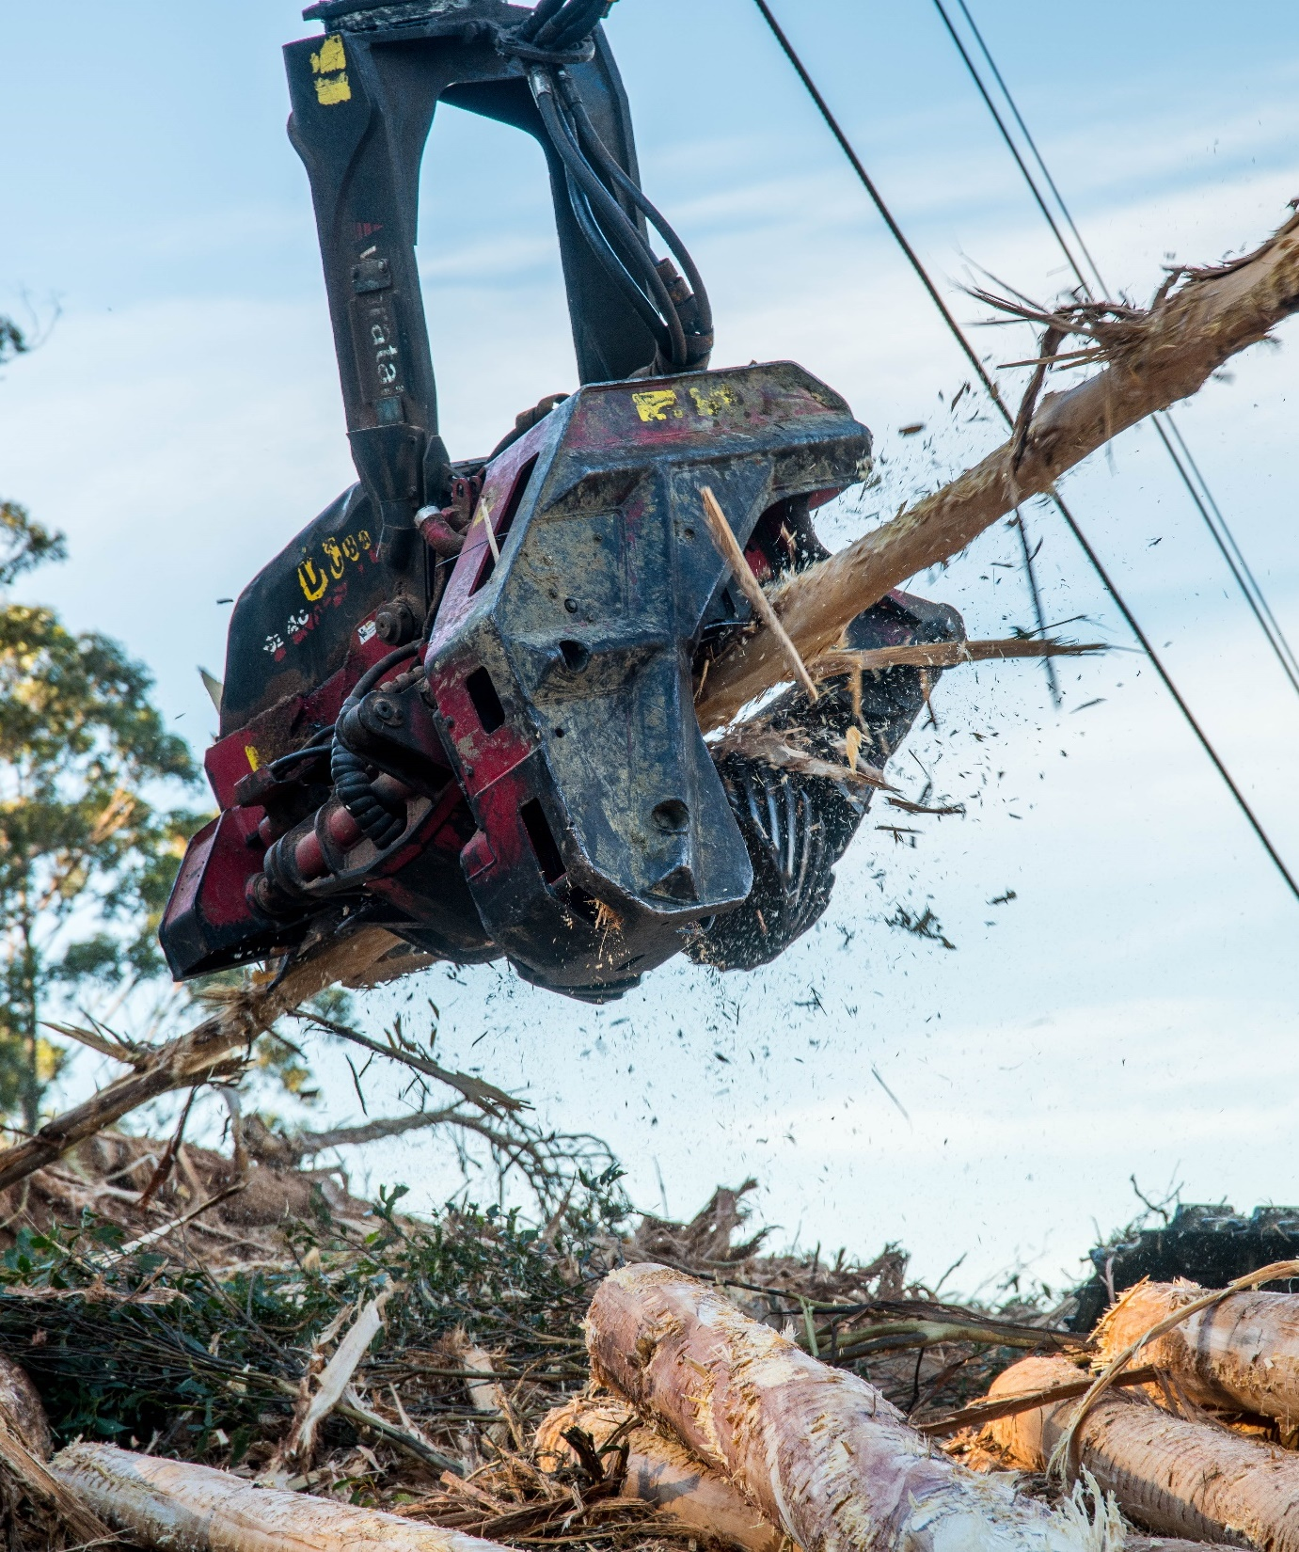
Common hazards
Hazard
Equipment and machinery operation
Potential harm
Injury caused by falling or flying objects
Image: Sustainable Timber Tasmania
Notes:
Forest workers must always be aware of safety hazards when they are on-site.
Equipment and machinery operation never ceases to be a safety hazard.
The only way forest workers can prevent injury from falling and flying objects is by following safe work procedures.

Slide 31
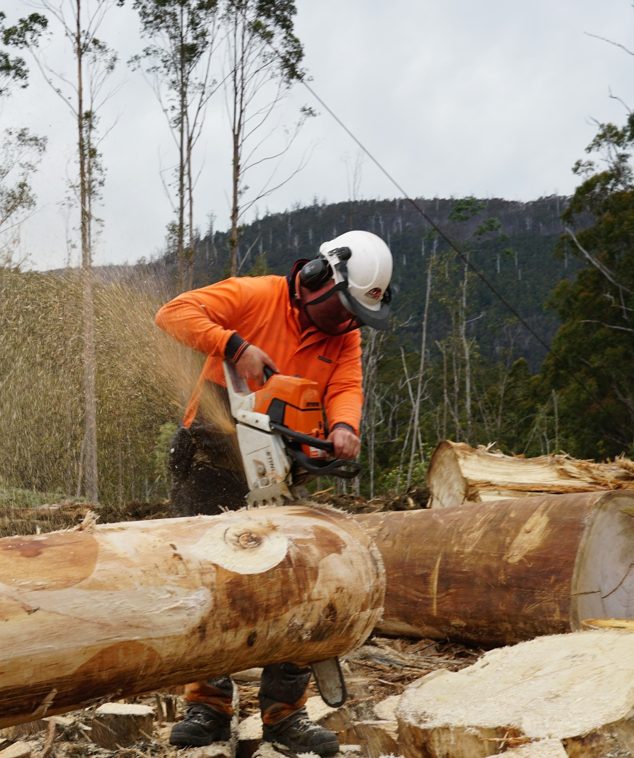
Common hazards
Hazard
Excessive noise
Potential harm
Hearing loss
Notes:
Forest workers must always be aware of safety hazards when they are on-site.
Excessive noise never ceases to be a safety hazard.
The only way forest workers can prevent hearing loss is by following safe work procedures.

Slide 32
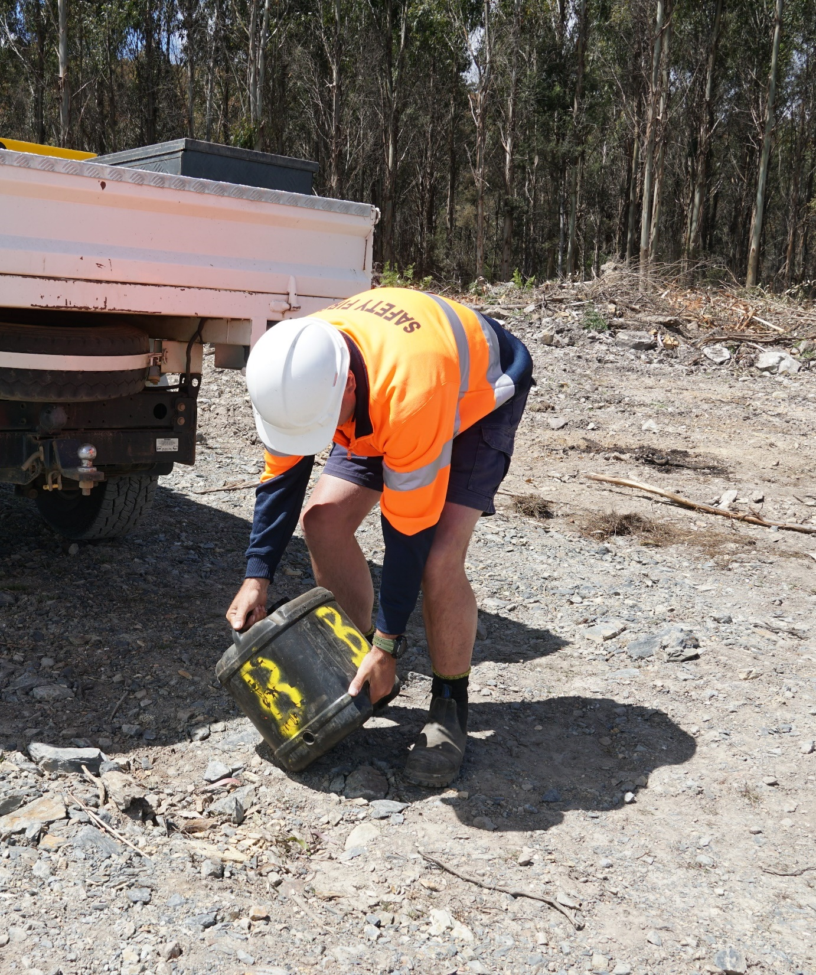
Common hazards
Hazard
Shifting, lifting and carrying (manual handling)
Potential harm
Musculoskeletal disorders
Notes:
Forest workers must always be aware of safety hazards when they are on-site.
Manual handling never ceases to be a safety hazard.
The only way forest workers can prevent musculoskeletal disorders is by following safe work procedures.

Slide 33
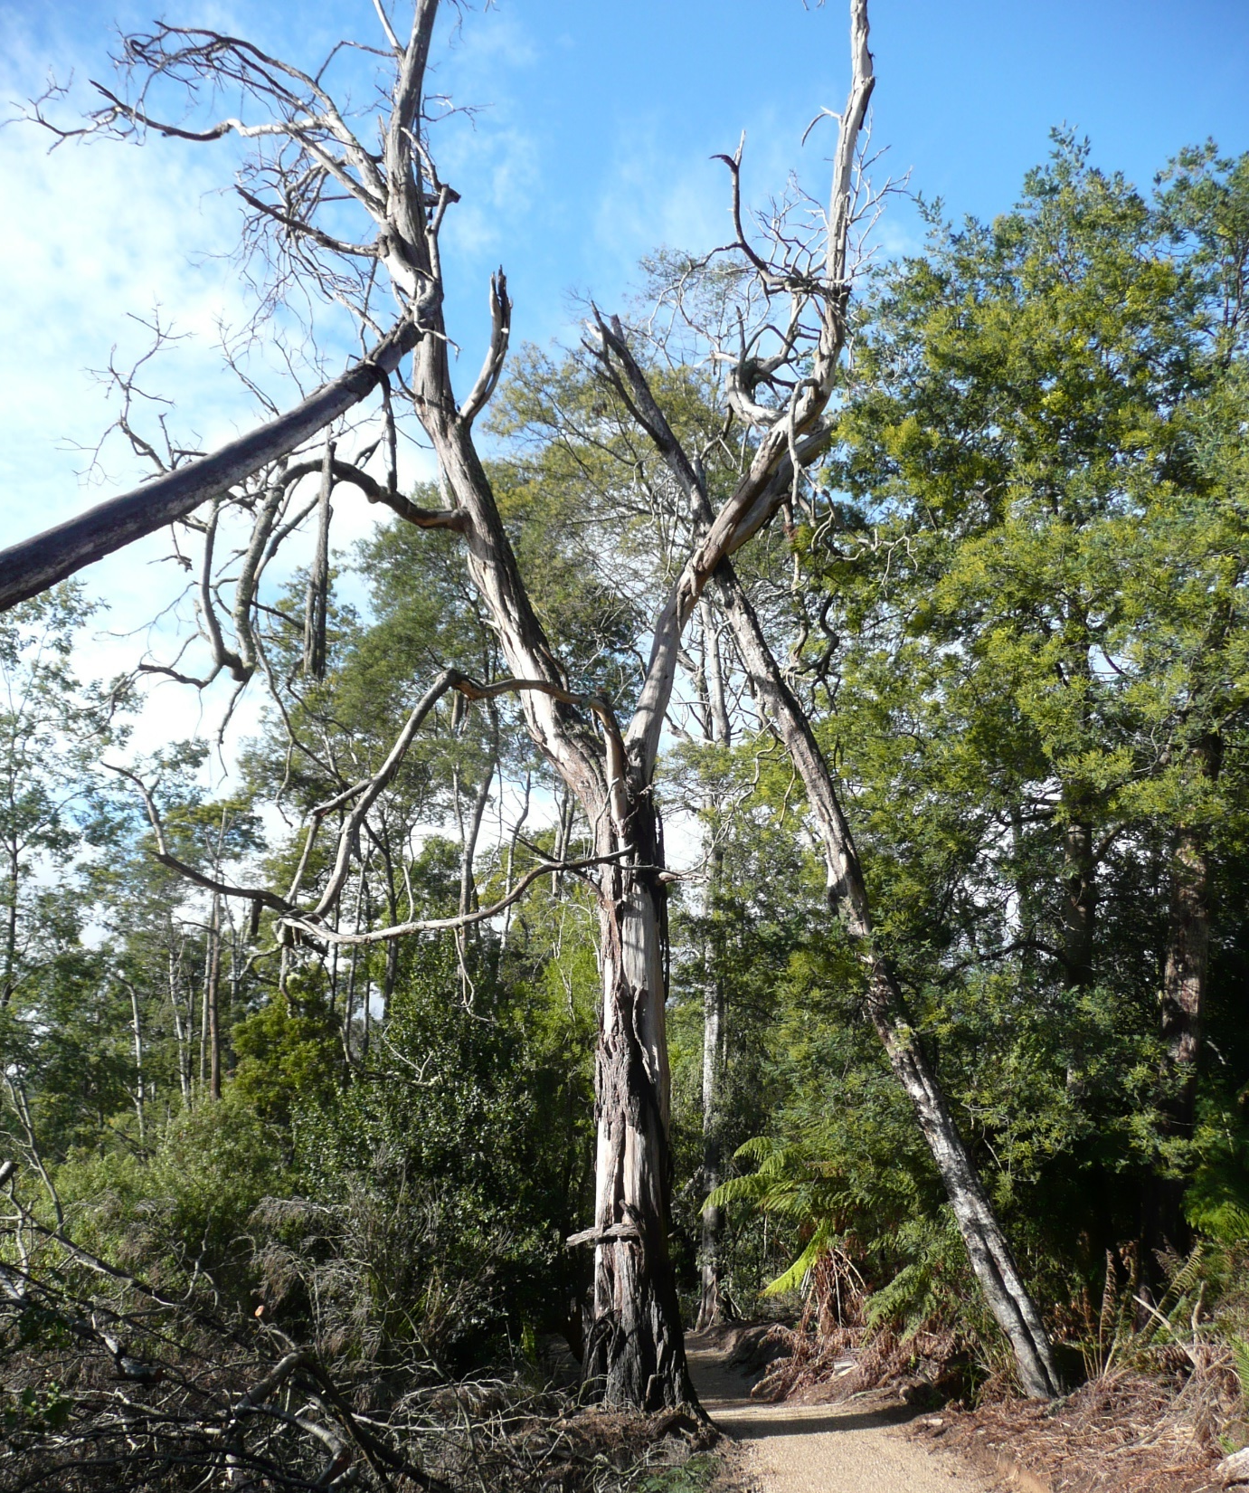
Common hazards
Hazard
Hazardous trees
Potential harm
Injury caused by falling limbs
Image: Forest Practices Authority (FPA)
Notes:
Forest workers must always be aware of safety hazards when they are on-site.
Hazardous trees never cease to be a safety hazard.
The only way forest workers can prevent injury from falling limbs is by following safe work procedures.

Slide 34
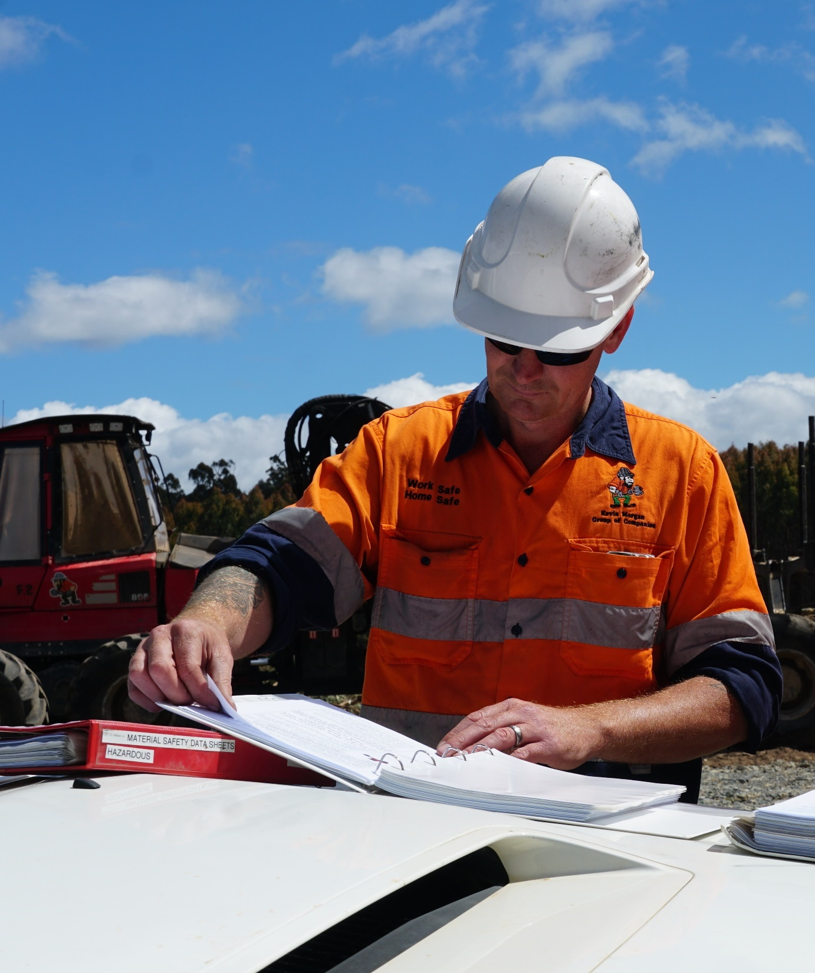
Common hazards
Hazard
Sunlight (ultraviolet radiation)
Potential harm
Sunburn, eye damage, sunspots, skin cancer
Notes:
Forest workers must always be aware of safety hazards when they are on-site.
Sunlight (UV radiation) never ceases to be a safety hazard.
The only way forest workers can prevent sunburn, eye damage, sunspots and skin cancer is by following safe work procedures.

Slide 35
Calculate risks
If you notice a hazard, you’ll need to calculate the likelihood of it causing any harm, and the consequence of this happening.
You can use a risk matrix to do this quickly:
  Step 1: Identify the likelihood
  Step 2: Identify the consequence
  Step 3: Determine the risk rating
Notes:
If forest workers notice a safety hazard at a forest worksite, they’ll need to calculate the likelihood of it causing any harm, and the consequence of this happening.
A risk matrix is a useful tool to do this.
Step 1: Identify the likelihood
What is the likelihood of the hazard causing harm? Unlikely or Certain
Step 2: Identify the consequence
What is the consequence this happening? Minor or Serious
Step 3. Determine the risk rating
Determine a risk rating for the hazard. High (1), Medium (2) or Low (3)

Slide 36
Activity 1
You’re working in summer.
The UV Index is predicted to reach 9 (very high).
You’re unable to rotate with other workers.
What is the risk of sunburn?
Notes:
Activity 1: Sunburn
The risk rating in this scenario would be high.
With a high risk rating, forest workers must stop and fix the problem.
They must apply sunscreen, wear sunglasses, work in the shade (where possible) and rotate with other workers to reduce their exposure to the sun.
They should always share the risk calculations they make with their work mates and supervisor.

Slide 37
Activity 2
You’re operating a chainsaw.
You’re using the highest rated hearing protection.
You’re taking breaks and rotating with other workers.
What is the risk of hearing loss?
Notes:
Activity 2: Hearing loss
The risk rating in this scenario would be medium.

Slide 38
Activity 3
You’re working in winter.
The worksite is known for jack jumpers, but only in summer.
You’re not allergic to jack jumper stings.
What is the risk of a severe allergic reaction?
Notes:
Activity 3: Severe allergic reaction
The risk rating in this scenario would be low.

Slide 39
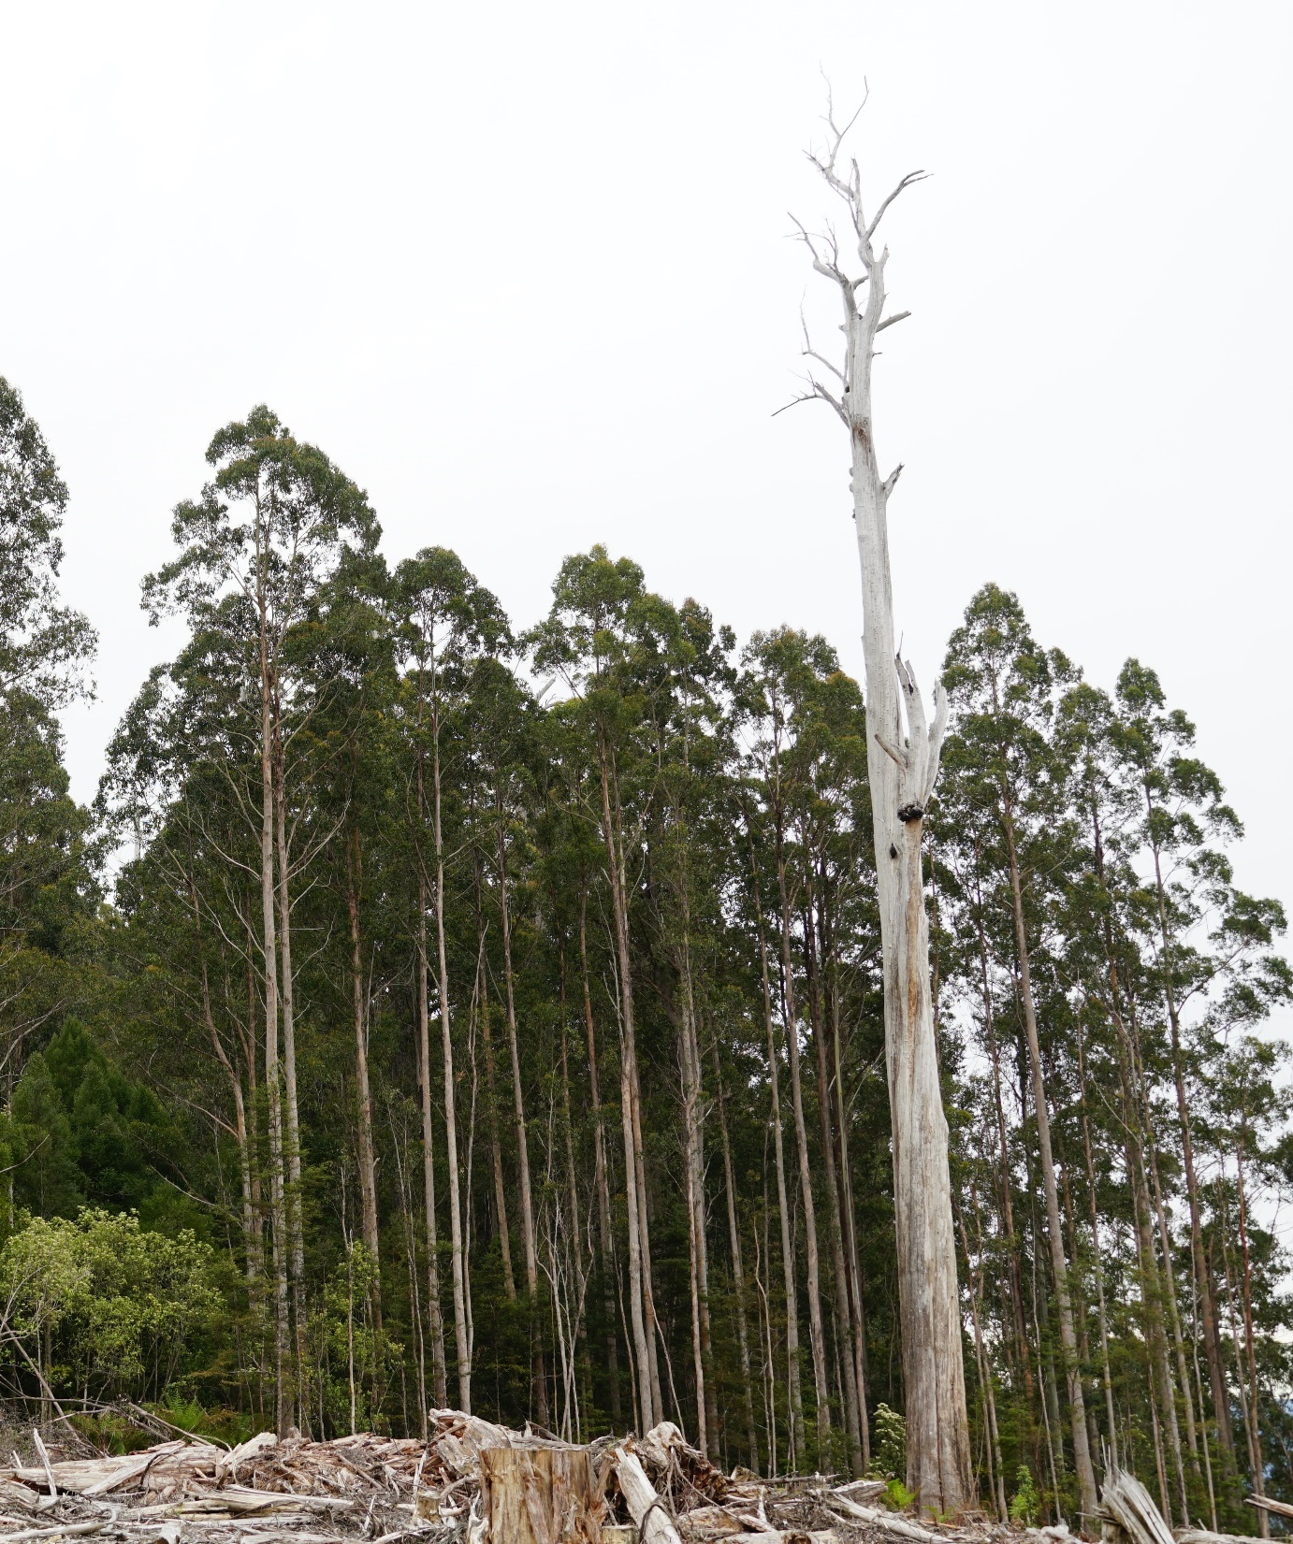
Activity 4
Look at the photo
What safety hazard do you see?
What potential safety risk do you see?
Notes:
Activity 4 (Hazardous tree)
Safety hazard: Hazardous tree
Potential safety risk: Injury caused by falling limbs

Slide 40
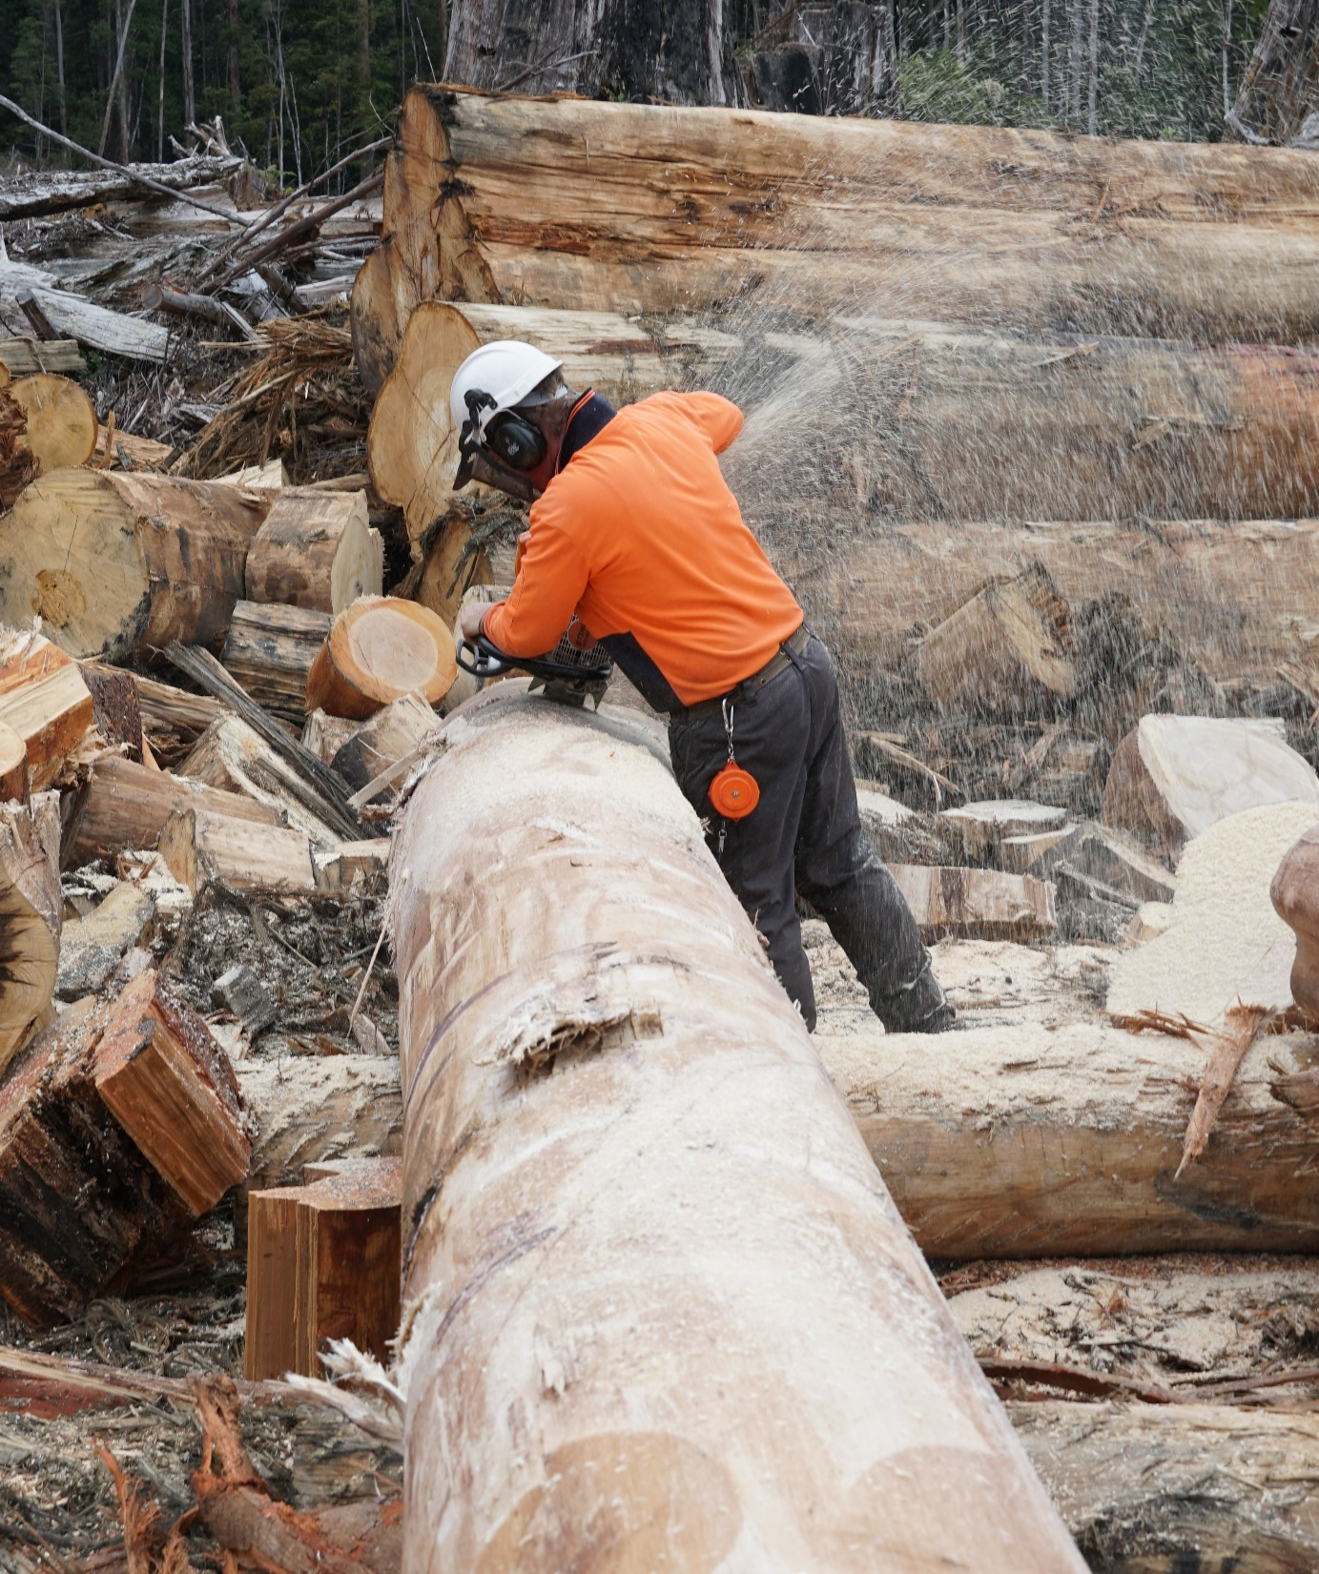
Activity 5
Look at the photo
What safety hazard do you see?
What potential safety risk do you see?
Notes:
Activity 5 (Hazardous tree)
Safety hazard: Excessive noise
Potential safety risk: Hearing loss

Slide 41
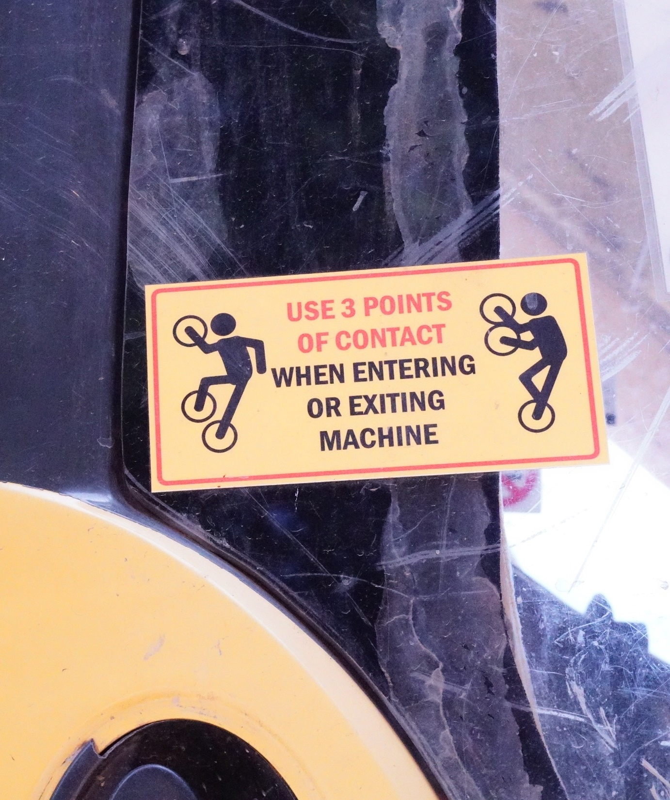
Control risks
A risk control is an action taken to eliminate or minimise a risk.
Your supervisor will take you through the risk controls that apply at a worksite during the site induction.
Risk controls are in place to keep you safe, so make sure you follow them.
Notes:
A risk control is an action taken to eliminate or minimise a risk.
The site supervisor will take forest workers through the risk controls they’ll need to be aware of during the site induction.
In addition to the advice provided in the FOS Plan, forest managers, landowners and contractors will have a safety management system in place, and this will include risk controls for common hazards.
There are different approaches to controlling risks in the forest industry, so forest workers must be aware of the procedures that apply at a specific site.
If they’re unsure about a risk control, they should check with their supervisor before they start work.
Risk controls are in place to keep forest workers safe, so they must follow them.

Slide 42
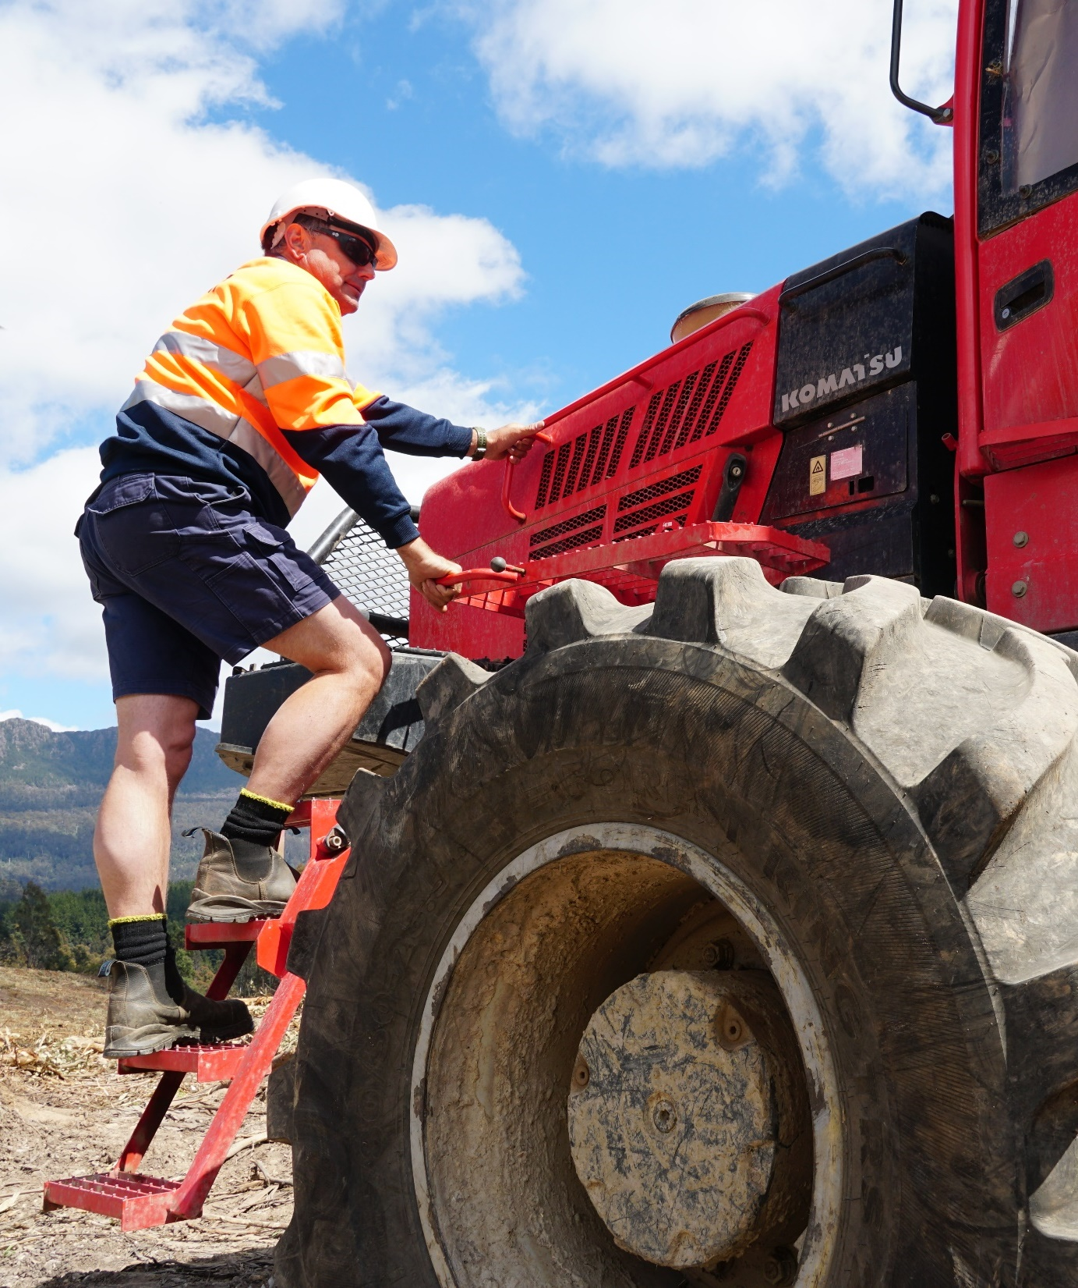
Control risks
Risk control for muscle strain
To minimise the risk of muscle strain when getting in and out of machinery, you should always apply the following risk control:
use three points of contact when entering or exiting a machine.
Notes:
Getting in and out of machinery is a common hazard for forest workers, because it can lead to musculoskeletal disorders (such as muscle strain) if the correct procedure is not followed.
However, by following the correct procedure – use three points of contact when entering or exiting a machine – forest workers can minimise the risk of muscle strain.

Slide 43
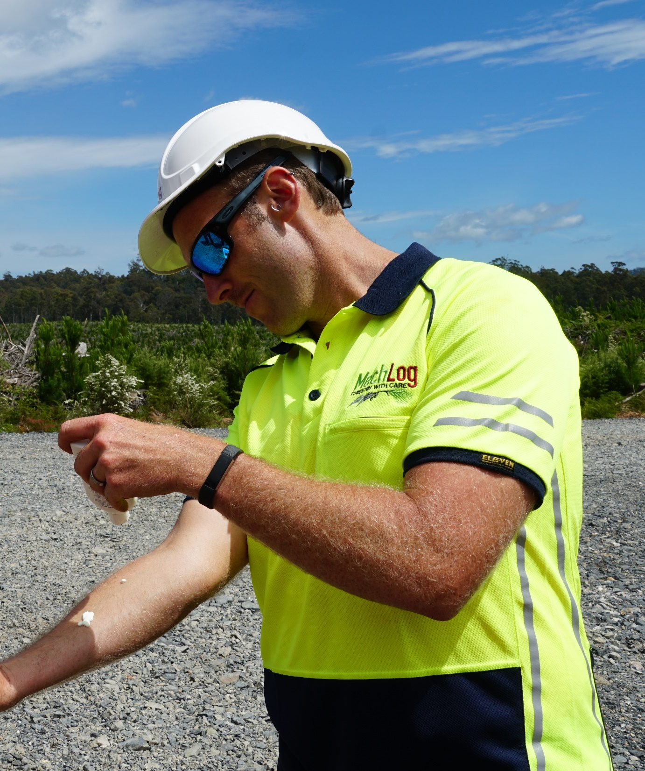
Control risks
Risk controls for sunburn
To minimise the risk of sunburn, you should always apply the following risk controls:
apply sunscreen
wear sunglasses
work in the shade (if possible)
rotate with other workers to reduce your exposure to the sun.

Slide 44
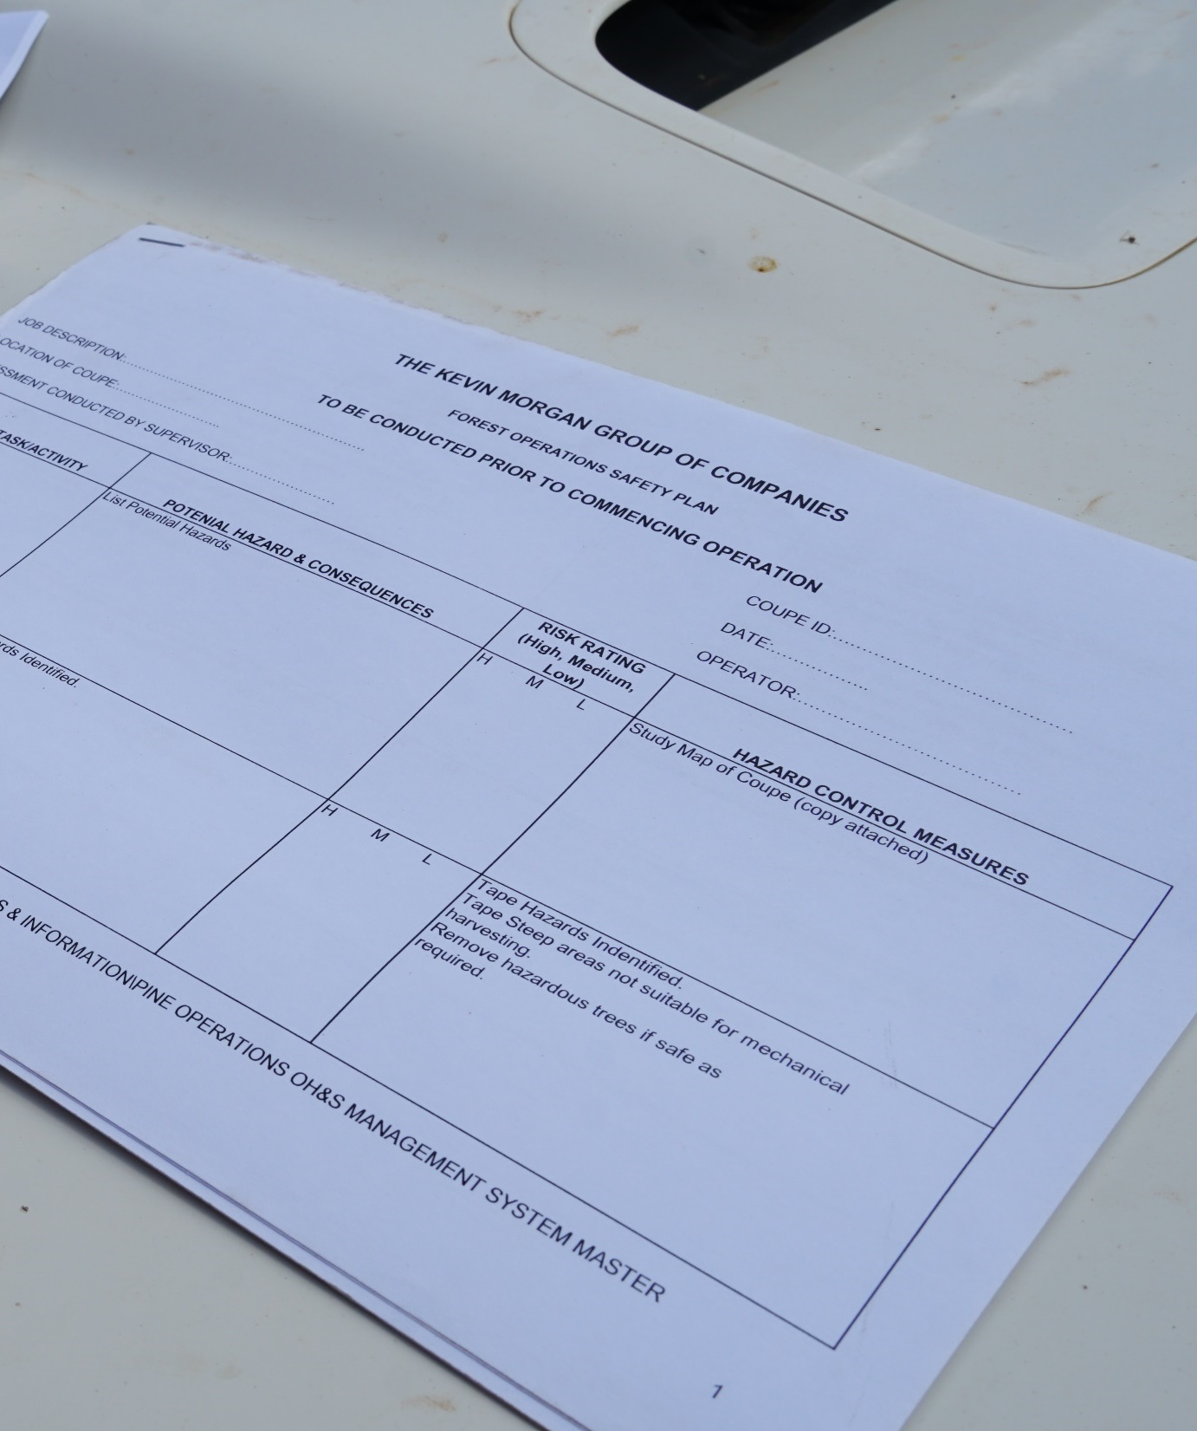
Complete reports
If you discover a new hazard at a worksite (e.g. an old mine shaft), you will need to report it to your supervisor immediately.
Your supervisor will then:
  add the hazard to the FOS Plan; or
  contact the forest manager or landowner and ask them to add the hazard to the FOS Plan.
Notes:
New hazards
FOS Plans list the known and likely hazards at a forest worksite.
If any new hazards are identified, they must be added to the FOS Plan.
For example, a forest worker may discover an old mine shaft at a worksite that is covered with forest debris and hidden from sight.
This would pose a major safety risk to machine operators and ground workers, so the forest worker who discovered the hazard would need to report it to their supervisor immediately.
Depending on the reporting protocols in place at the worksite, the supervisor would then:
add the new hazard to the FOS Plan; or
contact the forest manager/landowner and ask them to add the new hazard to the FOS Plan.

Slide 45

Complete reports
If you witness a safety incident at a forest worksite, you’ll need to complete an incident form.
Some contractors have a mobile phone app for this, while others have a hard-copy form.
Your supervisor will explain the incident reporting procedure at the site induction.
Notes:
If forest workers witness a safety incident, they’ll need to complete an incident report.
Some contractors use a mobile phone app to do this, while others use a hard-copy form.
The site supervisor will explain the procedure for reporting incidents during the site induction.

Slide 46
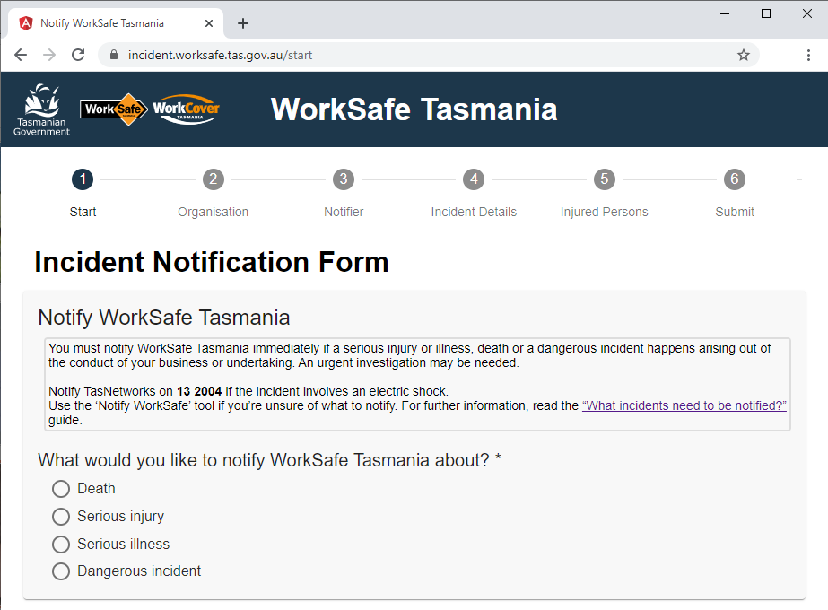
Complete reports
Notifiable incidents
If any of the following occur on-site, WorkSafe Tasmania must be notified on 1300 366 322:
  death
  serious injury or illness
  dangerous incident
An online form must also be lodged within 48 hours.
Notes:
Notifiable incidents
If the following incidents occur at a forest worksite, they must be reported to WorkSafe Tasmania:
Someone dies.
Someone suffers a serious injury or illness.
There is a dangerous incident.
Depending on the reporting protocols in place at the worksite, your supervisor will contact the forest manager, landowner or contractor, who in turn will contact WorkSafe Tasmania.
An online form must also be completed within 48 hours of the incident.
If you saw the incident, you’ll need to complete an incident report.
Some forest workers use a mobile phone app to do this, while others use a hard-copy form.
Your supervisor will explain the procedure for reporting incidents during the site induction.

Slide 47
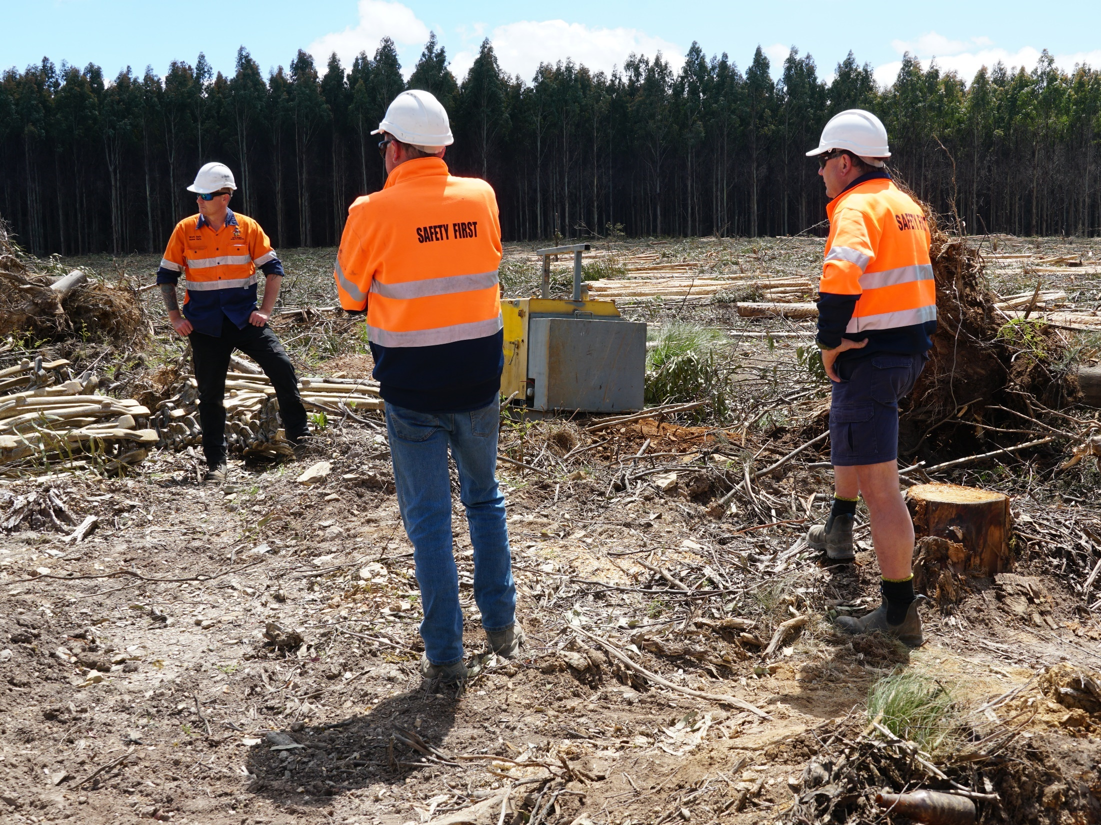
Respond
to accidents and emergencies
Notes:
This topic is aligned to Element 3: Follow emergency procedures.
It also covers some foundation skills and knowledge/performance evidence components.
Forest workers have an important role to play in practicing and following emergency procedures.

Slide 48
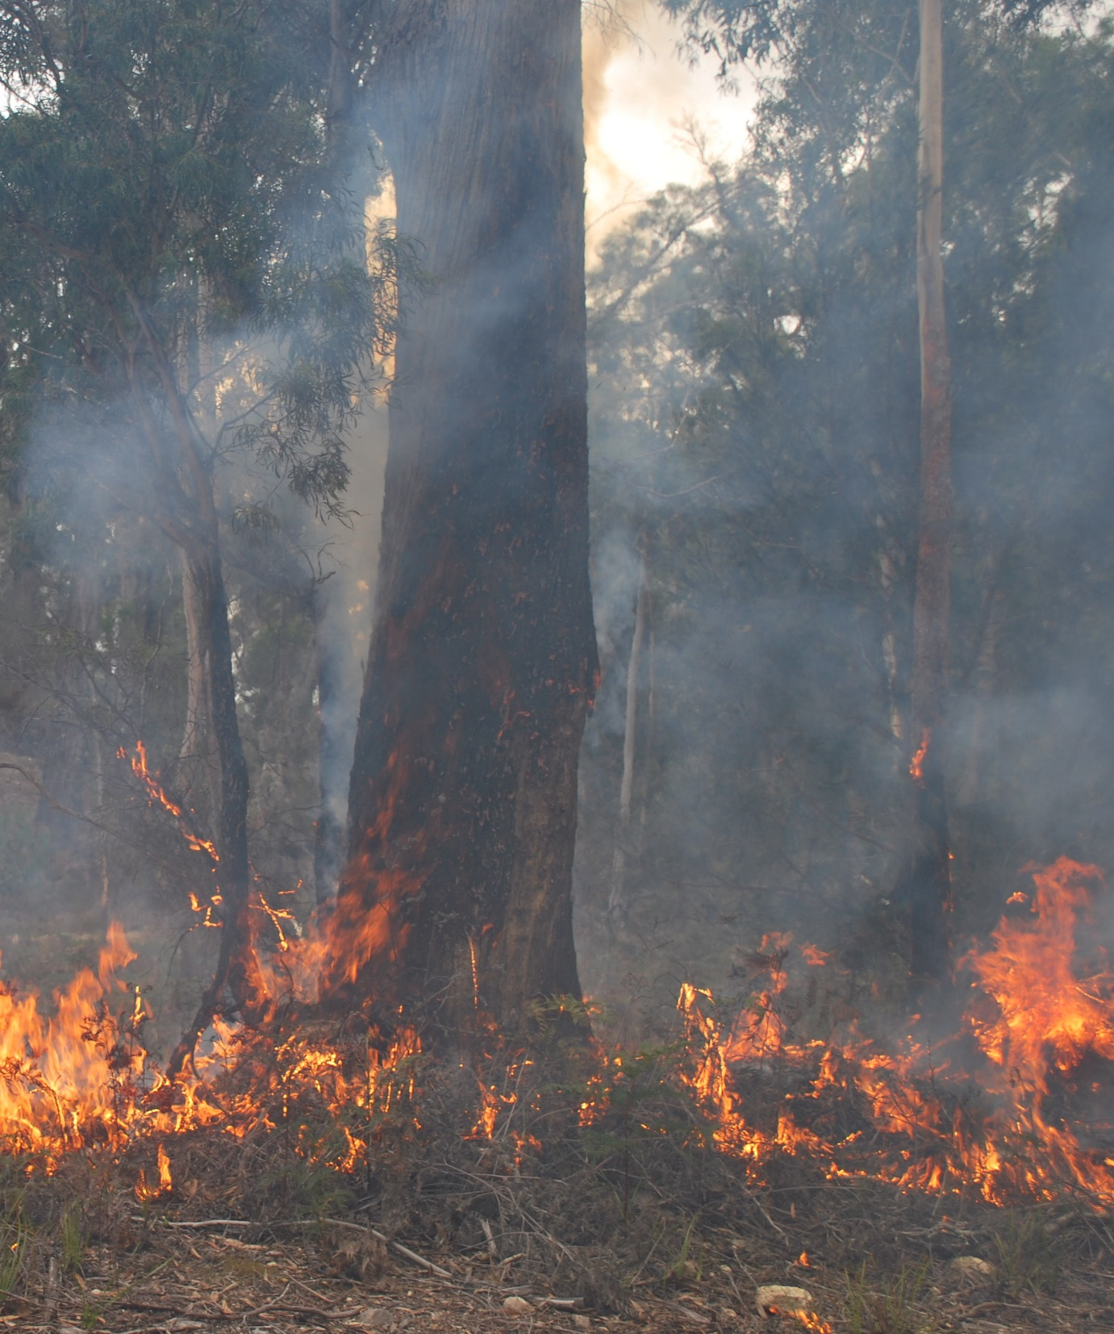
Notify people
Chemical spills, coupe invasions, injured workers and fires are the types of emergencies that can occur at forest worksites.
If you witness an emergency, you must notify your supervisor.
If someone is injured, you’ll also need to notify the worksite first aider.
Image: Sustainable Timber Tasmania
Notes:
Chemical spills, coupe invasions, injured workers and unplanned fires are the types of emergencies that can occur at forest worksites.
If forest workers witness an emergency, they must notify their supervisor immediately, and they will need to use a reliable communication device to do so (such as a mobile phone or UHF radio).
If someone is injured, they’ll also need to notify the worksite first aider.
If they need to contact the ambulance, fire or police services, encourage them to use the following emergency numbers:
000 (from any fixed, mobile or pay phone)
112 (from most mobile phones).
If the emergency is a notifiable incident, WorkSafe Tasmania must be informed on 1300 366 322.

Slide 49

Notify people
Use reliable communication devices in an emergency.
Use the following numbers to contact emergency services:
  000 (fixed/mobile/pay phones)
  112 (most mobile phones).
Contact WorkSafe Tasmania on 1300 366 322 if the emergency is a notifiable incident.
Image: Sustainable Timber Tasmania
Notes:
Chemical spills, coupe invasions, injured workers and unplanned fires are the types of emergencies that can occur at forest worksites.
If forest workers witness an emergency, they must notify their supervisor immediately, and they will need to use a reliable communication device to do so (such as a mobile phone or UHF radio).
If someone is injured, they’ll also need to notify the worksite first aider.
If they need to contact the ambulance, fire or police services, encourage them to use the following emergency numbers:
000 (from any fixed, mobile or pay phone)
112 (from most mobile phones).
If the emergency is a notifiable incident, WorkSafe Tasmania must be informed on 1300 366 322.

Slide 50
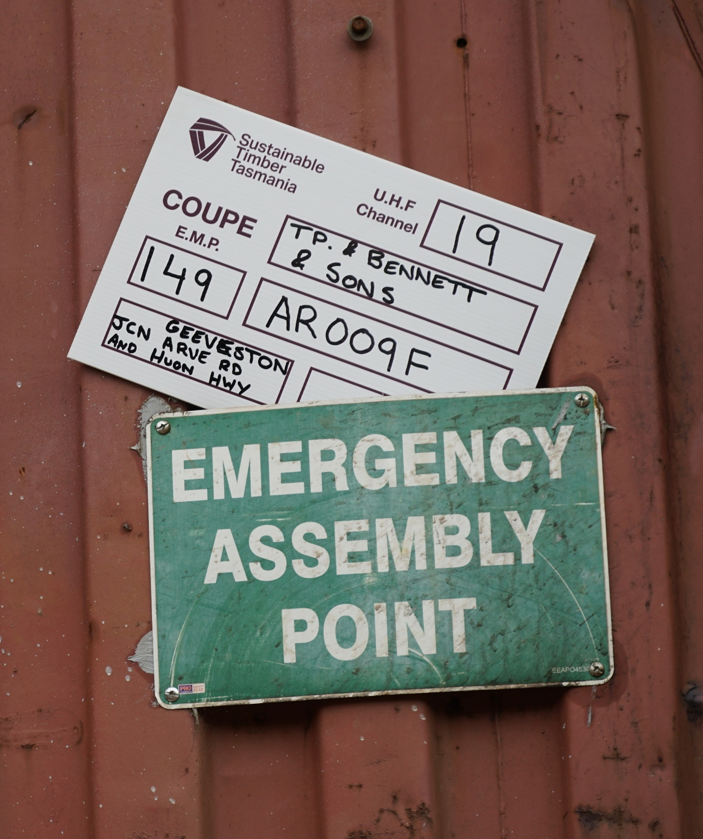
Follow emergency plans
Forest worksites must have emergency plans.
Your supervisor will take you through these during the site induction.
You must know where the EMPs (emergency meeting points) are.
You must be familiar with the evacuation procedure.
Notes:
Forest worksites must have emergency plans which contain the following information:
emergency meeting points (EMPs)
emergency phone contacts
emergency communication protocols (including the UHF radio channel for emergency use)
emergency procedures (including what to do in an emergency if you are working alone)
evacuation procedures.
This information may be included in the FOS Plan, or it may be detailed in separate documents.
The site supervisor will take forest workers through the emergency plans during the site induction.
Forest workers must know where the EMPs are, and they must be familiar with the evacuation procedure.

Slide 51
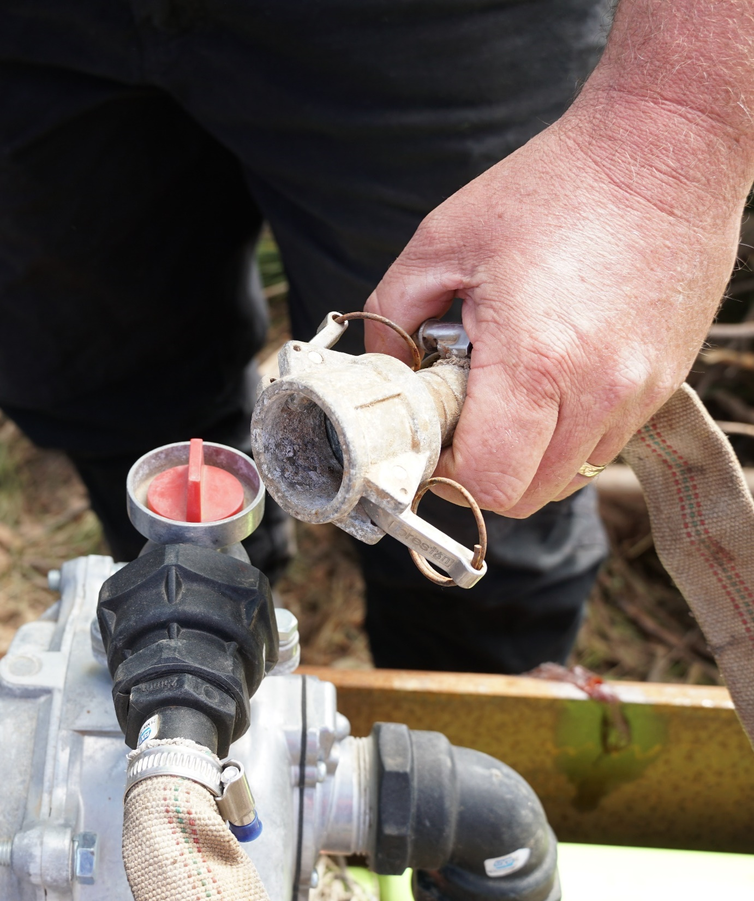
Follow emergency plans
Emergency plan (example only) for an unplanned fire on-site:
Notify supervisor/crew
Assess risk of fire behaviour
Notify fire service/landowner
Confirm EMPs and escape routes
If controllable, use firefighting equipment/PPE to control fire
If uncontrollable, evacuate site.
Notes:
Unplanned fire
The following is a sample emergency plan for an unplanned fire at a logging coupe:
Notify supervisor and crew.
Assess risk of current fire behaviour.
Assess risk of expected fire behaviour.
Notify fire service.
Notify forest manager/landowner.
Confirm EMPs, safe zones and escape routes.
If fire is not controllable with on-site equipment and crew capacity, initiate evacuation plan.
If fire is controllable with on-site equipment and crew capacity, initiate fire plan.
Put on firefighting PPE.
Use firefighting equipment to control fire.

Slide 52
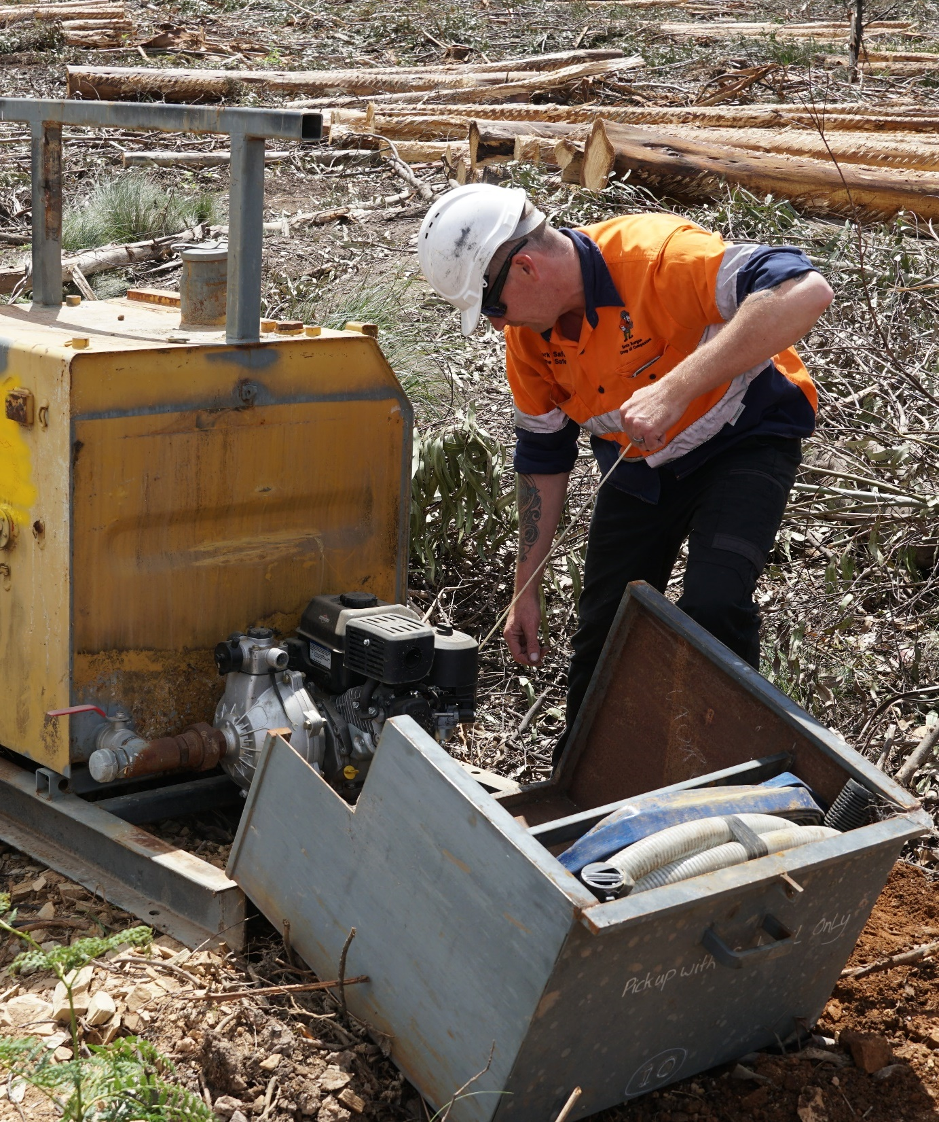
Test emergency procedures
Emergency and evacuation procedures must be tested regularly, and this involves:
testing on-site communications
updating emergency contacts
reviewing emergency plans
checking emergency equipment
confirming EMPs
practicing evacuations.
Notes:
Emergency and evacuation procedures must be tested and practiced regularly.
This involves:
testing communication across the worksite
testing communication to external contacts
checking/updating emergency contact details (and ensuring these are accessible at multiple known locations across the worksite)
discussing and reviewing emergency plans at toolbox meetings
maintaining on-site emergency equipment
confirming the EMPs with on-site workers
confirming the EMPs with emergency services
checking appropriate transport is available for an evacuation
practicing an evacuation – regularly!

Slide 53
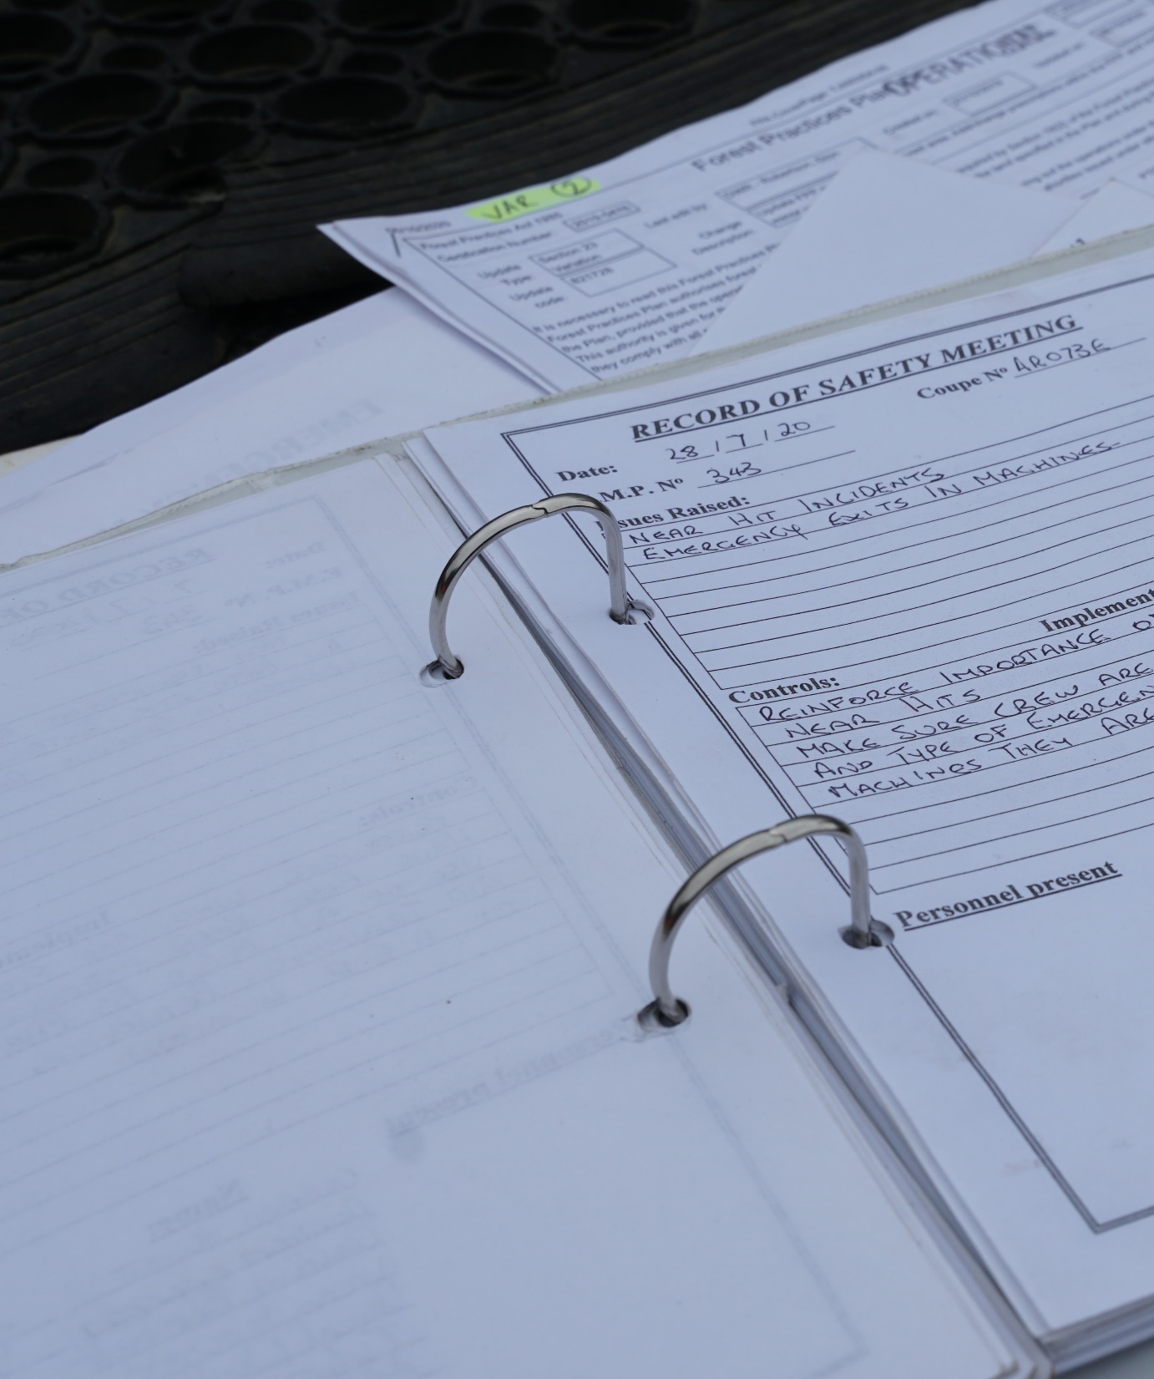
Record emergency procedures
If you think an emergency procedure can be improved, bring it up at a toolbox meeting.
If everyone agrees, your supervisor will record the toolbox discussion and update the emergency procedure.
By raising safety issues, you’re making the worksite safer for yourself and your work mates.
Notes:
Emergency and evacuation procedures are always discussed at toolbox meetings, and forest workers may raise an issue that requires a procedure to be altered.
For example, there may a better escape route than the one identified in the evacuation procedure.
Procedural changes like this need to be recorded, and they also need to be reported to everyone on-site.
The site supervisor (or safety officer) will update the procedure in the safety management system, and they’ll also make sure everyone understands the change.
When forest workers raise safety issues at toolbox meetings, they are making the worksite safer for themselves and their work mates.

Slide 54
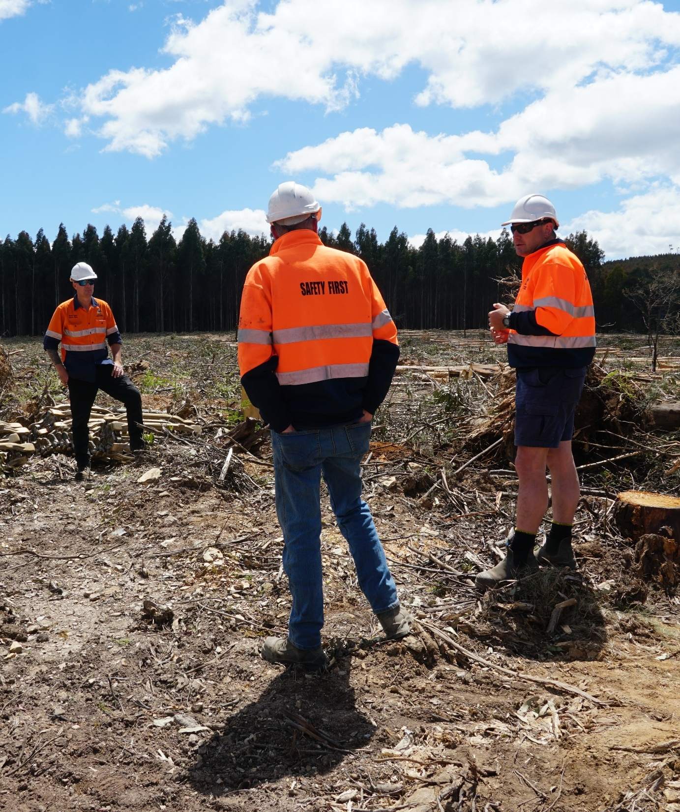
A final word…
If you’re not sure about a safety issue on-site, stop work and ask your supervisor.

Slide 55
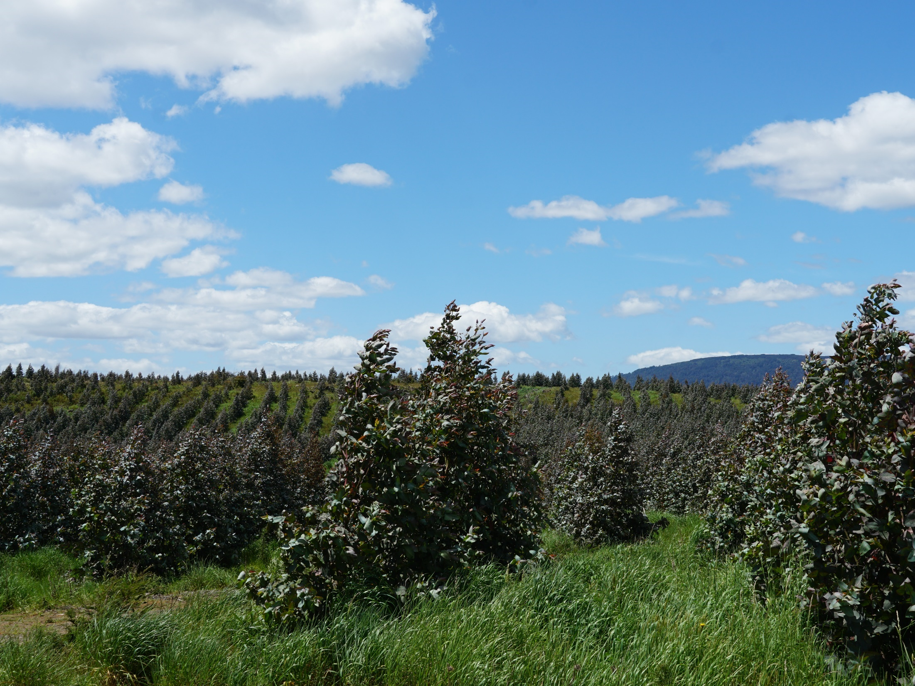
Where to from here?
How to reinforce and validate your training
Notes:
A number of learning and assessment materials have been developed to reinforce and validate the structured training you provide to forest workers.

Slide 56
Where to from here?
Complete the health and safety checklist
  this will only take a minute, and it will give you a useful summary of the topics covered in today’s training.
Take a copy of the following self-paced learning materials and work through them in your own time:
  Forest Safety for Contractors – Learner Guide
  Forest Safety for Contractors – Learner Questionnaire.
Organise a convenient date/time to undertake an assessment.
Notes:
Health and safety checklist
This has been provided at Appendix B of the Facilitator Guide.
Ask forest workers to complete the checklist at the end of the training session.
It will only take a minute or so, and it will provide them with a useful summary of the topics they’ve covered.
You will need to print the checklist prior to the training, and you will need to ensure each forest worker has a copy.
This is not an assessment process – it’s simply a tool to reinforce learning.
Self-paced learning materials
Hand out copies of the following materials to each forest worker at the end of the training:
Forest Safety for Contractors – Learner Guide
Forest Safety for Contractors – Learner Questionnaire.
These have been designed as self-paced learning materials, and they aim to reinforce the knowledge and skills attained through structured training.
Encourage everyone to work through the materials in their own time, especially the learner questionnaire (which includes all answers at the back).
Once again, this is not a formal assessment process – it’s simply a tool to reinforce learning.
Assessment tool
If you intend to assess forest workers at the end of the training, an assessment tool is provided in the Forest Safety for Contractors – Assessor Guide.

Slide 57
Acknowledgements / disclaimer
Acknowledgements
A number of key industry stakeholders supported the development of this presentation, including:
AKS Forest Solutions
CFMEU Manufacturing Division
Forico
Kevin Morgan Group of Companies
MechLog
Sustainable Timber Tasmania
Timber Training Creswick
Timberlands Pacific
TP Bennett and Sons.
ForestWorks is indebted to the open, generous and cooperative nature of all those who contributed. Special thanks is made to Eva James and Gerard Bennett, without whose guidance and advice the materials arising from this project would not have eventuated.
Unless otherwise stated, all photographs used in this presentation are attributable to purple infinity.
Disclaimer
This work is the result of consultations with Australian forestry industry participants. It is a collaborative view and does not necessarily represent the view of the developers or any specific body. For the sake of brevity, it may omit factors which could be pertinent in particular cases.
The developers do not accept any liability for any damage or loss (including direct and consequential loss) incurred by any person as a result of relying on the information contained in this material.
The developers do not accept any liability to any person for the information or advice (or the use of such information or advice) which is provided in this presentation or incorporated into it by reference. The information is provided on the basis that all persons accessing this material undertake responsibility for assessing the relevance and accuracy of its content. No liability is accepted for any information or services which may appear in any other format. No responsibility is taken for any information or services which may appear on any linked websites.
Notes:
Let forest workers know that the materials used in this training session were developed in close collaboration with the Tasmanian forest industry.

Slide 58
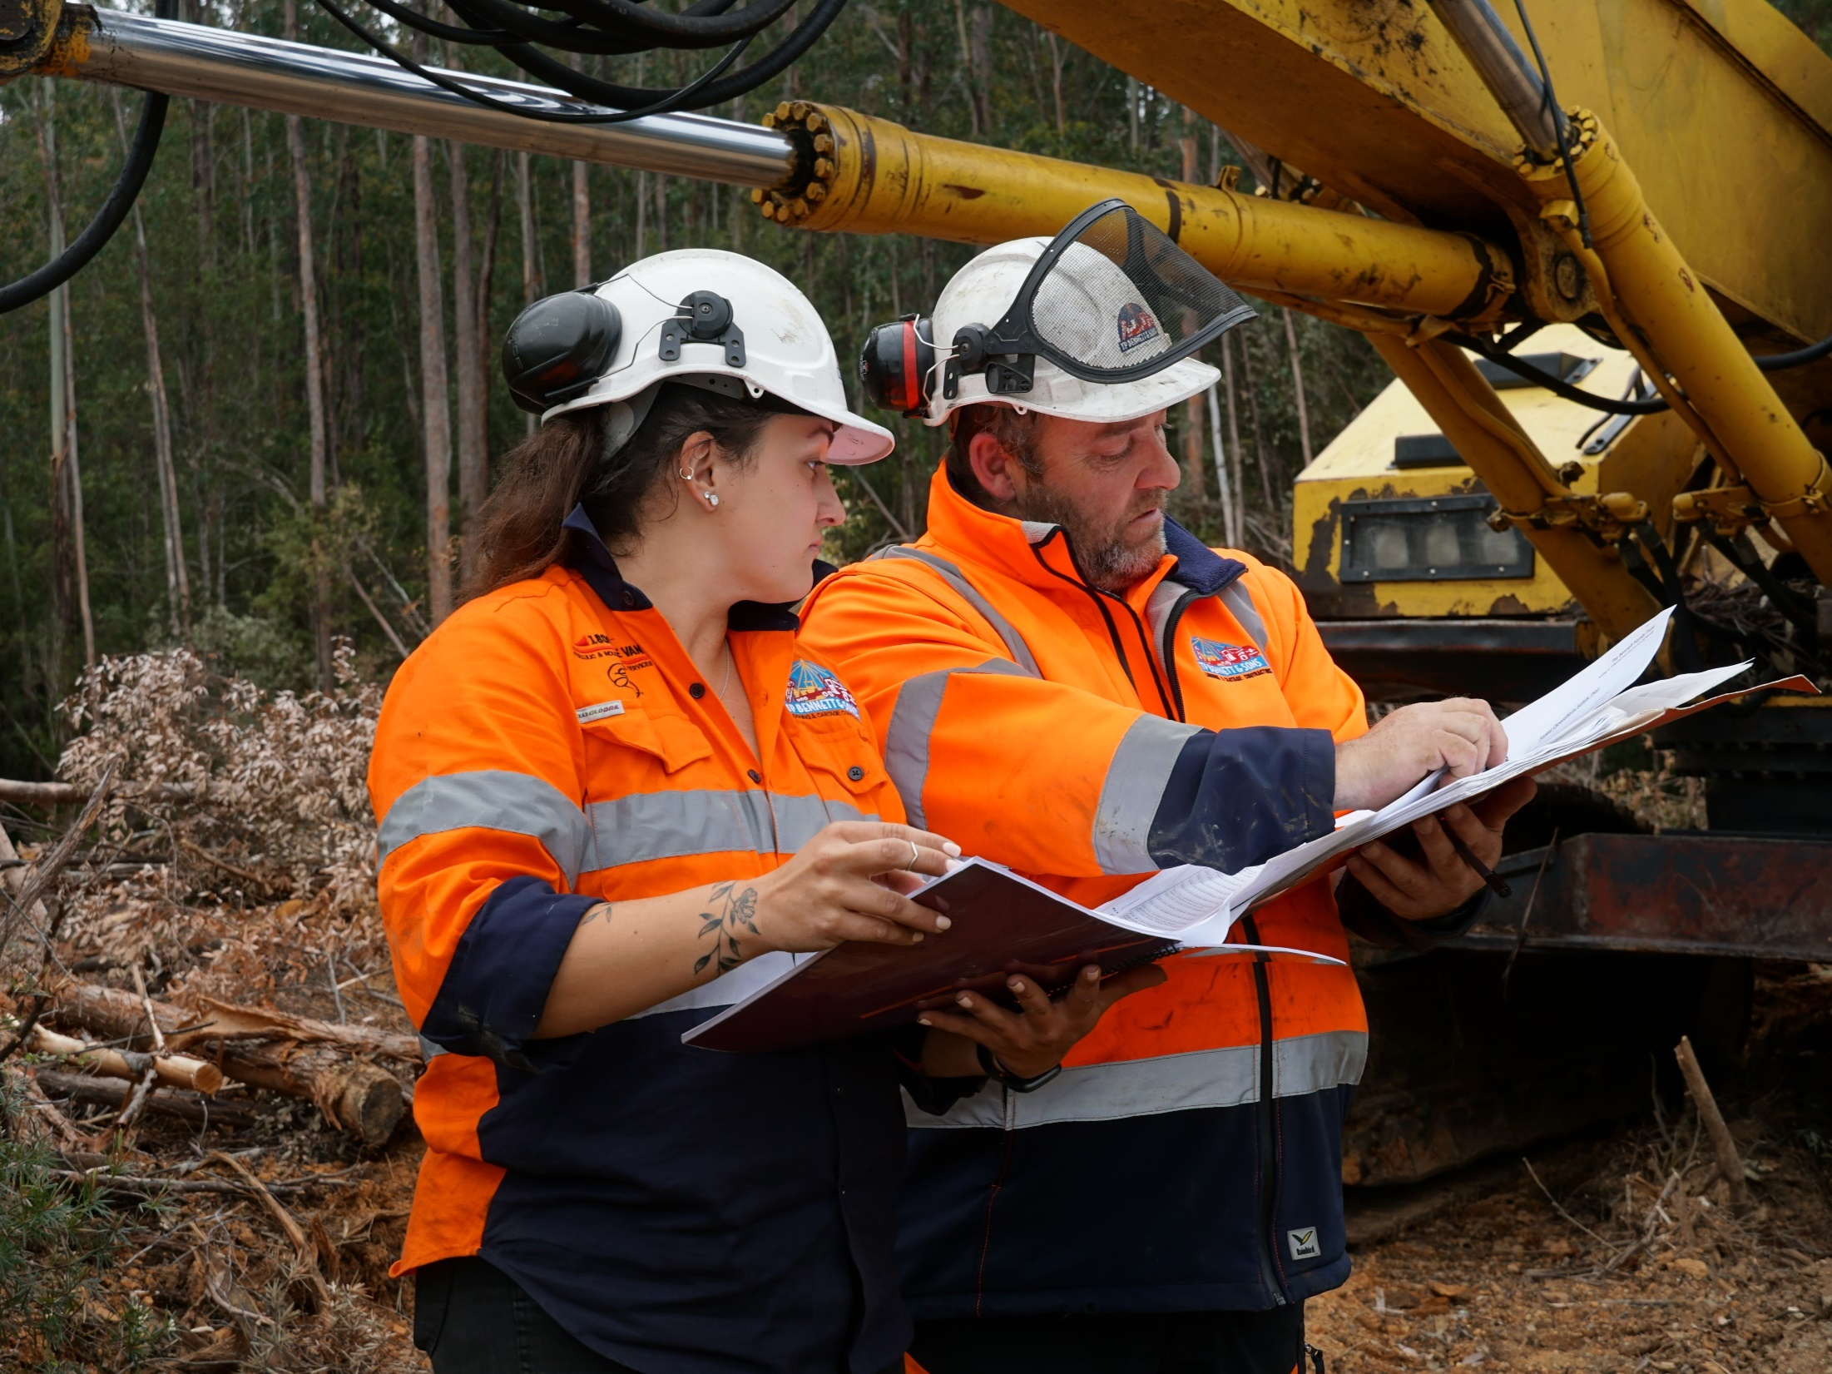
Forest safety…
…it’s up to you
Notes:
Forest safety… it’s up to you

